Slide 1

SAVE THE DATE SEPTEMBER
September 17, 2026 12:15 PM
Biomarkers in Assessing for Dementia- What We Know
Esther Oh, MD, PhD
Professor of Medicine / Co-Director, Johns Hopkins Memory and Alzheimer's Treatment Center /
Johns Hopkins Physician
Welcome. This meeting will be recorded.
Please mute your microphone.

Slide 2
The GUIDE Model
Presented by: Cynthia D. Fields, MD
Assistant Professor
Department of Psychiatry and Behavioral Sciences
Ask the Expert series
GWEP

Slide 3
DISCLOSURES
I have no relevant financial disclosures.

Slide 4
#1. What is the GUIDE Model and the background of this new care model?

Slide 5
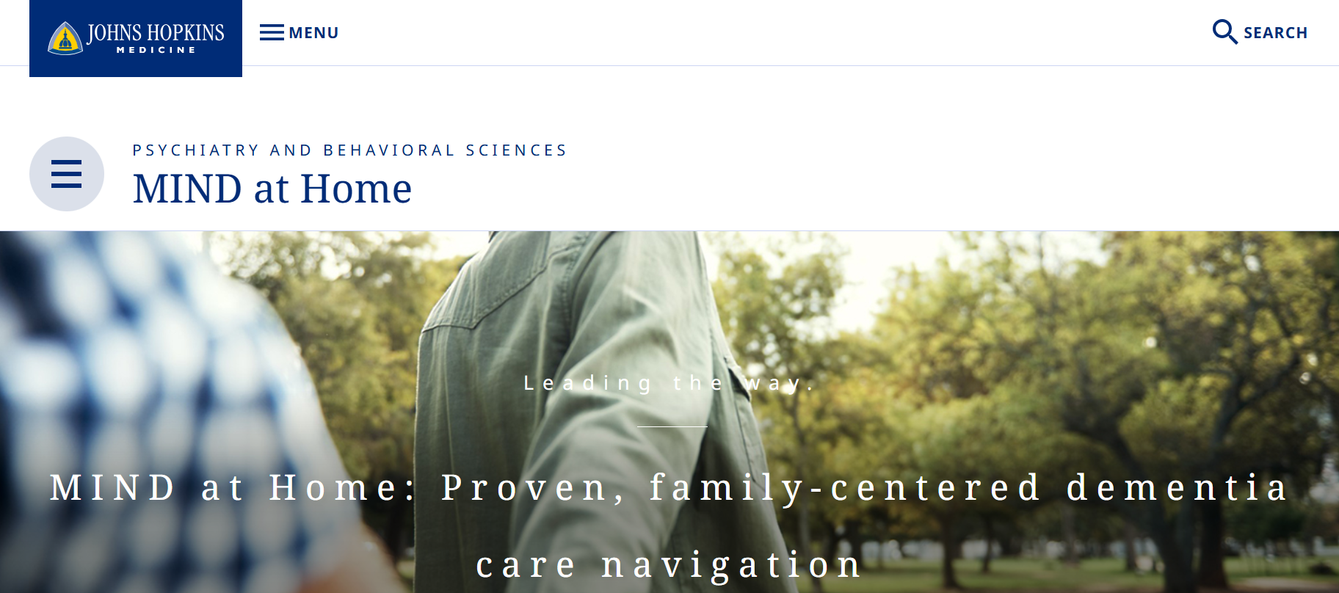
Notes:
Medical Co-Director MIND at Home dementia program
Newer role is Medical Co-Director of our GUIDE Program – clinical leadership along with Dr. Amjad
On MC page, there is a short primer by Dr. Halima Amjad

Slide 6

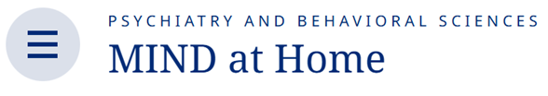
Maximizing Independence (MIND) at Home
Care navigation program for people living at home with cognitive impairment and their families
Comprehensive and scalable care management
Memory Care Coordinator supported by interdisciplinary team
Effective strategy that improves outcomes and reduces HC cost
  Three prior trials (two RCTs, one quasi-experimental design) with racially, economically and cognitively diverse patients and families
Most patients do not have access due to individual’s cost
Notes:
15 years in the making! Home is the nexus of care.

Slide 7
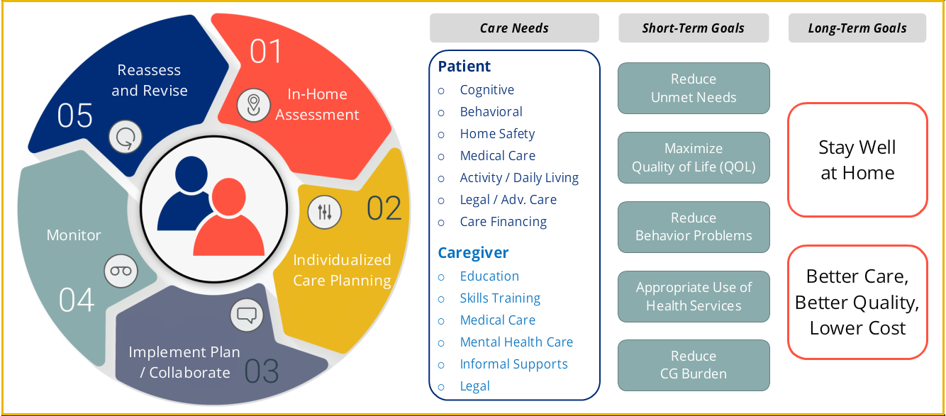
How MIND At Home works
Notes:
Care navigation to help address the medical and non-medical needs of patients with dementia and their CGs
JHDCNA (Dementia Care Needs Assessment) has 13 domains
PLWD side: Home/Personal Safety (98%), closely followed by General Medical Care (84%) and Meaningful/Daily Activities (74%)
CG side: Memory D/O education (98%), CG legal concerns (74%), CG mental health care (44%)
Looking at n=642 using the JHDCNA 2.0 tool -
Diverse pooled group of people:
Mean age of 80.0 (range 45–103); 69% were females; 56% were non-whites; average 12 years formal education; 43% had annual incomes <$25,000; 36% received Medicaid benefits; 21% lived alone; and mean MMSE score 17/30 (39% mild, 42% moderate, and 19% severely impaired).

Slide 8
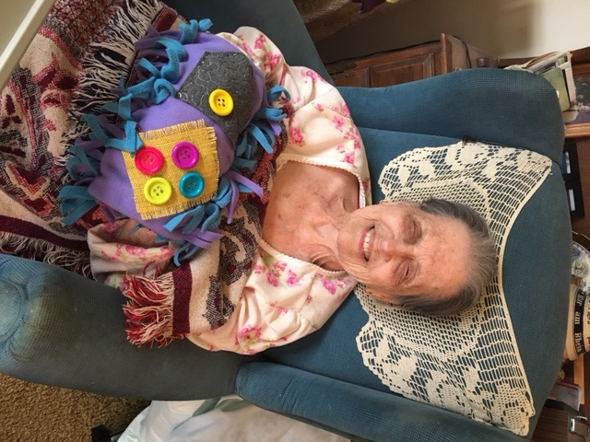
Examples of Care Navigator assistance
Helped a family caregiver learn to recognize symptoms of UTI, which prompted call to the PCP and obtained outpatient labs and treated—potentially avoiding ED or worse, a hospitalization.
Worked with a Physician Assistant to discuss a MOLST with a critically ill participant, who later died peacefully at home, according to his wishes.
Assisted with ordering a bedside commode to prevent entering a nursing home. PT could make it to the restroom in the middle of the night instead of inappropriately urinating and ruining the hardwood floors.
Assisted with calling Maryland Health Connection after patient lost health insurance coverage and was initially declined to have it re-instated. Assistance led to re-instate health insurance coverage so that the participant could obtain her medications.
Helping to secure an Alzheimer’s Association Caregiver Grant for a weekend get-a-way for a caregiver who had gone 8 years of daily caregiving without a full night respite.
Provided creative low-cost person-centered solutions to reduce aberrant motor behaviors and skin injury (e.g., custom-made sensory stimulation device—Twiddlemuff)
Twiddlemuff (photo. K. Marshall)
- Samus et al., American Geriatrics Society Symposium presentation, 2018

Slide 9
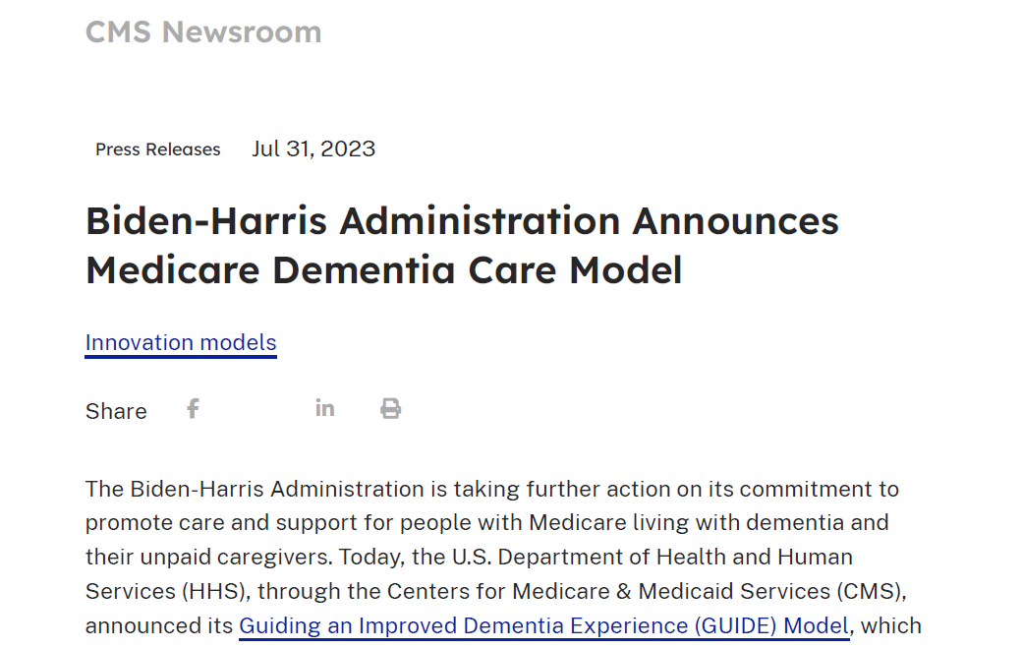
Based on evidence from MIND at Home + 5 other models

Slide 10
Guiding an Improved Dementia Experience (GUIDE) Model
Innovation from CMS is a Medicare benefit
Provides comprehensive dementia care management
Standardized set of services to support PWD and caregivers
Over 300 programs in the USA, expected to reach > 200K patients
We have 4 programs in MD; there are also many virtual options
Goals: QoL, NH placement, staying in their homes thru end of life
This is a test: can you reduce expenditures while preserving or enhancing quality of care? If yes, then permanent benefit

Slide 11
#2. What are the benefits/ services of participating with the GUIDE model?

Slide 12

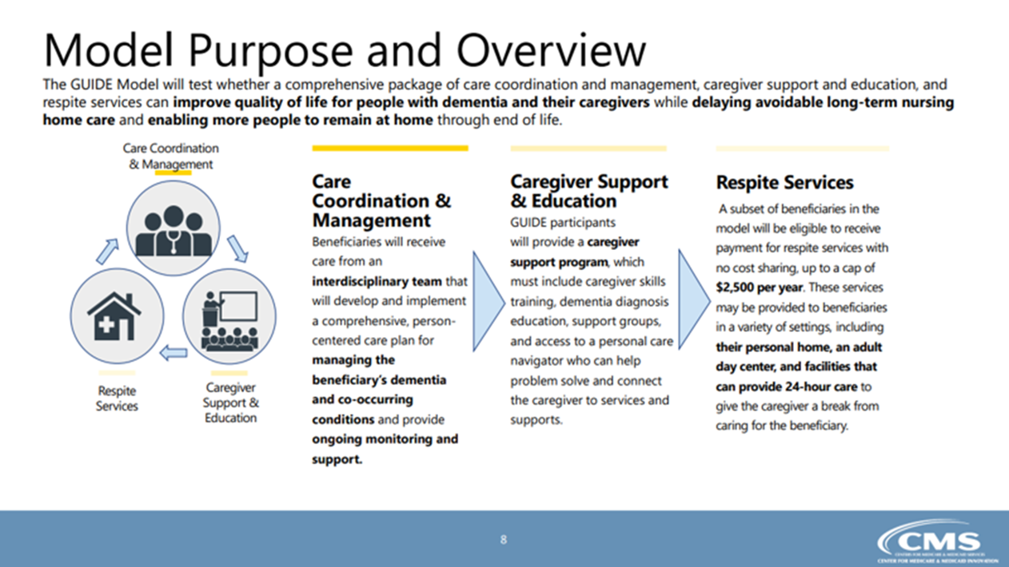
* Respite services apply to moderate & high “tiers” only.
Notes:
This is the most popular slide for GUIDE talks.

Slide 13
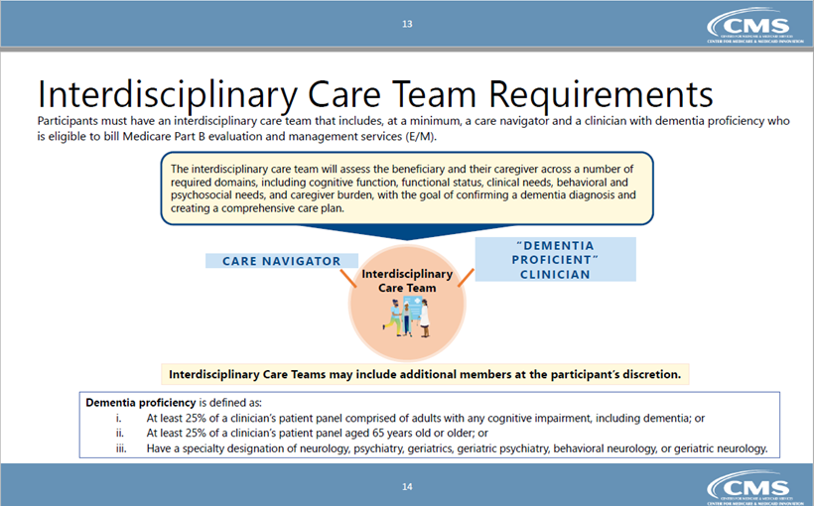




GUIDE Model
Notes:
Can include Neurologists in addition to Psych and Geri Med

Slide 14
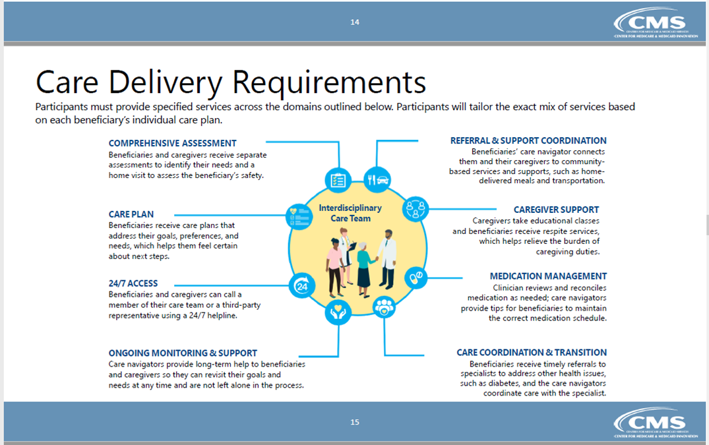
GUIDE Model
Notes:
Taken from the 6 major evidence-based models, inc MIND at Home
Monthly contact with navigator and yearly re-assessment over the 8yrs

Slide 15
#3. Can anyone with memory issues be referred to GUIDE or is there specific eligibility?

Slide 16
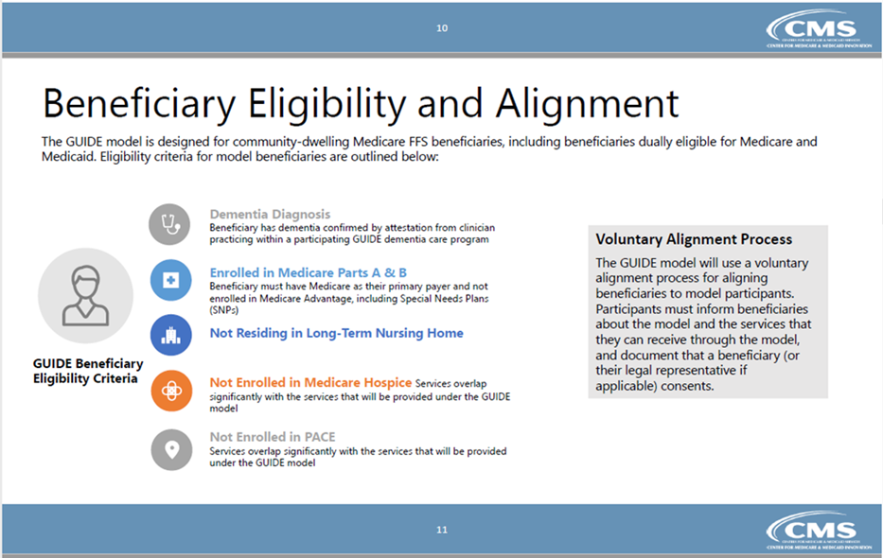
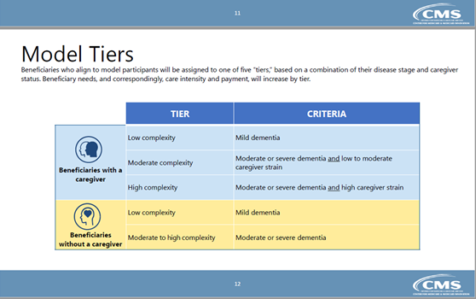
GUIDE Model
Notes:
Dementia stage (CDR, FAST) and caregiver strain determine complexity (most in moderate).
Required measure and alignment forms: Zarit Burden Inventory 22-item and PROMIS-10.

Slide 17
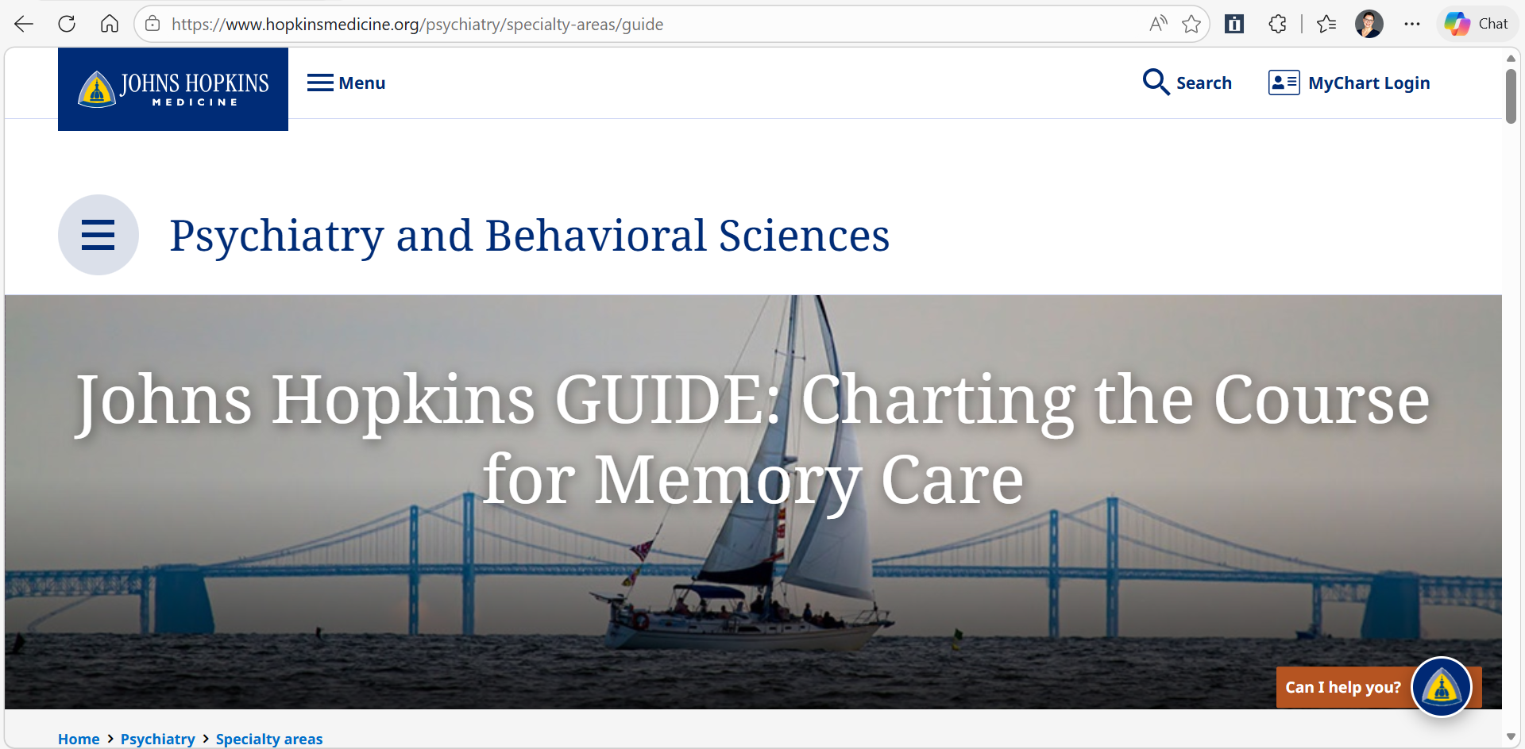

Slide 18
THANK YOU!
Contact Us
Johns Hopkins GUIDE
Phone: 667-306-9594
Fax: 410-367-2255
Email: guide@jh.edu
Any comments or questions?

Slide 19
Johns Hopkins Cynthia Fields
Gilcrest Amy Hewat
Hospice of the Chesapeake Elizabeth Hayword
MAC Inc. LWCE Leigh Ann Eagle
Central Maryland AHEC Tre’Jenae Mack
GUIDE PANEL

Slide 20
Johns Hopkins GUIDE Model Program

Slide 21
GUIDE Eligibility
Dementia Diagnosis
  Beneficiary has a diagnosis of dementia confirmed by one of our clinicians.
  If diagnosed outside of the Johns Hopkins system, copies of medical records will be required.
Enrolled in Medicare Parts A & B
  Medicare A & B must be the primary payer. Can’t be enrolled in a Medicare Advantage plan, including Special Needs Plans.
Not Residing in a Long-Term Nursing Home, Memory Care Facility or Assisted Living Facility
Has not been enrolled in the Hospice Benefit
Not enrolled in PACE

Slide 22
Areas Covered by the Johns Hopkins GUIDE program
All of Baltimore City
All of Baltimore County
Anne Arundel County: Annapolis Junction, Arnold, Brooklyn, Crownsville, Curtis Bay, Fort Meade, Glen Burnie, Gambrills, Gibson Island, Hanover, Harmans, Jessup, Laurel, Linthicum Heights, Millersville, Odenton, Crofton, Pasadena, Severn, Severn Park
Howard County: Clarksville, Columbia, Elkridge, Ellicott City, Fulton, Highland, Laurel, Marriottsville, Savage, Simpsonville, Woodstock
Harford County: Aberdeen, Abingdon, Edgewood, BelAir, Belcamp, Churchville, Darlington, Fallston, Forest Hill, Havre de Grace, Jarrettsville, Joppa Whiteford, White Hall, Street, Perryville
Cecil County: North East, Perry Point, Port Deposit, Rising Sun, Charlestown, Childs, Coloro, Conowingo, Elkton

Slide 23
Areas Covered by the Johns Hopkins GUIDE program
All of Baltimore City
All of Baltimore County
Anne Arundel County: Annapolis Junction, Arnold, Brooklyn, Crownsville, Curtis Bay, Fort Meade, Glen Burnie, Gambrills, Gibson Island, Hanover, Harmans, Jessup, Laurel, Linthicum Heights, Millersville, Odenton, Crofton, Pasadena, Severn, Severn Park
Howard County: Clarksville, Columbia, Elkridge, Ellicott City, Fulton, Highland, Laurel, Marriottsville, Savage, Simpsonville, Woodstock
Harford County: Aberdeen, Abingdon, Edgewood, BelAir, Belcamp, Churchville, Darlington, Fallston, Forest Hill, Havre de Grace, Jarrettsville, Joppa Whiteford, White Hall, Street, Perryville
Cecil County: North East, Perry Point, Port Deposit, Rising Sun, Charlestown, Childs, Coloro, Conowingo, Elkton

Slide 24
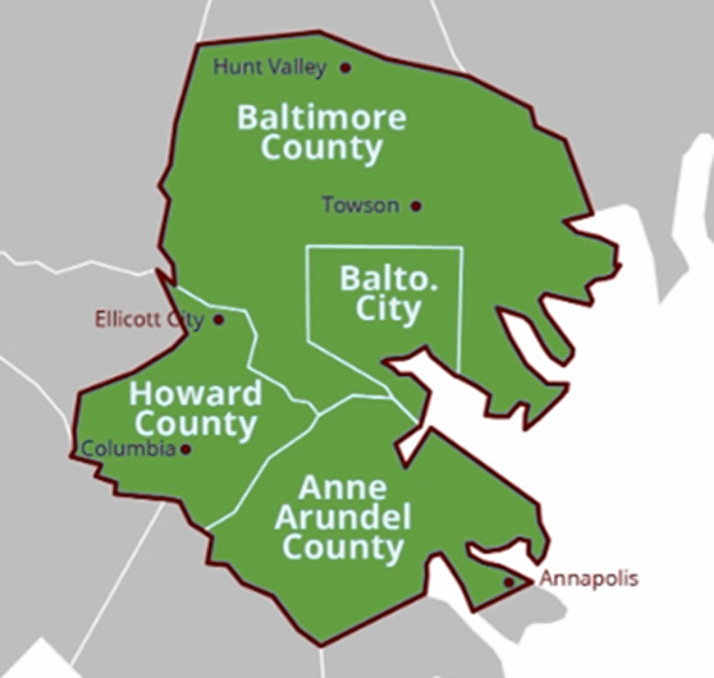
Gilchrist GUIDE Model Service Area
Baltimore City
Baltimore County
(South of Hunt Valley)
Harford County
(South of Kingsville)
Howard County
(East of Laurel)
Anne Arundel County
(North of Annapolis)

Slide 25
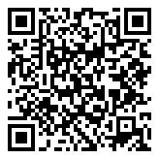
Who Qualifies for Gilchrist’s GUIDE Program?
Individuals who meet Medicare GUIDE Model eligibility criteria and reside within our service area are eligible to participate.
GUIDE services are provided independently of all other Gilchrist programs.
How to reach us:
888.823.8880
GilchristCares.org

Slide 26
GUIDE Model Goals– Hospice of the Chesapeake
Improve quality of life - The GUIDE model aims to enhance the overall well-being of individuals with dementia by providing person-centered care and support.
Reduce Strain on Caregivers- It seeks to alleviate the stress and burden on unpaid caregivers by offering education, support, and respite services.
Promote Community Based Care- The model encourages keeping individuals with dementia in their homes and communities for as long as possible.
Potentially Reduce Healthcare Costs- By providing better care coordination and support, the GUIDE model may also help to reduce overall healthcare costs associated with dementia
Resource Navigation - They connect patients and families with community resources, benefits, and supportive programs to address unmet practical and financial needs.
Flexible Visit Model - They deliver support through in-person or telehealth visits based on patient and caregiver need, ensuring timely and accessible intervention.

Slide 27
GUIDE Model Eligibility
Must have a dementia diagnosis (confirmed using diagnosis codes)
Enrolled in Original Medicare (Part A and B) – Medicare advantage enrollees are not eligible
Not enrolled in hospice or residing in a nursing home long-term
Have a caregiver, or be assessed as not needing one (some patients without caregivers can still qualify)
Currently serving Anne Arundel and Prince Georges Counties

Slide 28


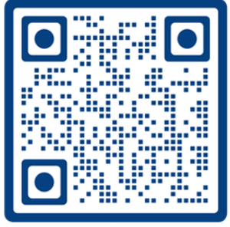
Scan or email info@mdlivingwell.org
GWEP GUIDE Presentation 7.16.2026

Slide 29


Current partner agreements
agency | CURRENT Service area Coverage | Contact
MAC Inc. Maryland Living Well Center of Excellence (LWCE) | Dorchester County, Wicomico County, Worcester County and Somerset County | Tracy Wainwright, CWDP twainwright@macinc.org
Central Maryland Area Health and Education (CMAHEC) | Anne Arundel, Baltimore County, Baltimore City, Carroll County, Cecil County, Charles County, Frederick County, Harford County, Howard County, Prince Georges County | Paula Blackwell, MBA, MHA pblackwell@centralmarylandahec.org Tre’ Jenae Mack, MS tmack@centralmarylandahec.org
Coastal Drug Pharmacy | Worcester County | Ray Patel OCPHARMA11@hotmail.com
Chinese Culture and Community Service Center, Inc. (CCACC) | Montgomery County | Yuhsin Chou, MS yuhsin.chou@ccacc-dc.org

Slide 30


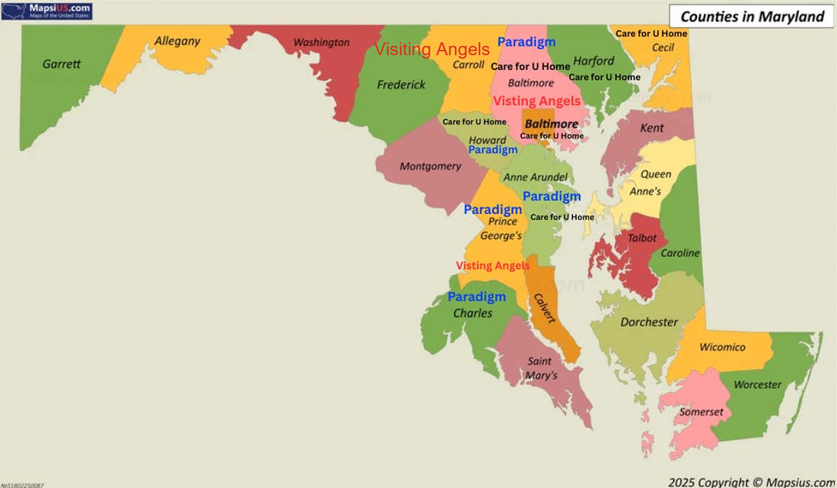
Central Maryland AHEC GUIDE Program
Comprehensive Dementia Care for Patients and Caregivers
Our Mission
To improve the quality of life for people living with dementia while supporting caregivers through coordinated, community-based care.
What We Provide
Dementia care navigation
Comprehensive assessments
Care planning and coordination
Community resource referrals
Caregiver education and support
Respite care coordination
Ongoing follow-up with patients and caregivers
Service Area
Counties Served: Harford, Cecil, Baltimore, Carroll, Frederick, Howard, Anne Arundel, Prince George’s, Charles, Baltimore City

Slide 31
Eligibility & Referral Process
Eligible Participants
Patients who:
Have Traditional Medicare
Have a dementia diagnosis (or suspected dementia pending clinical screening)
Live in the community (not in a nursing home)
May enroll with or without a caregiver
Referral Process
Referral received
Eligibility screening
Clinical assessment (if needed)
Community Health Worker assigned
Comprehensive assessment
Individualized care plan
Care navigation, caregiver support & respite coordination
Ongoing follow-up and provider communication
Referral Requirements
Please have available:
Medicare Beneficiary ID
Dementia diagnosis (ICD-10)
Primary Care Provider information
Current medications
Chronic conditions
Primary caregiver information
Contact Information
Paula Blackwell, MBA, MHA
pblackwell@centralmarylandahec.org
Tre’ Jenae Mack, MS
tmack@centralmarylandahec.org

Slide 32
SAVE THE DATE SEPTEMBER
September 17, 2026 12:15 PM
Biomarkers in Assessing for Dementia- What We Know
Esther Oh, MD, PhD
Professor of Medicine / Co-Director, Johns Hopkins Memory and Alzheimer's Treatment Center /
Johns Hopkins Physician
Link to the recording, PowerPoint and resources will be emailed. No meeting in August – Have a great summer!

