Slide 1

Welcome. This webinar will be recorded.
Please mute your microphone.

Slide 2
SAVE THE DATE
June 18, 2026 12:15 PM
What is ‘LATE’
Limbic Predominant Age-Related TDP-43 Encephalopathy
Chiadi U. Onyike, MD

Slide 3
Medication Safety Tips
Daniel Z. Mansour, PharmD, MS, AGSF, BCGP, FASCP
Director of Education and Interprofessional Clinical Training
The Peter Lamy Center on Drug Therapy and Aging
University of Maryland School of Pharmacy

Slide 4
What should we know about medications we are taking or our care recipient?

Slide 5
Medications
Important to know as much as possible about all meds you or your care recipient is taking
  Prescription
  Over the counter
  Vitamins/ supplements and herbs
All medications should be taken with care
Know potential interactions

Slide 6
What should we ask our health care professional about medications we or our care recipient are taking or new medications prescribed?

Slide 7
Know Your Medications (or care recipient)
What is the name (trade name vs generic)
Why am I taking it
What is the dose I am taking
What are potential side effects I should be aware of
When do I take the medicine
How long will I need to take it
Can it be stopped or does it need to be tapered?

Slide 8
Is it safe to take over the counter medications or supplements without checking first with a health professional?

Slide 9
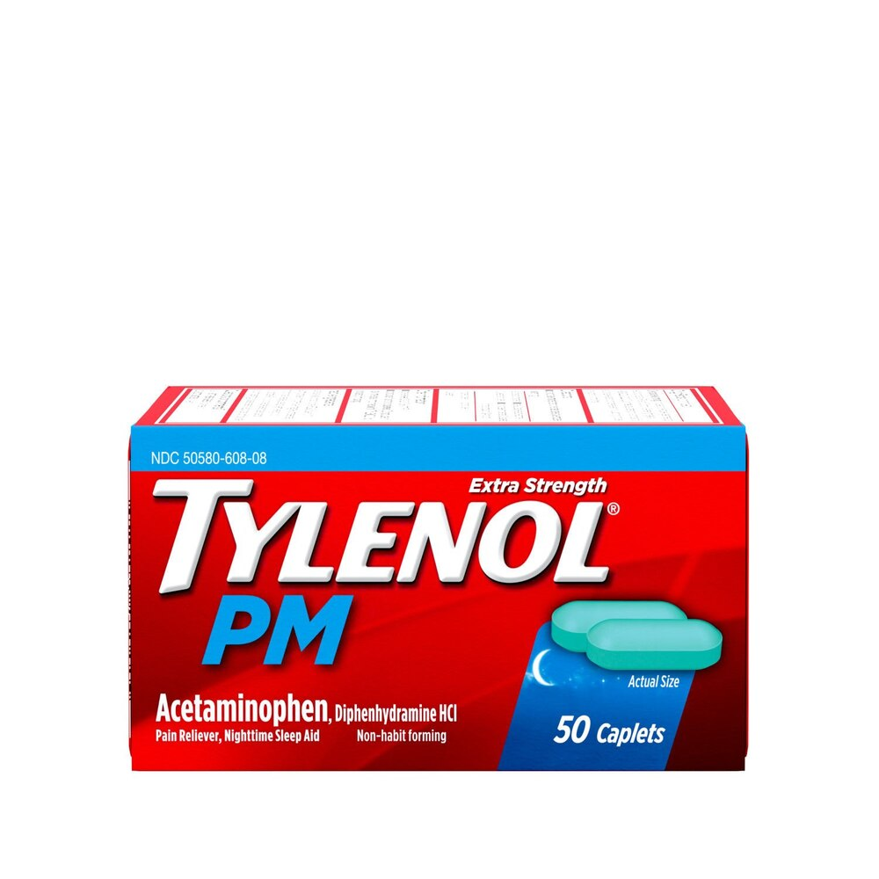
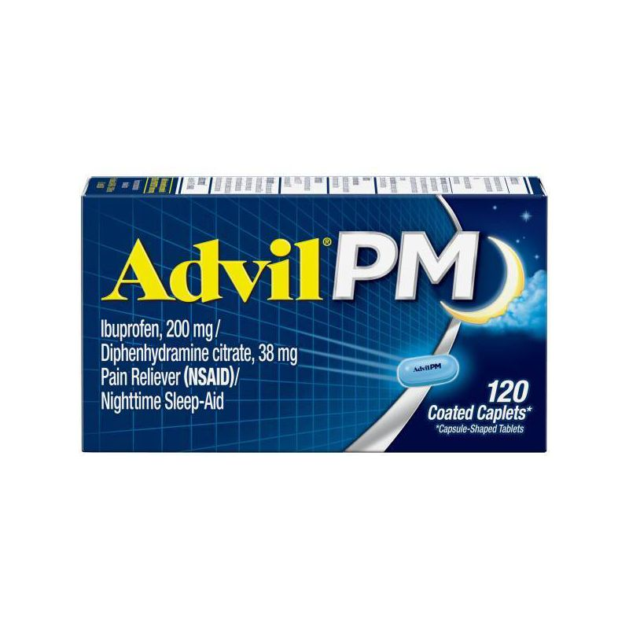

Over the Counter
Medications
Dietary Supplements
Vitamins
Herbs
Ointments/creams
KNOW WHAT IS ON THE LABEL!!!

Slide 10
As caregivers what are tips to ensure medication safety with our care recipient?

Slide 11
Tips for Caregivers
Keep a current medication list (all meds)
Prevent interactions between meds by telling provider about all medications they are taking
Plan ahead for refills
Write down important information about medication
Have a medication plan that fits their schedule (ask for help from pharmacist or provider)
Keep meds in original bottle (if using pill organizer keep doses organized)

Slide 12
If my care recipient has difficulty taking their medications due to issues with swallowing pills, can all pills be crushed?

Slide 13
NO!!!!
Always check with your pharmacist or provider before crushing pills to administer.

Slide 14
What is the best way to dispose unused medications?

Slide 15
Medication disposal containers in your area
  Pharmcy
  Police stations
Poison control can help you

Slide 16
Can you tell us about the Maryland Poison Center and their function.

Slide 17
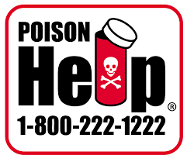
Poison Center
POISON HELP 1-800-222-1222
Call if you think:
  A medication was taken as not directed
  Too much medicine was taken by accident
  A child took or you suspect they took your medication
  CALL 911 if someone unconscious, having a seizure or difficulty breathing

