Slide 1
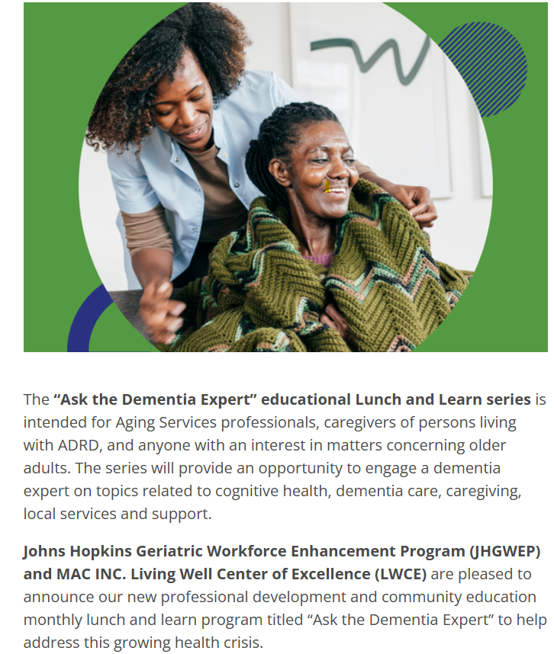
Welcome. This webinar will be recorded.

Slide 2

VIRTUAL STATEWIDE WORKSHOPS

Slide 3
Save the date: March 19, 2026 12:15 PM Maryland’s Dementia Initiatives

Slide 4
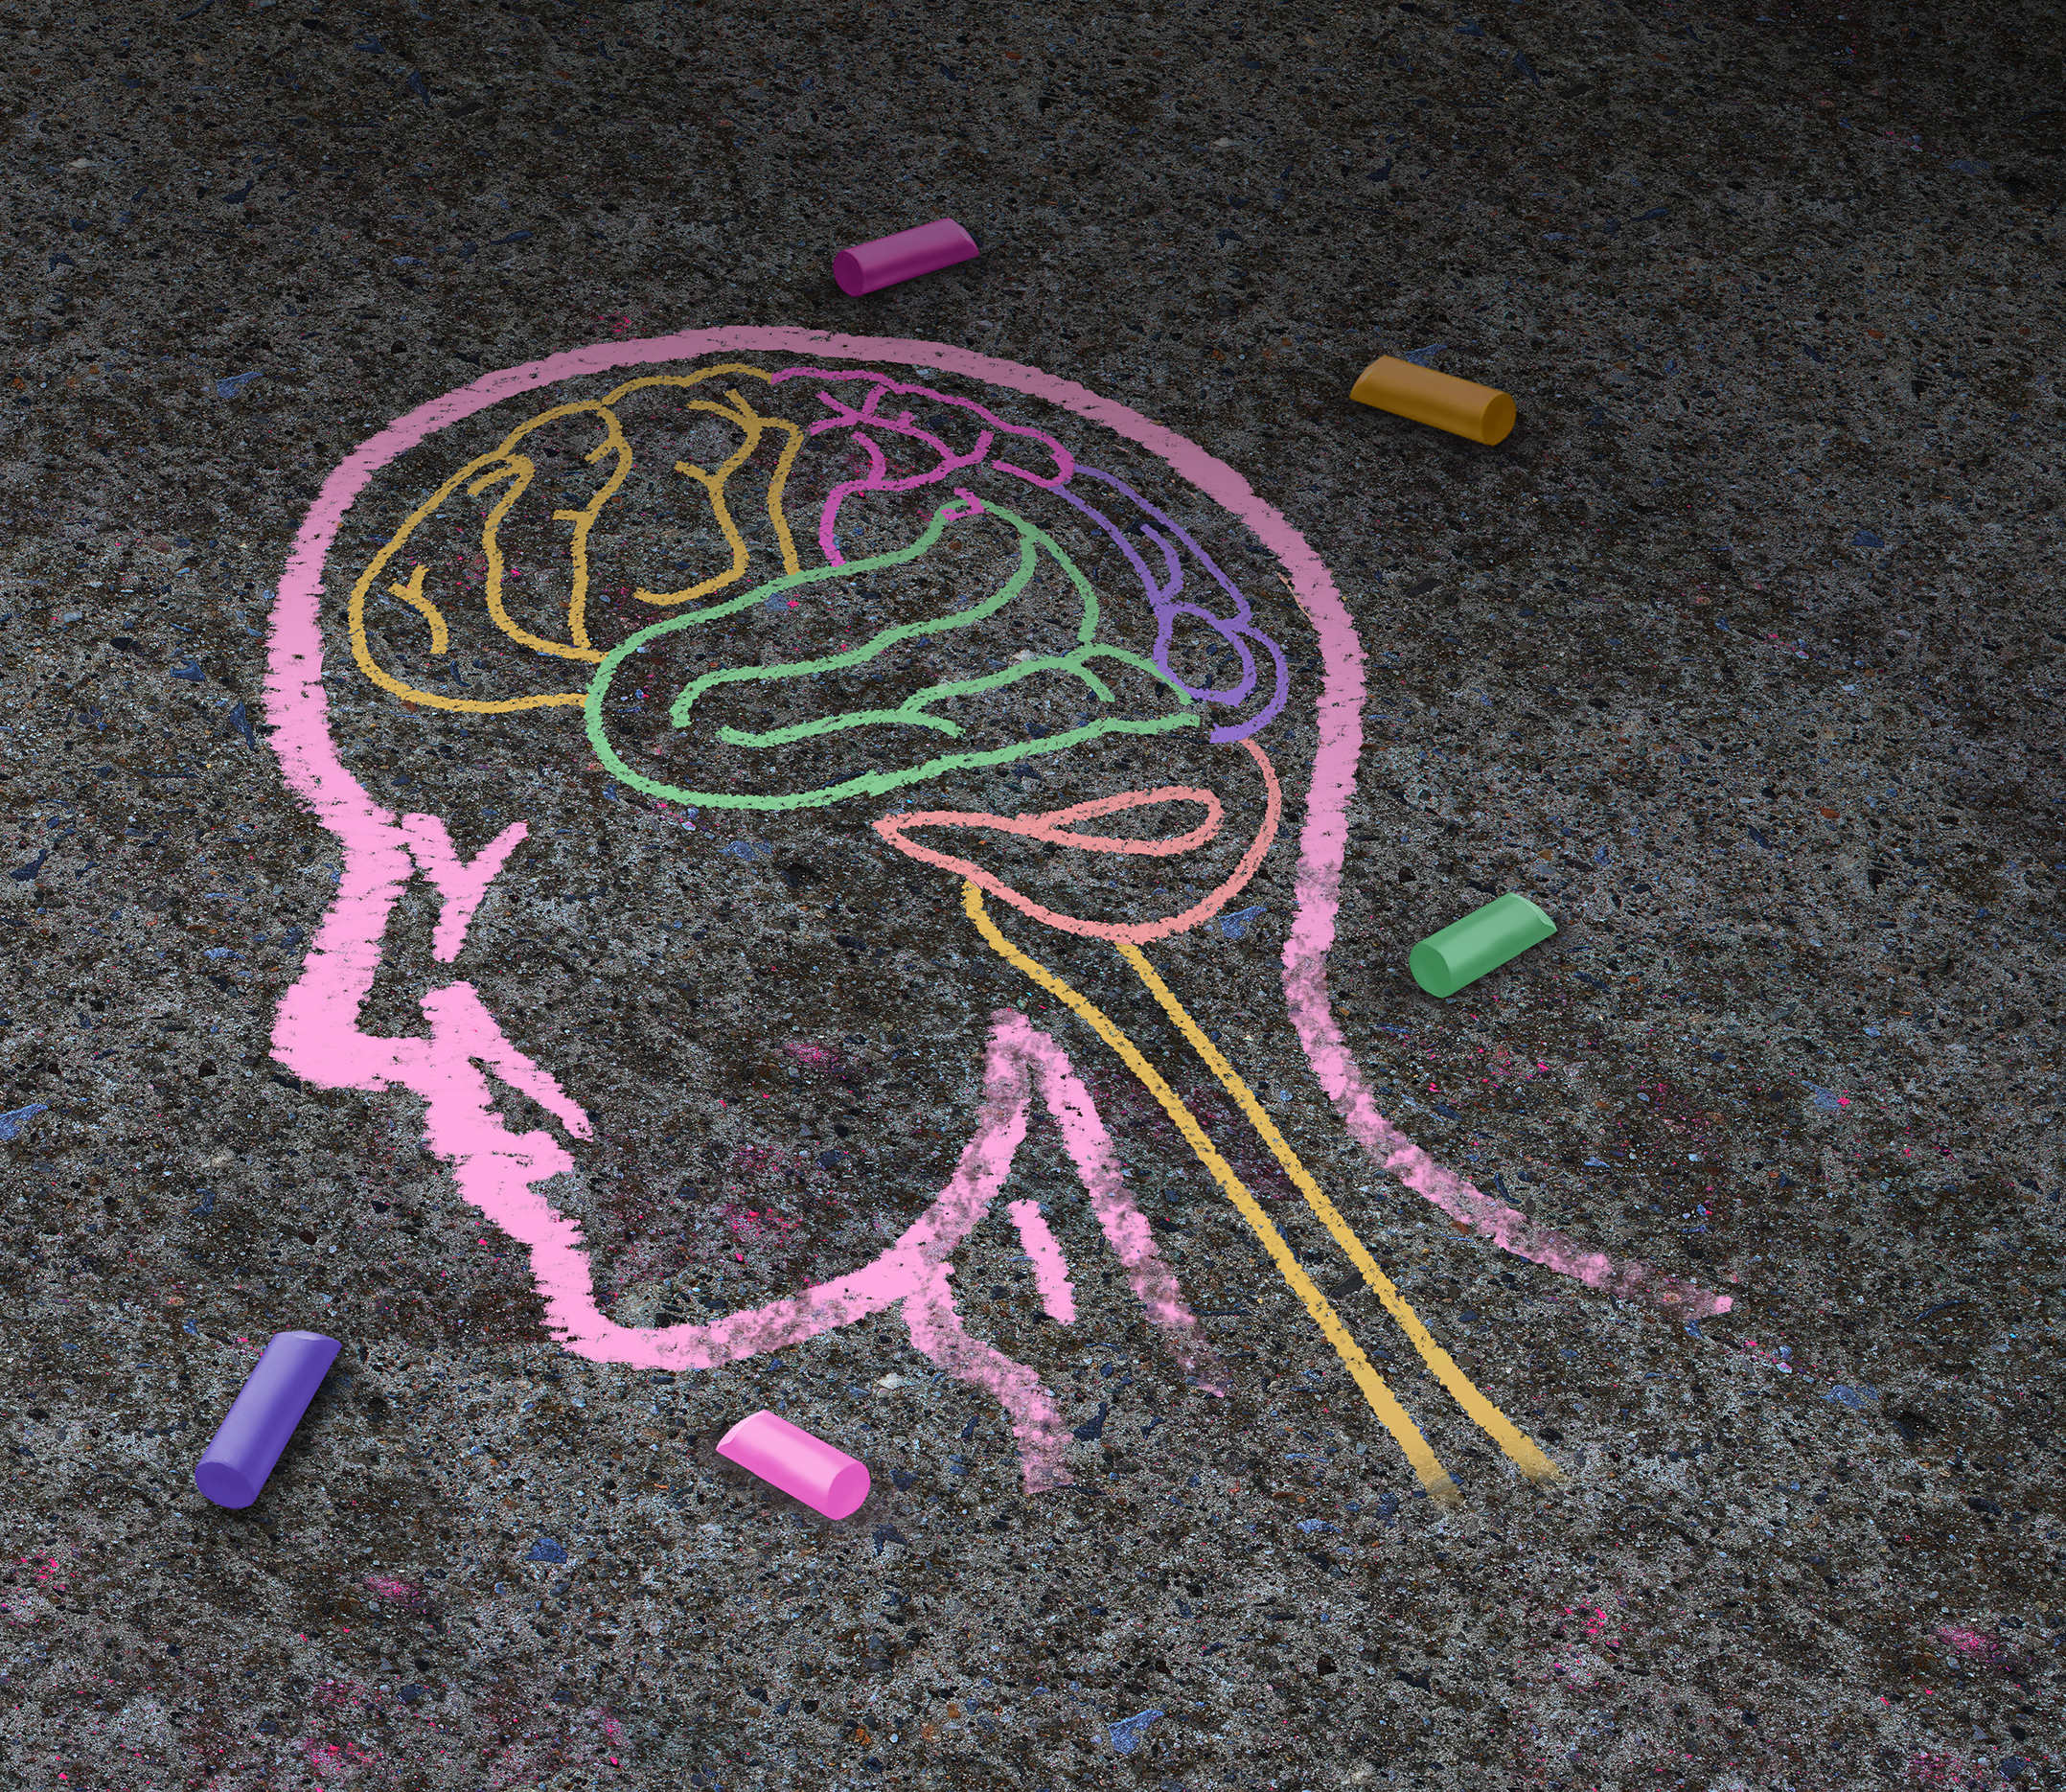
Diagnosing and Classifying Dementia/Alzheimer’s Disease
Lunch & Learn Dementia Series
February 19, 2026
Lolita Nidadavolu MD, PhD
Assistant Professor of Medicine
Johns Hopkins University, School of Medicine
Division of Geriatric Medicine and Gerontology

Slide 5
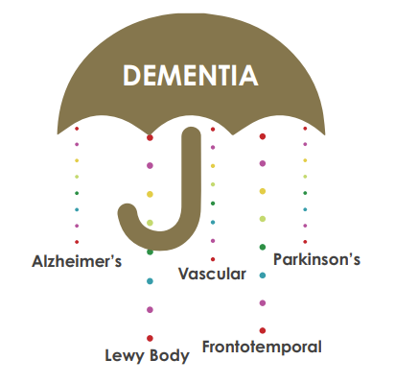
What is dementia?
Dementia is a broad term
Loss of memory and other cognitive abilities. Serious enough to interfere with daily life
60% due to Alzheimer disease (AD)
Not a normal part of aging
Worsens over time (progressive)
Notes:
Dementia is a general term for memory loss and other cognitive abilities serious enough to interfere with daily life. Alzheimer's disease accounts for 60-80% of dementia cases.
Just like the rest of our bodies, our brains change as we age. Most of us eventually notice some slowed thinking and occasional problems with remembering certain things.
However, serious memory loss, confusion and other major changes in the way our minds work may be a sign that brain cells are failing.

Slide 6
Types of neurodegenerative disorders that cause dementia
Alzheimer's Disease
Frontotemporal dementia
Lewy Body Dementia
Vascular dementia
Mixed disease
Other diseases
Notes:
Dementia is a general term for memory loss and other cognitive abilities serious enough to interfere with daily life. Alzheimer's disease accounts for 60-80% of dementia cases.
Just like the rest of our bodies, our brains change as we age. Most of us eventually notice some slowed thinking and occasional problems with remembering certain things.
However, serious memory loss, confusion and other major changes in the way our minds work may be a sign that brain cells are failing.

Slide 7
Other important contributing factors
Alcohol use (and misuse)
Can be associated with severe vitamin deficiencies
Medications that contribute to confusion:
Sedatives (Xanax, Ativan, Ambien)
Antihistamines (Benadryl)
Pain medicine (opioids)
Steroids
Some medicines for urinary incontinence (Detrol)
History of repeated head injuries
Untreated depression and/or anxiety

Slide 8
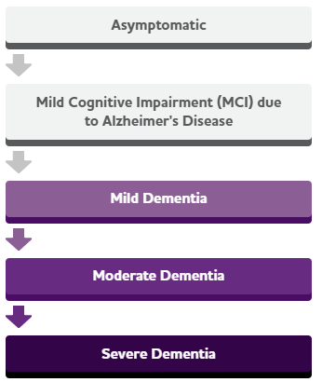
Progression to dementia
Asymptomatic
Typical progression through the following stages
Some people may skip stages
Don't know how long a specific individual will be at a specific stage before progressing
(Major area of current research)
Very common to see anxiety and/or depression at any stage of dementia
Mild Cognitive Impairment (MCI)
Mild dementia
Moderate dementia
Severe dementia
Notes:
Dementia is a general term for memory loss and other cognitive abilities serious enough to interfere with daily life. Alzheimer's disease accounts for 60-80% of dementia cases.
Just like the rest of our bodies, our brains change as we age. Most of us eventually notice some slowed thinking and occasional problems with remembering certain things.
However, serious memory loss, confusion and other major changes in the way our minds work may be a sign that brain cells are failing.

Slide 9
Age-related memory changes
Asymptomatic
It’s normal to forget things once in a while at any age
Difficulty with multi-tasking (lack of attention)
Mental slowing (take extra time when needed to do mental tasks)
Need for cues to remember things (stress can worsen your ability to remember)
Take longer to learn new things (personal meaning strengthens memory)
Mild Cognitive Impairment (MCI)
Mild dementia
Moderate dementia
Severe dementia
Notes:
Dementia is a general term for memory loss and other cognitive abilities serious enough to interfere with daily life. Alzheimer's disease accounts for 60-80% of dementia cases.
Just like the rest of our bodies, our brains change as we age. Most of us eventually notice some slowed thinking and occasional problems with remembering certain things.
However, serious memory loss, confusion and other major changes in the way our minds work may be a sign that brain cells are failing.

Slide 10
Mild Cognitive Impairment
Asymptomatic
Start to have difficulty remembering important information that was easy to remember before:
Appointment, conversations, recent events
Difficulty with making complex decisions, judging the time it takes to complete tasks or the sequence of steps to complete a complex task
Still able to do more complex tasks: driving, cooking, household chores
Medications: infusion medications, donepezil
Mild Cognitive Impairment (MCI)
Mild dementia
Moderate dementia
Severe dementia
Notes:
Dementia is a general term for memory loss and other cognitive abilities serious enough to interfere with daily life. Alzheimer's disease accounts for 60-80% of dementia cases.
Just like the rest of our bodies, our brains change as we age. Most of us eventually notice some slowed thinking and occasional problems with remembering certain things.
However, serious memory loss, confusion and other major changes in the way our minds work may be a sign that brain cells are failing.

Slide 11
Mild dementia
Asymptomatic
Forgetting information you just heard or read
Difficulty coming up with the right word or name in conversation
Losing items
Difficulty planning and organizing
Starting to have difficulty with complex tasks
Simplify tasks, fewer steps
Medications: infusion medications, donepezil, memantine
Mild Cognitive Impairment (MCI)
Mild dementia
Moderate dementia
Severe dementia
Notes:
Dementia is a general term for memory loss and other cognitive abilities serious enough to interfere with daily life. Alzheimer's disease accounts for 60-80% of dementia cases.
Just like the rest of our bodies, our brains change as we age. Most of us eventually notice some slowed thinking and occasional problems with remembering certain things.
However, serious memory loss, confusion and other major changes in the way our minds work may be a sign that brain cells are failing.

Slide 12
Moderate dementia
Asymptomatic
Forgetful of more recent events or personal history (family events, vacations)
Confusion about where they are or what day it is, sometimes wandering
Mood changes, difficulty with social situations
Behavior changes, including being suspicious or paranoid of others
Being unable to recall information about themselves (home address, phone number)
Still can participate in daily activities, but with assistance
May start having difficulty with controlling bladder/bowels
Medications: memantine
Mild Cognitive Impairment (MCI)
Mild dementia
Moderate dementia
Severe dementia
Notes:
Dementia is a general term for memory loss and other cognitive abilities serious enough to interfere with daily life. Alzheimer's disease accounts for 60-80% of dementia cases.
Just like the rest of our bodies, our brains change as we age. Most of us eventually notice some slowed thinking and occasional problems with remembering certain things.
However, serious memory loss, confusion and other major changes in the way our minds work may be a sign that brain cells are failing.

Slide 13
Severe dementia
Asymptomatic
Lose ability to interact with others, respond to environment
Difficulty communicating
Difficulty controlling movement (walking, increased falls)
Significant personality changes, inability to take care of self
Often need 24/7 supervision and help with personal care
Medications: possibly memantine, treat symptoms (behaviors, mood)
Mild Cognitive Impairment (MCI)
Mild dementia
Moderate dementia
Severe dementia
Notes:
Dementia is a general term for memory loss and other cognitive abilities serious enough to interfere with daily life. Alzheimer's disease accounts for 60-80% of dementia cases.
Just like the rest of our bodies, our brains change as we age. Most of us eventually notice some slowed thinking and occasional problems with remembering certain things.
However, serious memory loss, confusion and other major changes in the way our minds work may be a sign that brain cells are failing.

Slide 14
Palliative Care in dementia
Asymptomatic
Palliative care can help with symptoms:
Pain
Anxiety, anxiety, hallucinations
Difficulty with swallowing
Inability to move
Difficulty communicating
Hospice care
Not only helping loved one with their symptoms and function, but providing care to family
Mild Cognitive Impairment (MCI)
Mild dementia
Moderate dementia
Severe dementia
Notes:
Dementia is a general term for memory loss and other cognitive abilities serious enough to interfere with daily life. Alzheimer's disease accounts for 60-80% of dementia cases.
Just like the rest of our bodies, our brains change as we age. Most of us eventually notice some slowed thinking and occasional problems with remembering certain things.
However, serious memory loss, confusion and other major changes in the way our minds work may be a sign that brain cells are failing.

Slide 15

Diagnosing memory impairment – in the clinic
Specify changes in memory and thinking
Short term memory, ability to remember conversations
Changes in ability to do daily tasks
Changes in ability to do more complex tasks (
Changes in mood or behavior
Memory testing – done at follow up visits to monitor disease progression
Neurologic examination
Notes:
Dementia is a general term for memory loss and other cognitive abilities serious enough to interfere with daily life. Alzheimer's disease accounts for 60-80% of dementia cases.
Just like the rest of our bodies, our brains change as we age. Most of us eventually notice some slowed thinking and occasional problems with remembering certain things.
However, serious memory loss, confusion and other major changes in the way our minds work may be a sign that brain cells are failing.

Slide 16
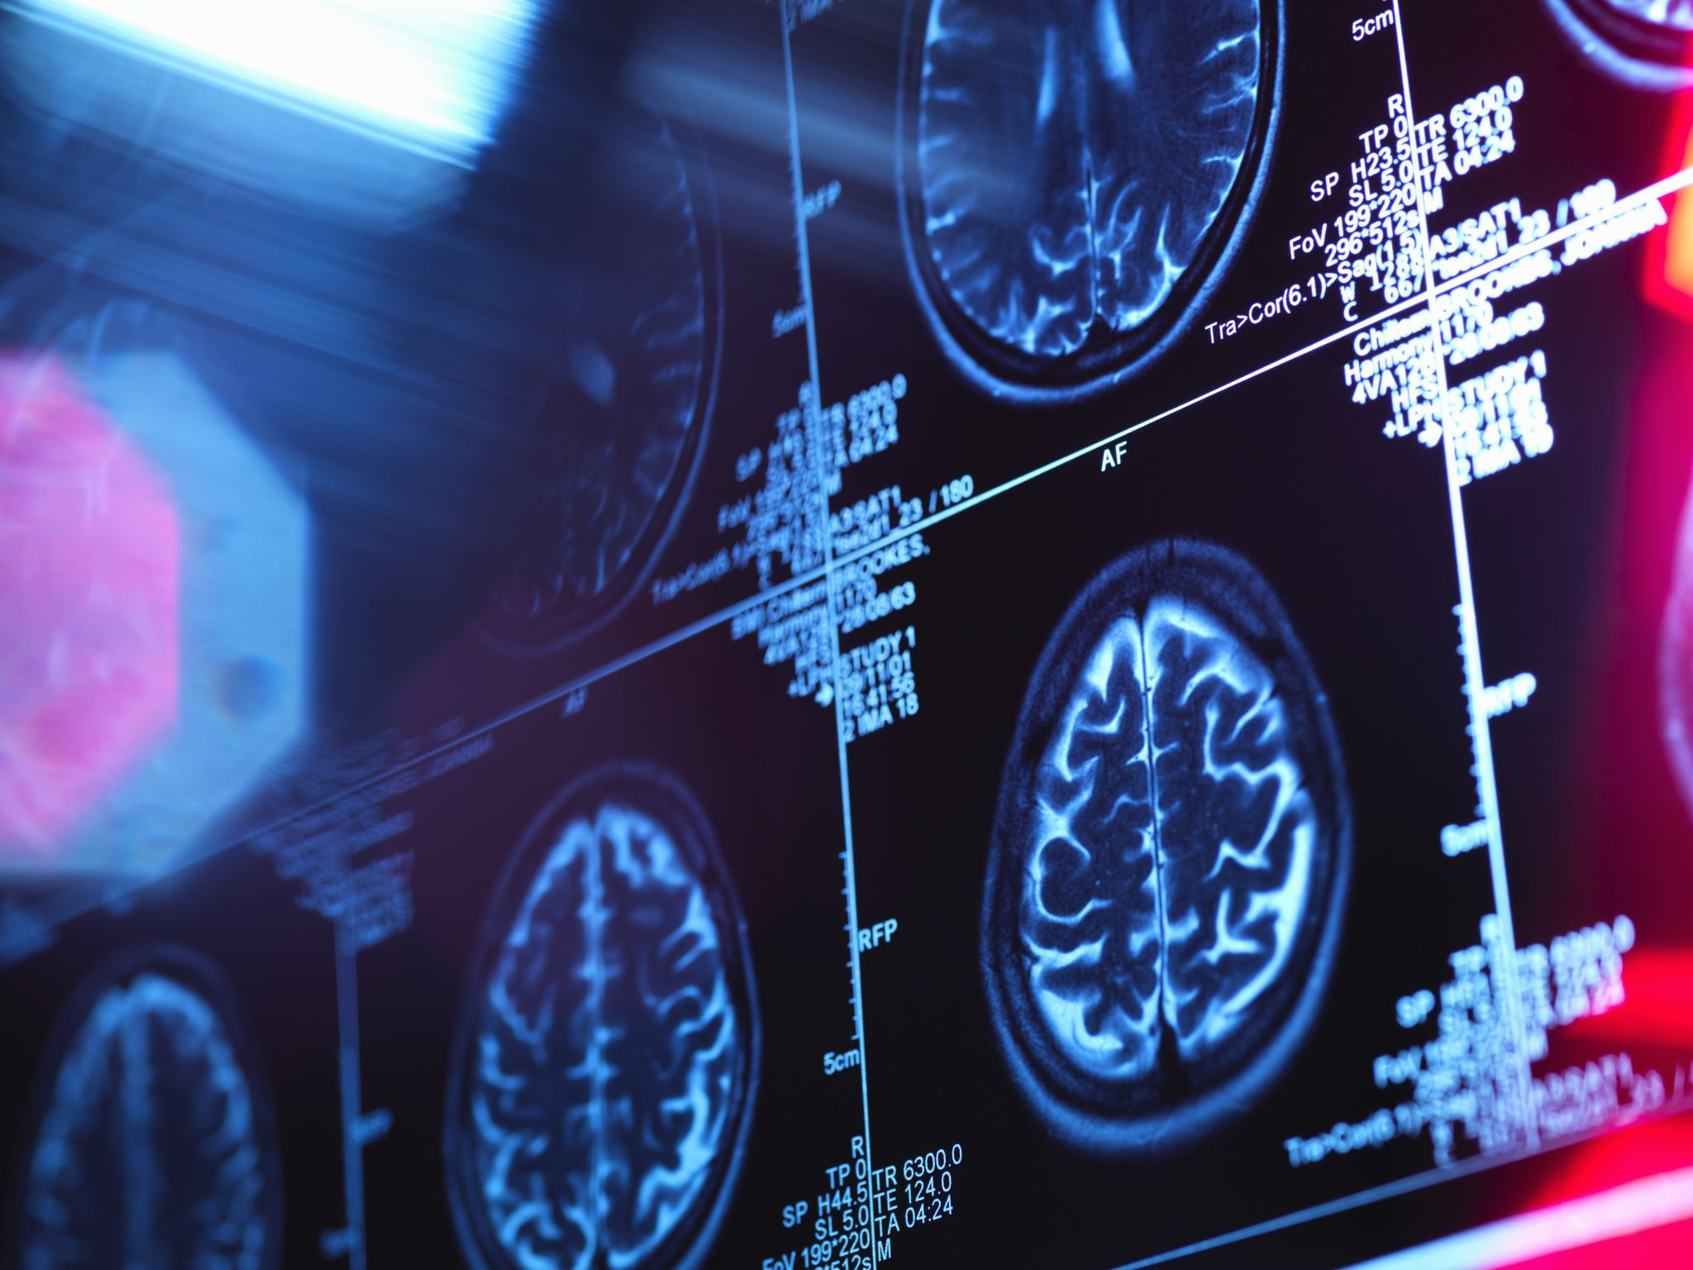
Diagnosing memory impairment – imaging
Structure
MRI
Function
FDG-PET, looks at the activity of different parts of the brain
Protein build-up in the brain
Amyloid-PET
Tau-PET (currently only in clinical trials)
Notes:
Dementia is a general term for memory loss and other cognitive abilities serious enough to interfere with daily life. Alzheimer's disease accounts for 60-80% of dementia cases.
Just like the rest of our bodies, our brains change as we age. Most of us eventually notice some slowed thinking and occasional problems with remembering certain things.
However, serious memory loss, confusion and other major changes in the way our minds work may be a sign that brain cells are failing.

Slide 17

Diagnosing memory impairment – blood tests
Amyloid PET often not covered by insurance if patient does not qualify for infusion therapies
Blood tests that measure proteins from the brain that are in blood circulation
Caution – false positives and false negatives
Newer technology – Lumipulse (not in use now due to technical issues)
Notes:
Dementia is a general term for memory loss and other cognitive abilities serious enough to interfere with daily life. Alzheimer's disease accounts for 60-80% of dementia cases.
Just like the rest of our bodies, our brains change as we age. Most of us eventually notice some slowed thinking and occasional problems with remembering certain things.
However, serious memory loss, confusion and other major changes in the way our minds work may be a sign that brain cells are failing.

Slide 18
Additional Questions
Difficulty with taking medicines
Not wanting to take medications
Conversion to other formulations (liquid, oral dissolving tablets, patches, crushing)
Can try to coax person to take medicine by stating how the medication can help them ("this is to help you sleep" or "this can help you with focus and attention")
Not able to tolerate patch medications (rashes)
All patches have tablet versions of the medication
Herbs and natural medications
No evidence for these treatments helping to slow down progression of dementia
Funding assistive living facility programs in MD:
Local Area Agencies on Aging for more specific information
Senior Assisted Living Subsidy Program

Slide 19
Thank you!

Slide 20
Save the date: March 19, 2026 12:15 PM Maryland’s Dementia Initiatives

