Slide 1

Welcome. This webinar will be recorded.

Slide 2
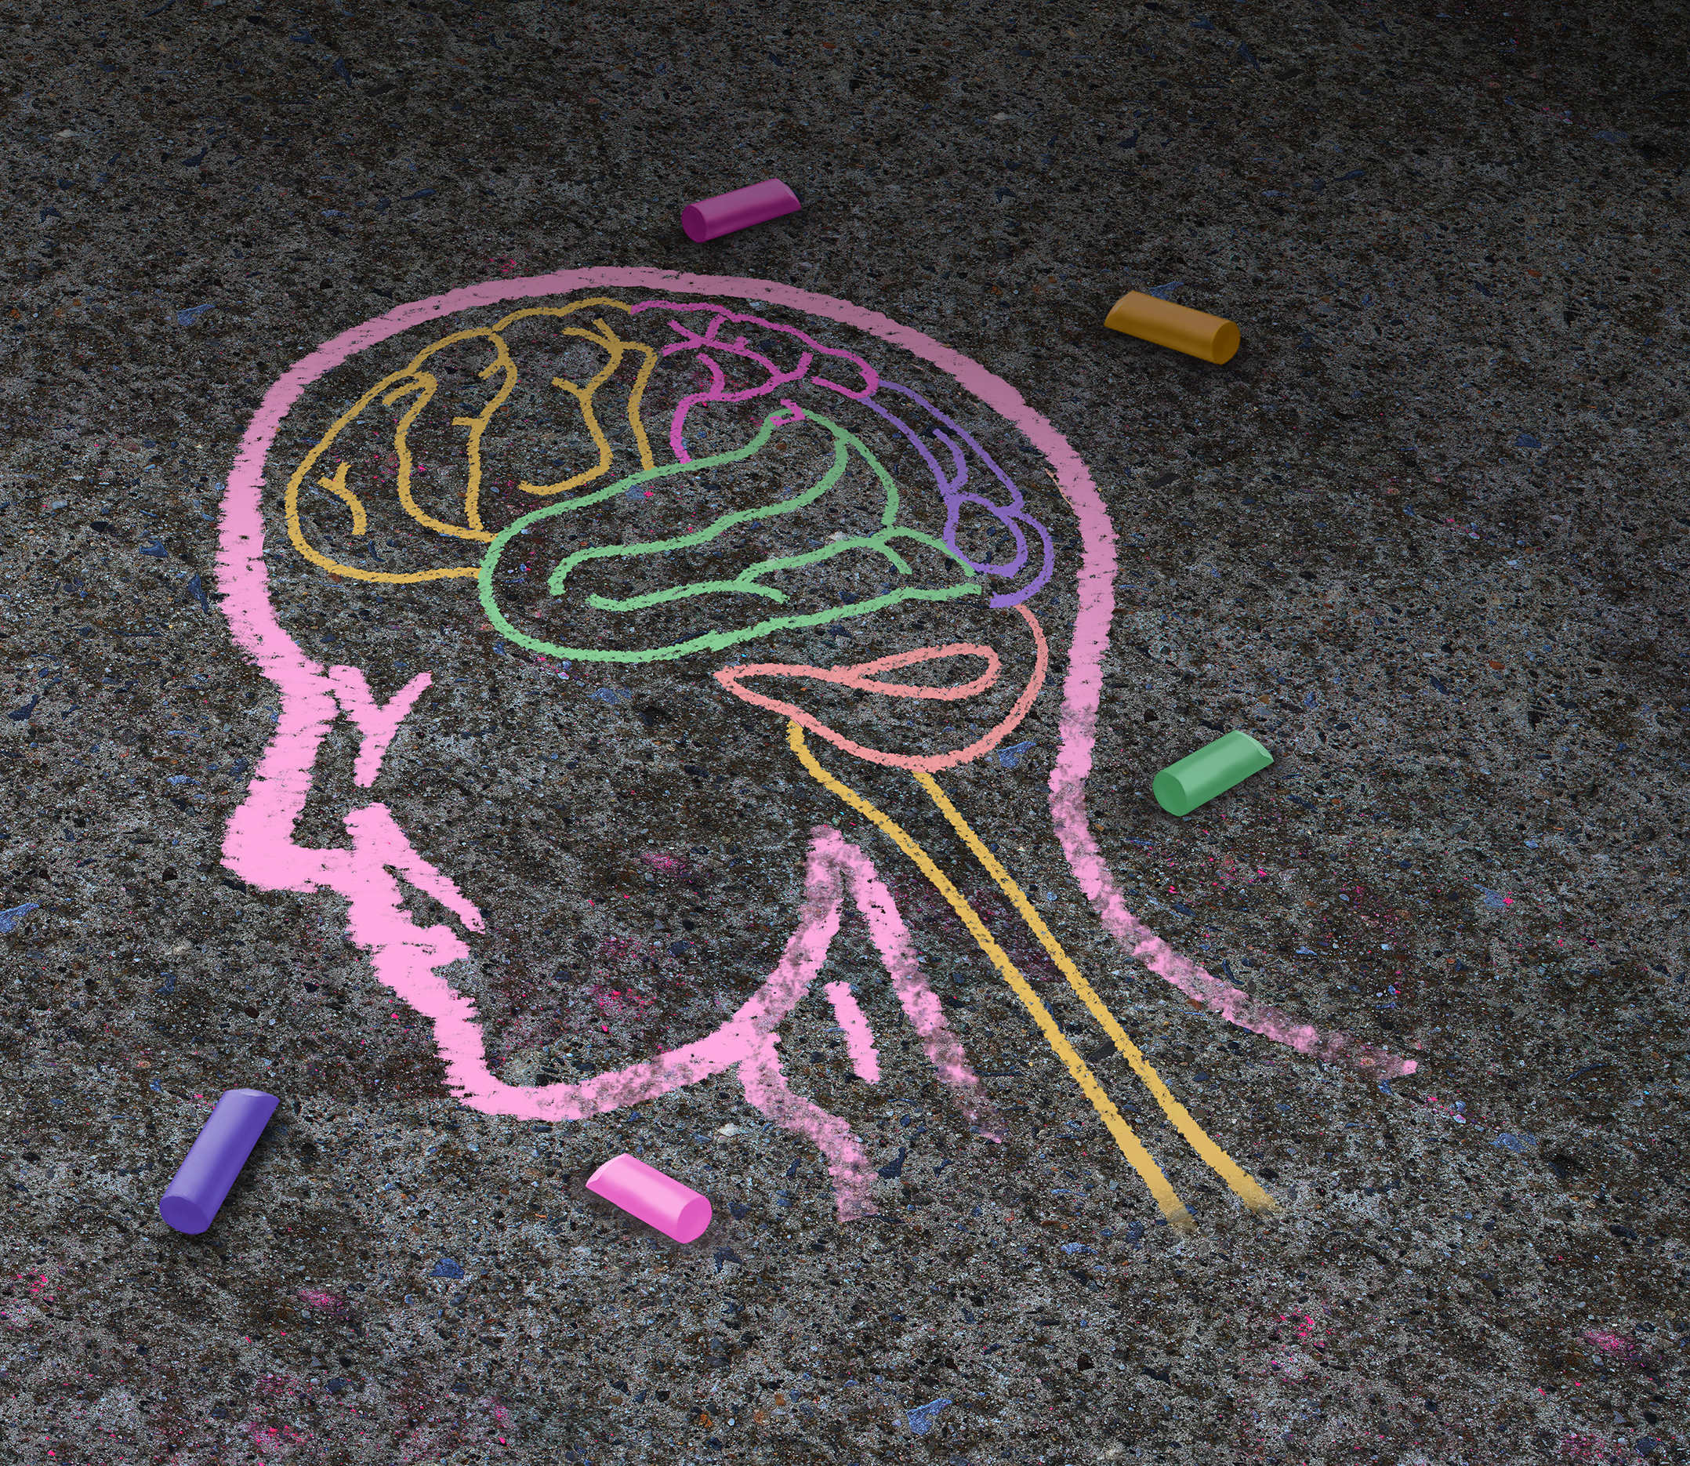
SAVE THE DATE
Diagnostic Testing for Dementia and Stages of Alzheimer’s Disease
Lunch & Learn Dementia Series
February 19, 2026
Lolita Nidadavolu MD, PhD
Assistant Professor of Medicine
Johns Hopkins University, School of Medicine
Division of Geriatric Medicine and Gerontology

Slide 3
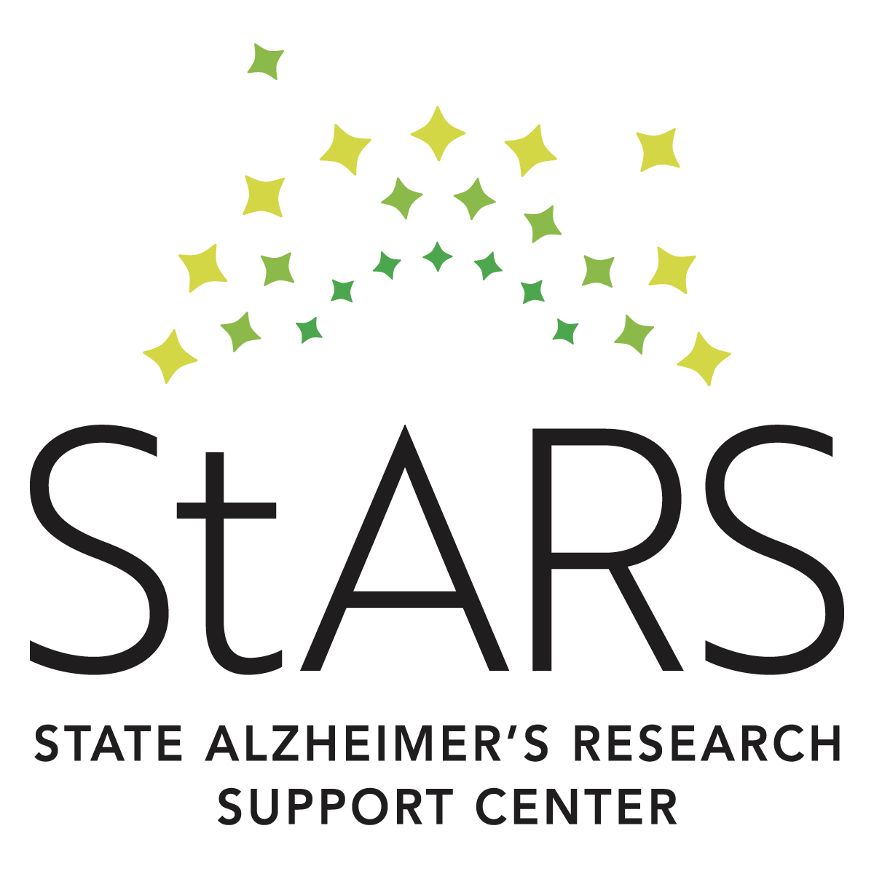
StARS Lived Experience Panel
The State of Maryland and the Alzheimer’s Association is seeking nominations for the State Alzheimer’s Research Support (StARS) Center Lived Experience Panel
Goal: to lift the voices of those living with dementia and caregivers to influence dementia care
  Share your experiences with dementia care services and supports within Maryland
  Provide feedback to state leaders and partners to guide dementia services
Who we are seeking:
  5 people living with mild cognitive impairment or early-stage dementia
  5 caregivers/care partners (unpaid family members or friends supporting someone with dementia)
Commitment:
  One-year term
  Quarterly virtual meetings and review of materials
  Honorarium of up to $400 upon completion of the term

Slide 4
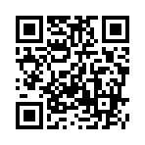
Sign up Now!
To have an impact on your local dementia services, please nominate yourself for the lived experience panel
If interested, fill out our interest form at:
  https://alz.surveymonkey.com/r/StARSMD
  Or Scan QR Code:
Questions?
  Reach out to Kerry Finegan at kfinegan@alz.org

Slide 5
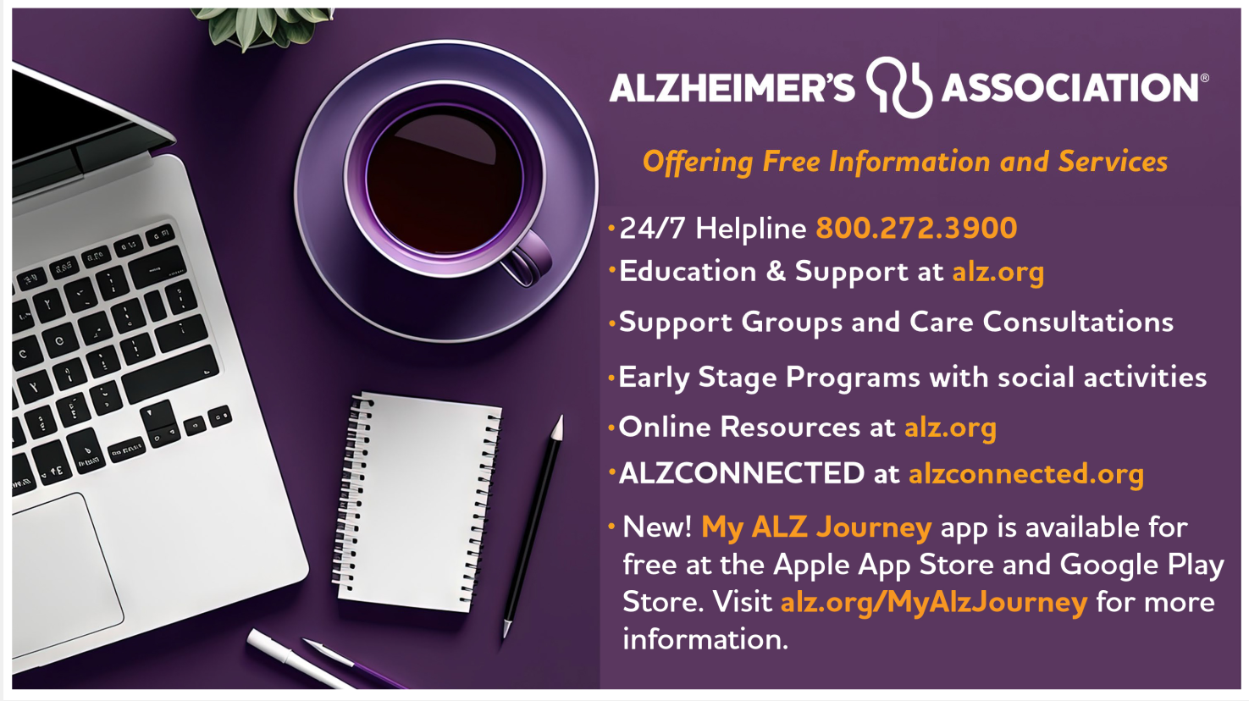

Slide 6
Overview of Medications to Treat Dementia/Alzheimer’s Disease
Lunch & Learn Dementia Series
January 15, 2026
Lolita Nidadavolu MD, PhD
Assistant Professor of Medicine
Johns Hopkins University, School of Medicine
Division of Geriatric Medicine and Gerontology

Slide 7
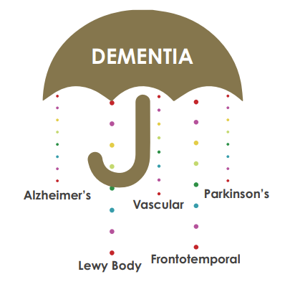
What is dementia?
Dementia is a broad term
Loss of memory and other cognitive abilities. Serious enough to interfere with daily life
60% due to Alzheimer disease (AD)
Not a normal part of aging
Worsens over time (progressive)
Notes:
Dementia is a general term for memory loss and other cognitive abilities serious enough to interfere with daily life. Alzheimer's disease accounts for 60-80% of dementia cases.
Just like the rest of our bodies, our brains change as we age. Most of us eventually notice some slowed thinking and occasional problems with remembering certain things.
However, serious memory loss, confusion and other major changes in the way our minds work may be a sign that brain cells are failing.

Slide 8
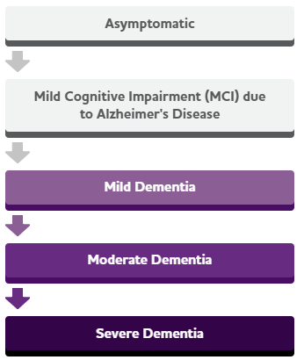
How does AD progress?
Asymptomatic
AD changes start in the part of the brain that affects learning
As AD advances it leads to more severe symptoms:
  disorientation
  mood and behavior changes
  deepening confusion about events, time and place
  unfounded suspicions about family, friends and professional caregivers
  difficulty speaking, swallowing and walking
Mild Cognitive Impairment (MCI)
Mild dementia
Moderate dementia
Severe dementia
Notes:
People with memory loss or other possible signs of Alzheimer's may find it hard to recognize they have a problem.
Signs of dementia may be more obvious to family members or friends.

Slide 9
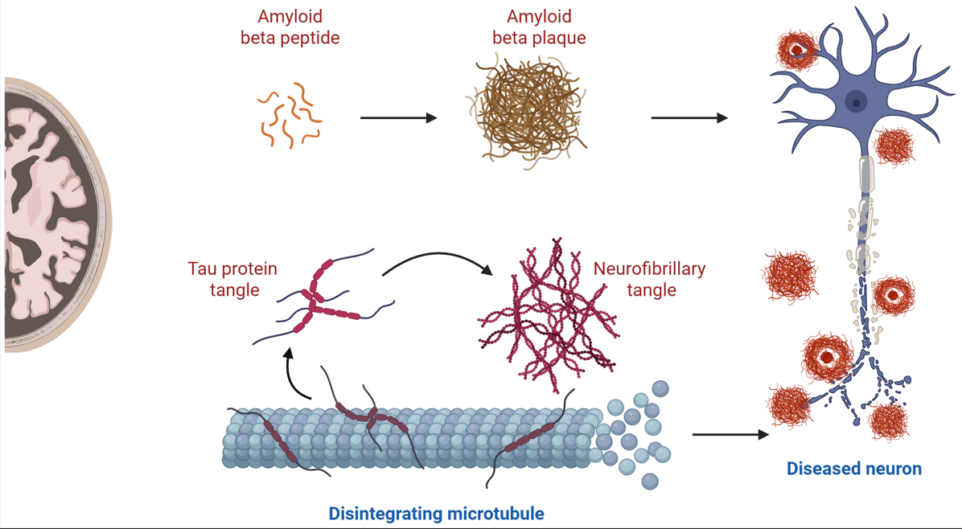
Mechanisms contributing to disease in AD
Notes:
To discuss the medications available to treat dementia, specifically AD, we need an overview of the changes that happen in the brain that contribute to the development of AD
Microscopic changes in the brain begin long before the first signs of memory loss.
They are not sure where the trouble starts. But just like a real factory, backups and breakdowns in one system cause problems in other areas. As damage spreads, cells lose their ability to do their jobs and, eventually die, causing irreversible changes in the brain.
One particular protein, amyloid beta forms deposits called plaques that build up near nerve cells (neurons) and can cause them to not properly function
Another protein called Tau can form deposits called tangles and these can build up inside nerve cells and this can also damage and kill nerve cells.
We are still learning about exactly what role plaques and tangles play in contributing to

Slide 10
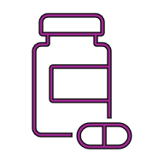
Categories of drugs for treating AD
No current treatments are cures
Drugs that treat symptoms
Drugs that can change disease progression
Drugs that treat behavioral and psychological symptoms

Slide 11
Drugs that treat symptoms

Slide 12
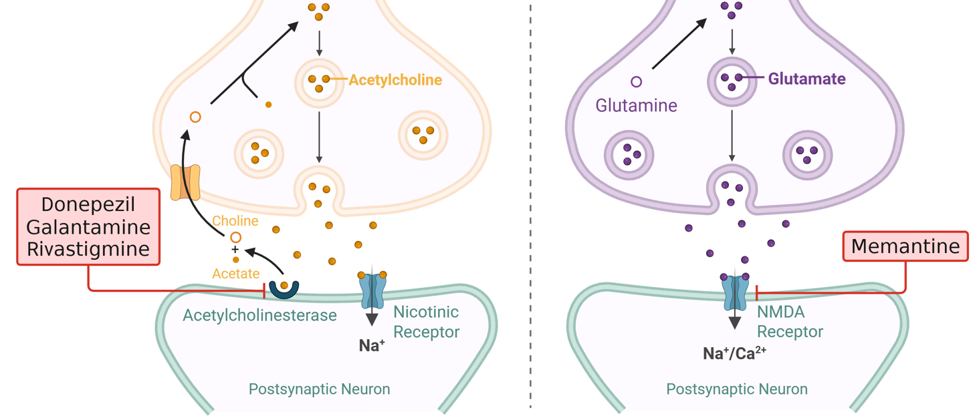
Targets for drugs that treat symptoms
Notes:
In AD brain cells die and connections among cells are lost, causing cognitive symptoms to worsen. While these medications do not stop the damage Alzheimer’s causes to brain cells, they may help lessen or stabilize symptoms for a limited time by affecting certain chemicals involved in carrying messages among and between the brain's nerve cells.
The medicines target different receptors that can help nerve cells communicate better with each other.
On the left: acetylcholinesterase is a molecule that nerve cells use to talk to each other, and in AD, there is less of this signal in the brain. Medicines like donepezil, galantamine, rivastigmine help prevent these signals from being degraded, and this can help with memory and function.
On the right: studies have shown that there are changes to the "normal" levels of a molecule called glutamine in AD, and regulating glutamine with a medicine like memantine may lead to helping the brain process information.

Slide 13
Cholinesterase Inhibitors
Most patients with newly diagnosed AD should be offered a trial of a cholinesterase inhibitor
The degree of expected benefit is modest
Do not continue in patients who do not appear to be benefiting or who have significant side effects.
Donepezil (Tablet or Patch)
Galantamine (Tablet)
Rivastigmine (Tablet or Patch)
Notes:
Expected benefits can be improved focus and attention. These are important elements involved in memory, but this medicine does not specifically improve memory.

Slide 14
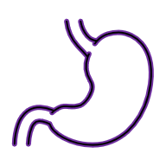


Cholinesterase inhibitor side effects and monitoring
Gastrointestinal symptoms (upset stomach, nausea, diarrhea, anorexia) are the most common side effects
Vivid dreams (severe cases can see nightmares, insomnia)
Bradycardia (slow heart rate)
  Can contribute to risk of falls
  Caution if cardiac issues

Slide 15
NMDA Receptor Antagonists
Used in patients with moderate to severe AD, can see modest benefits
Do not continue in patients who do not appear to be benefiting or who have significant side effects.
Memantine (Tablet or Patch)

Slide 16


Memantine side effects and monitoring
Some common side effect include:
  Headache
  Constipation
  Dizziness, drowsiness, confusion (if dose increased too quickly)
Caution in individuals with kidney disease (reduced dose)

Slide 17
Drugs that change disease progression

Slide 18


What does it mean to change disease progression?
Without Treatment
Normal Cognition
With Treatment
Cognitive Function
Mild Cognitive Impairment
Dementia
Time (Years)

Slide 19
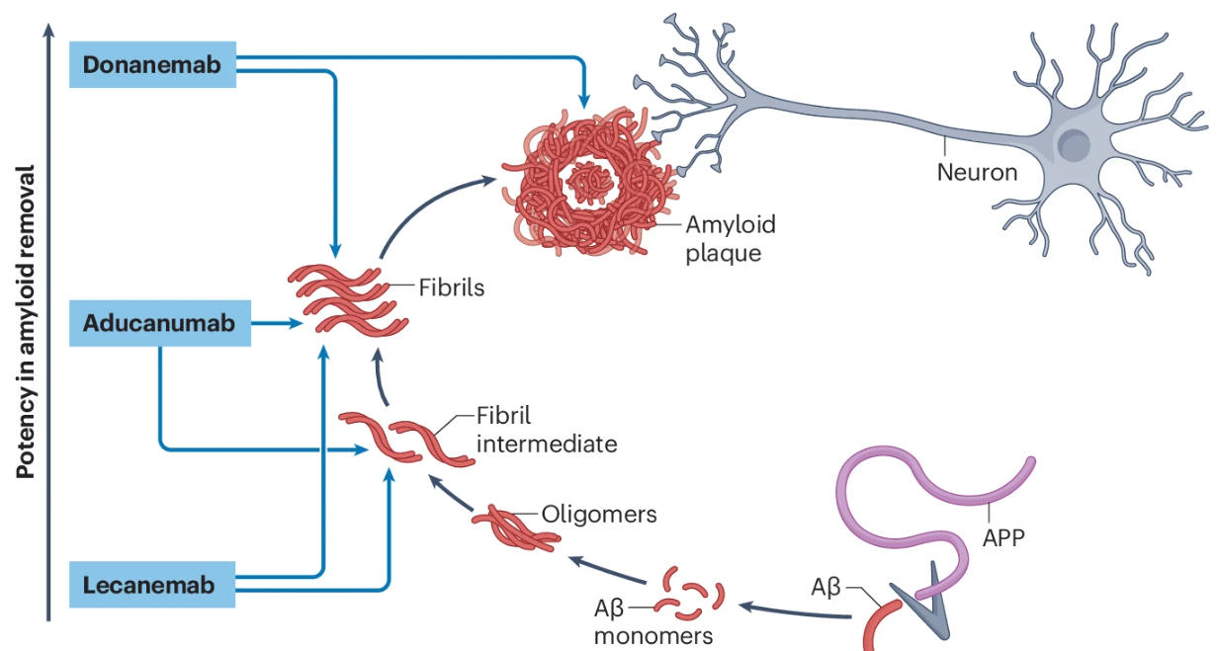
Build up of amyloid protein plaques in AD

Slide 20
Monoclonal antibodies target amyloid proteins

Slide 21
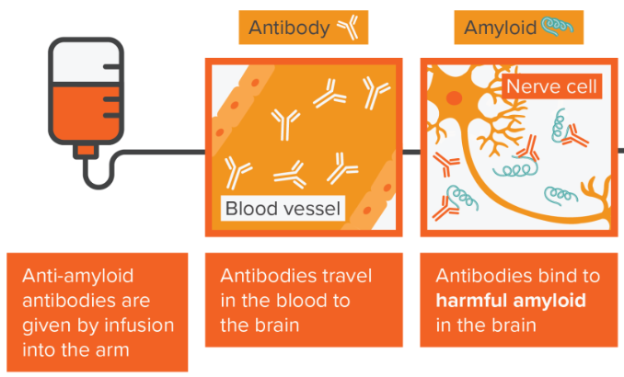
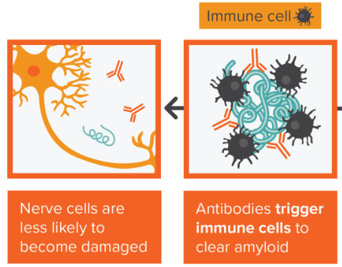
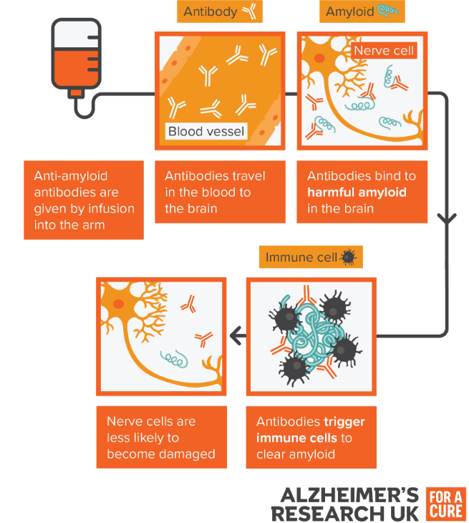
How do antibodies remove amyloid?

Slide 22
Anti-amyloid monoclonal antibodies (mAb)
Consider in patients that have mild cognitive impairment or mild dementia (better outcomes with earlier treatment)
Infusion medicines that require regular treatments (every 2 weeks or every 4 weeks)
Expected benefit is modest. These do not stop amyloid from building up in the brain. These medicines are not a cure for AD.
Slow down progression (worsening of memory) by 6 – 8 months
Lecanemab (Leqembi)
Donanemab (Kisunla)

Slide 23
Anti-amyloid mAb eligibility criteria
MRI within 6 months, genetic testing (APOE)
Stable well managed chronic medical conditions
No other neurological disorders (seizures)
No bleeding disorders
Stable dose of blood thinner (treatment for Afib or blood clot)
No treatment with other monoclonal antibodies
Most costs are covered by Medicare and most secondary insurance companies

Slide 24
Anti-amyloid mAb monitoring
Commitment to 12 – 18 months of treatment
Treatment every 2 weeks (lecanemab) or 4 weeks (donanemab)
  Travel to and from infusion center
  Time at infusion center for treatment, post-treatment monitoring
  Additional doctors appointments for monitoring while on treatment
Regularly scheduled MRI brain scans (at 5 time points)
  Extra unscheduled brain scans if the patient has side effects/symptoms

Slide 25
Anti-amyloid mAb side effects
Some common side effect include:
  Infusion-related reactions
  “ARIA” or amyloid-related imaging abnormalities seen on MRI
    swelling (ARIA-E)
    bleeding (ARIA-H)
  Headache
  Cough
  Skin rashes
Notes:
Donanemab - Alzheimer's Research UK

Slide 26
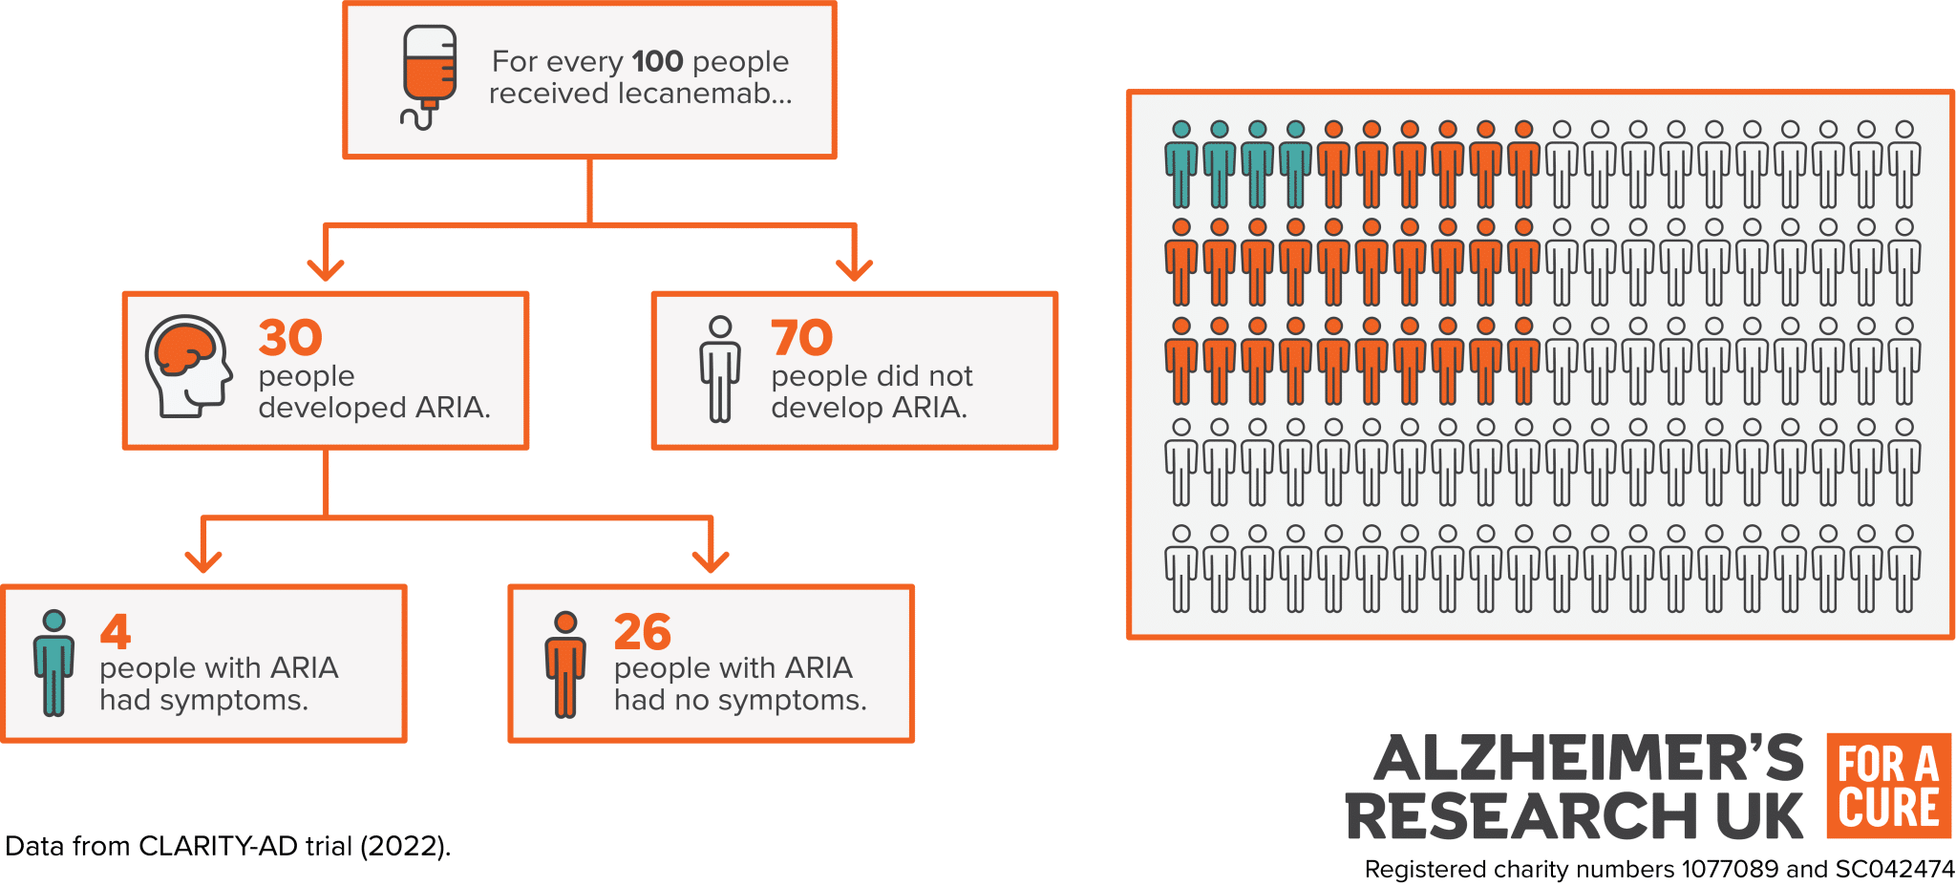
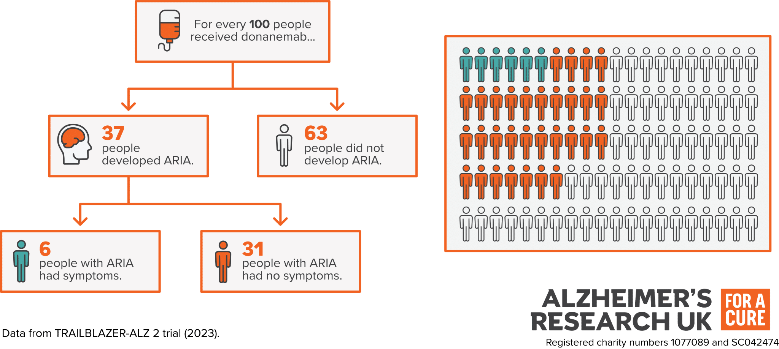

Slide 27
Symptoms of ARIA
  Headache
  Confusion
  Dizziness
  Vision Changes
  Nausea
  Difficulty walking
  Seizures
Treat with steroids, hold next dose and monitor on MRI
Risk factors for ARIA:
  APOE4/E4 status
  Cerebral angiopathy
  Existing microhemorrhages
  Prior strokes
  Use of blood thinners
  Older age

Slide 28
Drugs that treat behavioral and psychological symptoms

Slide 29
Neuropsychiatric Symptoms
Frequently occur after diagnosis, in some people symptoms occur before memory problems
Can be subtle: apathy, social disengagement, and irritability
Progress into behavioral disturbances: agitation, aggression, wandering, and psychosis (hallucinations, delusions, misidentification syndromes)
When new behavioral disturbances occur, look into common causes:
  Developing a sudden medical illness (infection)
  Dehydration, constipation

Slide 30
Non-pharmacological management
Medication side effects
Address pain
Treat depression
Treat sleep disorder

Slide 31
Antidepressants
Selective serotonin reuptake inhibitors (SSRI)
Many other classes of antidepressants can be used
Can help with mild symptoms of irritability, agitation
Citalopram
Bupropion
Sertraline
Mirtazazpine
Escitalopram

Slide 32
Antipsychotics
Not FDA approved to treat behavioral symptoms, but benefits outweigh their risks in patients with severe psychotic symptoms
  Severe hallucinations, paranoia, and delusions
  Symptoms that affect patient and caregiver safety, wellbeing, and quality of life
Quetiapine
Brexpipirazole
Risperidone
Olanzapine

Slide 33
Antipsychotic medicine side effects
Some common side effects include:
  Sedation
  Dizziness, falls
  Weight gain
  Involuntary movements, twitches (extrapyramidal symptoms)
Black box warning: increased risk of stroke, heart attack and death with long term use
  However, this risk is highest in older (first generation) medicines - haloperidol
Goal is to use lowest dose possible that helps with symptoms
Notes:
Donanemab - Alzheimer's Research UK

Slide 34
Methylphenidate (Ritalin)
Medication usually prescribed for ADHD
Using this may help improve motivation pathways in the brain
Studies show it can be helpful for patients with severe apathy who have Alzheimer disease.
Monitoring for any cardiac changes (EKG)
Watch for reduced appetite and weight loss
Can interact with other medicines: blood pressure, SSRIs

Slide 35
Thank you!

