Slide 1

Welcome. Please mute your audio. This webinar will be recorded.

Slide 2
Save the date: November 20th 12:15 PM
Advance Care Planning for a Person with Dementia
Valerie T. Cotter, DrNP, FAANP, FNAP, FAAN Associate Professor | School of Nursing and School of Medicine, Dept of Psychiatry & Behavioral Sciences Nurse Practitioner | Johns Hopkins Memory & Alzheimer's Treatment Center Johns Hopkins University

Slide 3

Calendar
Explore Available Resources
CALENDAR OF WORKSHOPS Find a state-wide listing of in-person and virtual workshops and events offered by LWCE Hub AND our partner agencies.
DEMENTIA SERIES Register for the hub’s upcoming webinar series or access previous recordings and resources.
HUB STATEWIDE WORKSHOPS Upcoming virtual state-wide workshops supporting individuals to live life to the fullest. Offering in a variety of workshops supporting caregiving, dementia, diabetes, chronic disease and more.

Slide 4
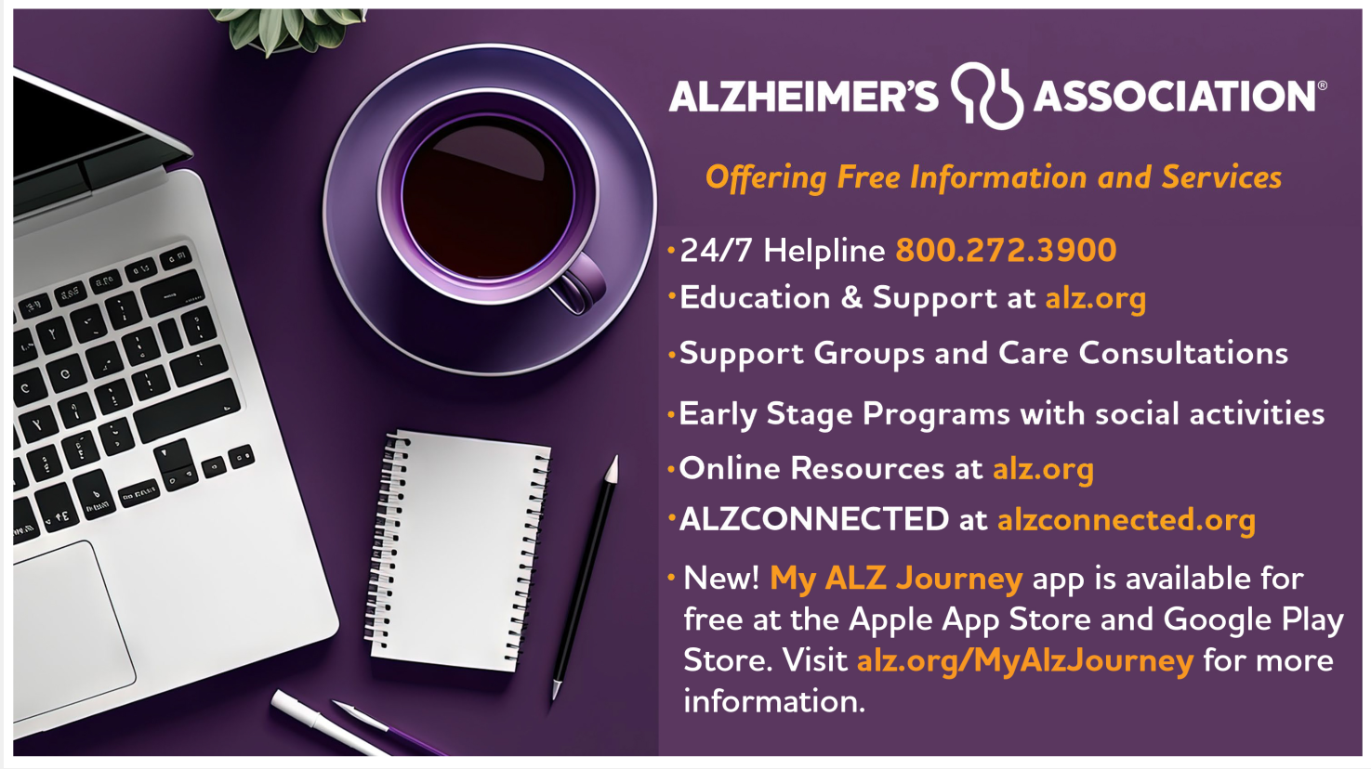
Explore Available Resources from our Partners

Slide 6
Preparing for the Holidays for Care Partners
Ask the Expert
Marti Brown Bailey, BS, CSA, CDP, CADDC, CLYL of Support for Aging
October 16, 2025

Slide 7
What should the caregiver consider in assessing their care pair capacity during the holiday?

Slide 8
Care Pair Capacity
Evaluate the size of your “Tank”
This is a metaphor
Everyone has a different energy capacity
Capacity is variable
Capacity is the combo of both your tank and your person’s
Often linked to Introversion/extraversion

Slide 9
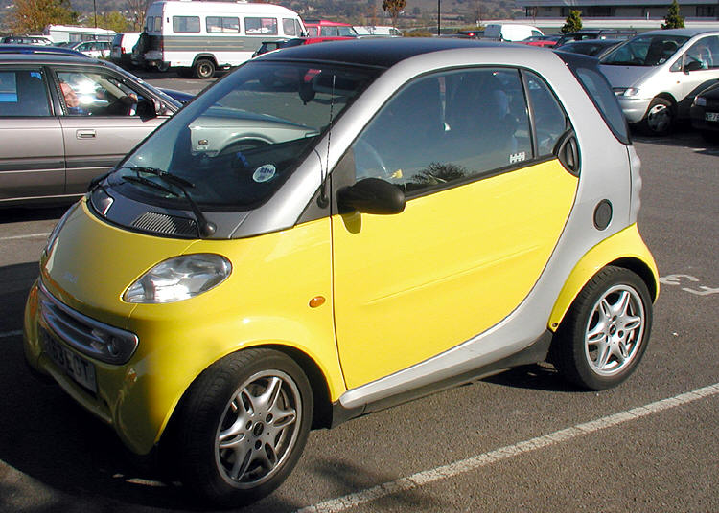
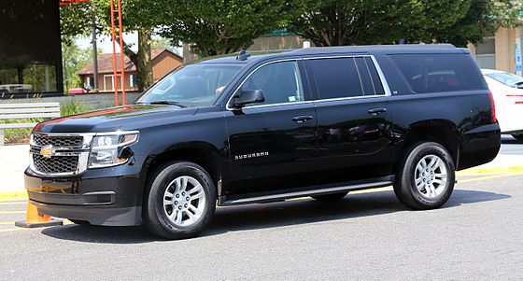
Care Pair Capacity
Evaluate the size of your “Tank”
8.7 Gal.
28 Gal.
This Photo by Unknown Author is licensed under CC BY-SA
This Photo by Unknown Author is licensed under CC BY-SA

Slide 10
What are some tips for non-negotiable traditions that caregivers should consider in their holiday planning?

Slide 11
Tips for Non-Negotiables
Whose non-negotiable is it?
May need to rethink what we think of as non-negotiable
Number of non-negotiables may need to be renegotiated
May need to reduce the size of the event and the location
Having good boundaries may be difficult and sometimes we need them for ourselves
Different holidays may have different non-negotiables (Thanksgiving versus December holidays)

Slide 12
Would you please discuss some PACING strategies that caregivers should consider during the busy holiday season?

Slide 13
Pacing
Type and amount of pacing is dependent on:
Stage of illness
Current health
# of participants in holiday festivities
Techniques
Reduction of people
Reduction of # of activities
Space for quiet (getting away from the activity)

Slide 14
If travel is involved during the holiday, what are some strategies that caregivers could utilize to smooth the way?

Slide 15
Travel
Reduce ambiguity
Direct flights
If travel by car, short travel with frequent stops for movement and toileting (at least every two hours)
Look for family restrooms, don’t be afraid to take an opposite sex partner into a restroom
Use favorite music in earpods to reduce external noise or use noise canceling headphones (practice them beforehand)

