Slide 1

Welcome. Please mute your audio. This webinar will be recorded.

Slide 2

SAVE THE DATE SEPTEMBER 18, 2025
Falls continue to be a national public health concern. Falls Prevention Awareness Week is a national health campaign observed on the first day of fall to increase awareness around falls health and injury prevention. Falls Prevention Awareness Week runs September 21-27, 2025. This year’s theme is “From Awareness to Action”.
Join GWEP, the Maryland Living Well Center of Excellence and guest speaker Dennis Klima, PT, MS, PhD, DPT, FNAP to discuss
‘Preventing Falls in Dementia Patients’
September 18th 12:15 pm - 1:00 pm
Board-Certified Geriatric Clinical Specialist, Board-Certified Neurologic Clinical Specialist
Professor Department of Physical Therapy University of Maryland Eastern Shore
Falls Risk Self-Assessment
This self-assessment tool developed by the National Council on Aging (NCOA) provides
consumers with a falls risk score and follow-up contact with resources based on their falls risk.
Please visit: https://www.ncoa.org/tools/falls-free-checkup/

Slide 3
Managing Urinary Incontinence and Bowel Elimination
Ask the Expert
Jane Marks RN, MS
Johns Hopkins Geriatrics Workforce Enhancement Program
August 21, 2025

Slide 4
What does the general term "Urinary Incontinence“ mean?

Slide 5
Urinary Incontinence
Involuntary loss of urine
impact social activities
result in skin and hygiene problems

Slide 6
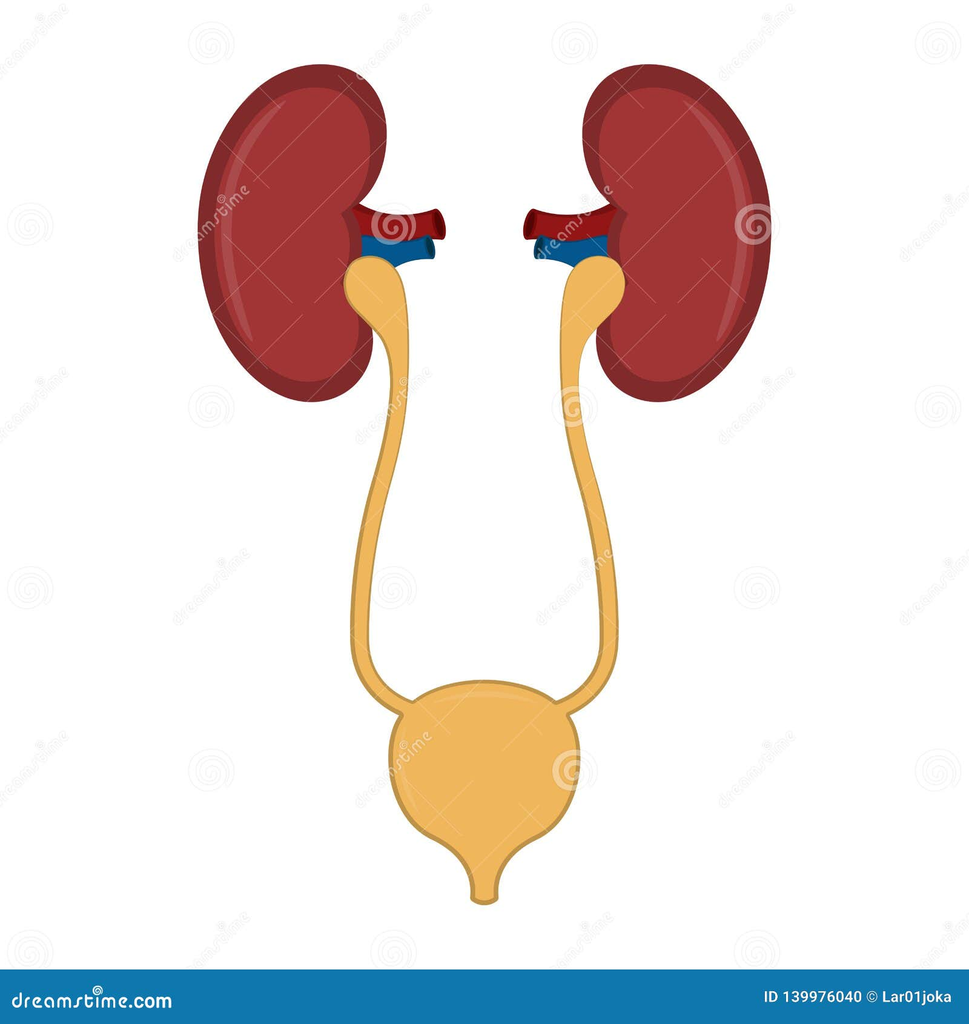

Common Types of UI in Older Adults

Slide 7
What are common types of UI?

Slide 8
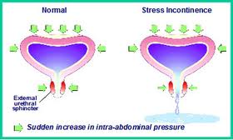
Stress
Leakage associated with activities that increase intra-abdominal pressure
Usually small amount of urine leakage

Slide 9
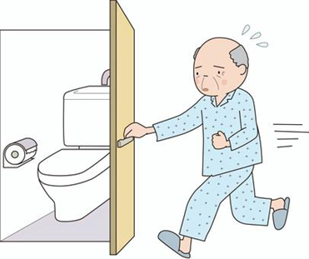
Urge
Urge presents - must urinate
Large amounts of urine leakage

Slide 10
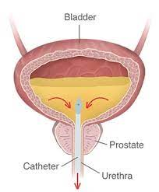
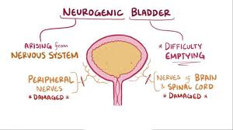
Overflow
Difficulty passing urine- obstruction
Bladder muscle not being stimulated

Slide 11
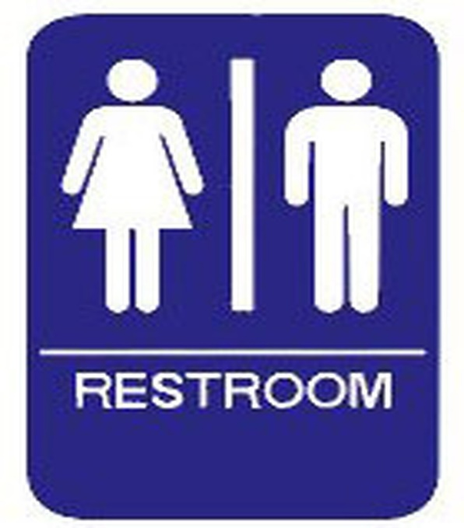
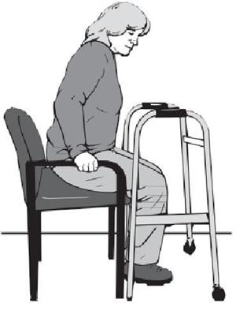
Functional
Mobility difficulties
Cognition

Slide 12
What about a person with dementia and UI?

Slide 13
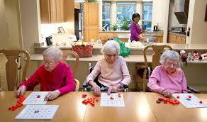
Person with Dementia
Notes:
Person with dementia symptoms may increase as they progress in dementia
See urge/detrusor instability and functional

Slide 14
Know their history/baseline
Did they have trouble with urinary leakage prior to diagnosis?
If so, what were their symptoms?
What was their bowel elimination schedule?

Slide 15
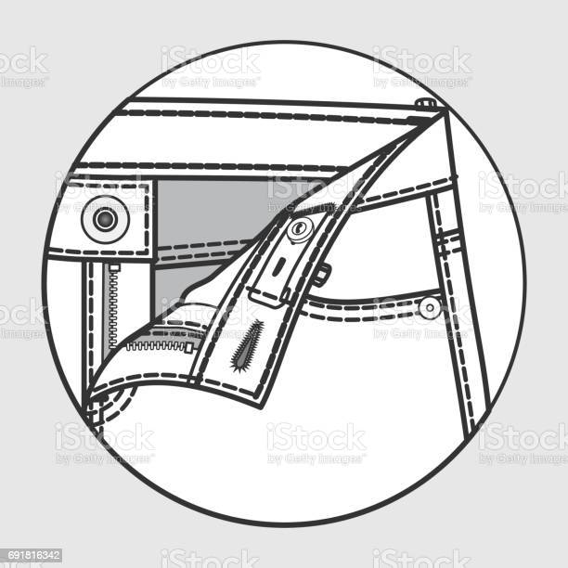
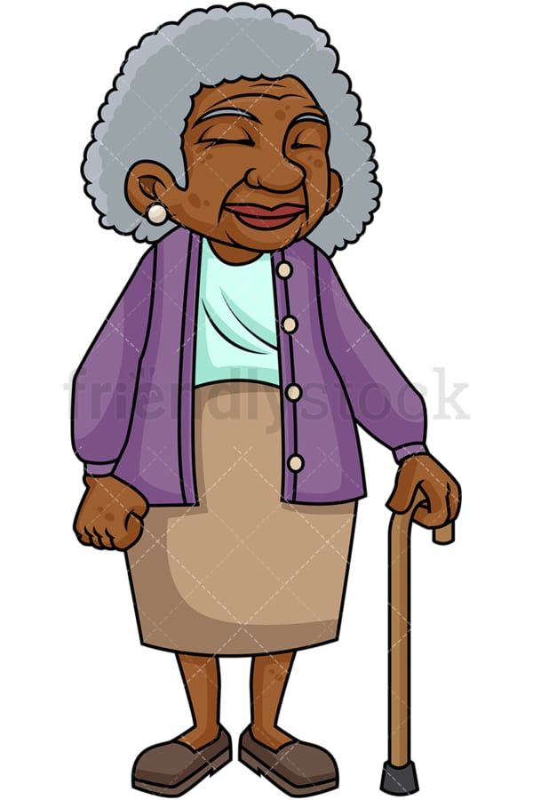
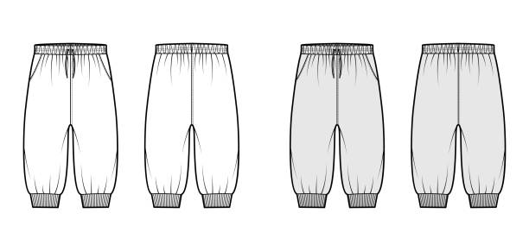
Clothing
NO!!
Notes:
Elastic waist bands are easier to adjust to promote toileting and promote independence as long as possible
Let families know of need for change…zippers will become more difficult and take longer to remove to toilet.

Slide 16
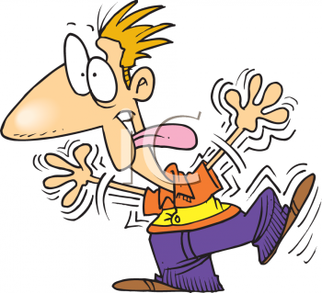


Don’t know what to do when urge presents?!

Slide 17
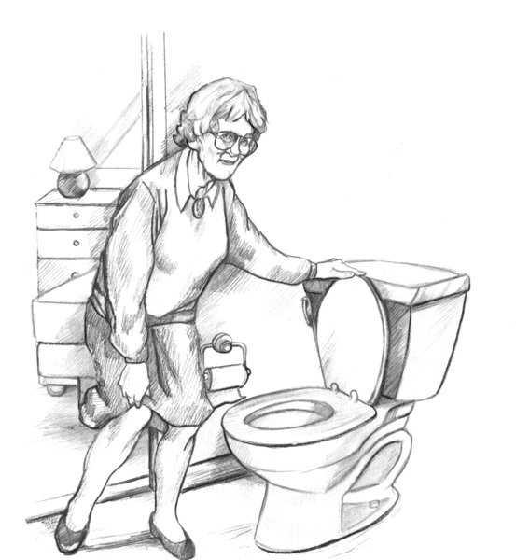
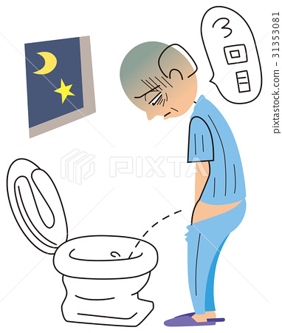
Positioning

Slide 18



Toileting Program
Scheduled Voiding
Timed

Slide 19




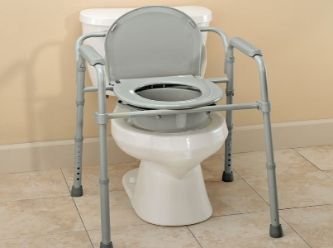

Things to Consider
Addressing medical history/medications
Fluids
Environment Alterations
Bowel Elimination Schedule

Slide 20
What are some strategies to promote regular bowel movements?

Slide 21
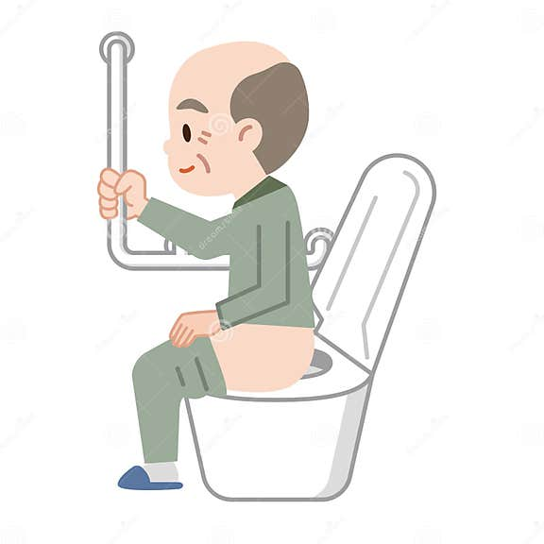
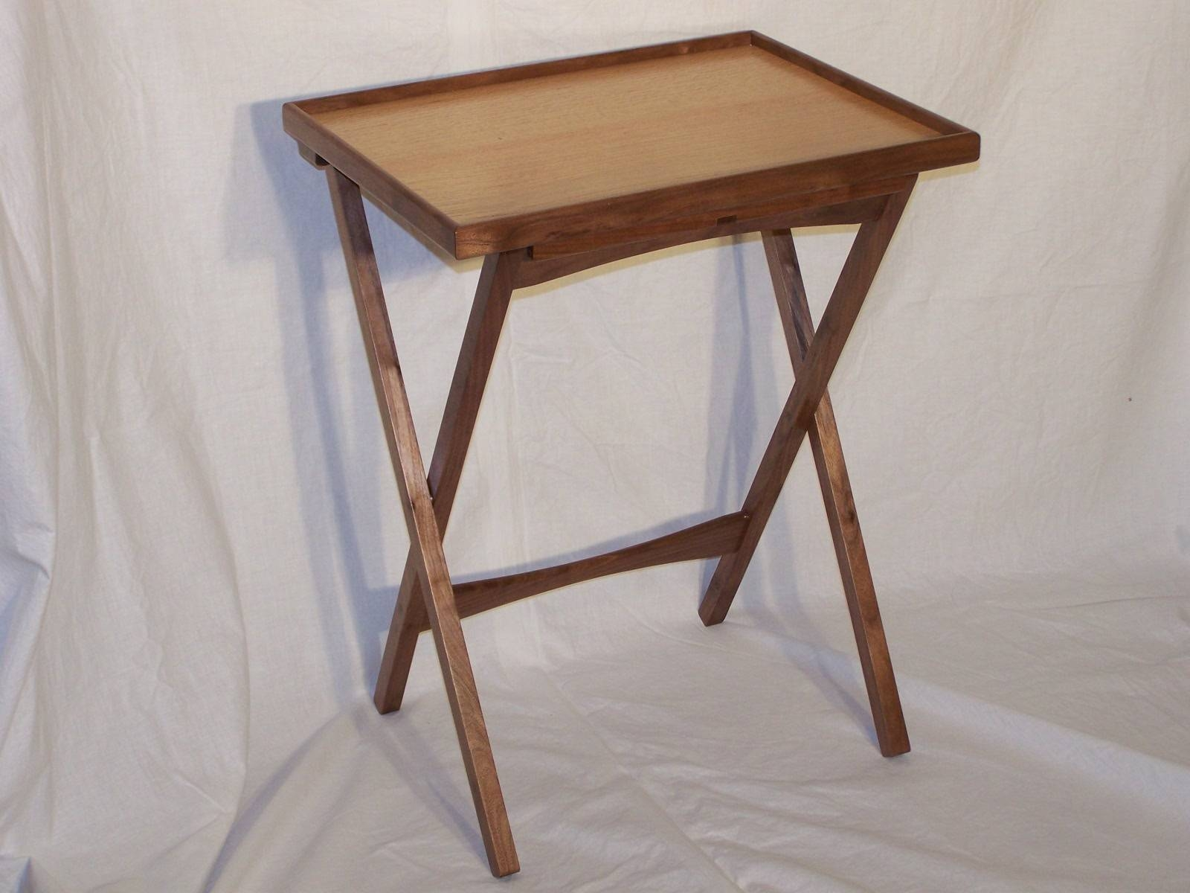








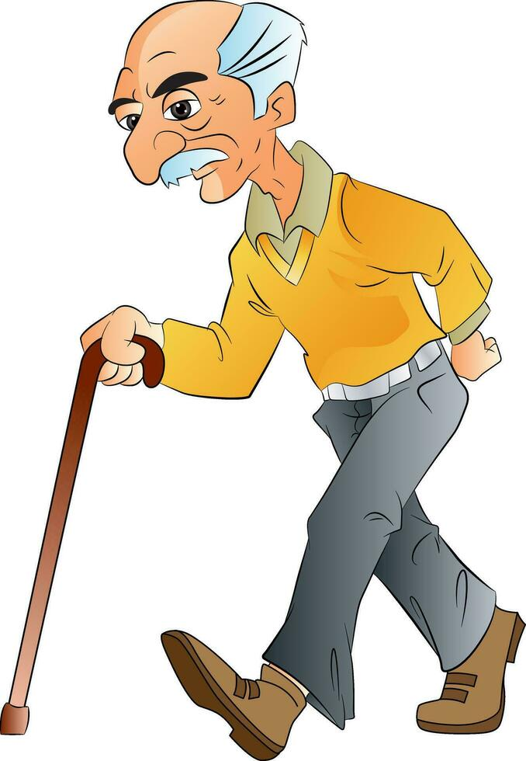
Promote Bowel Elimination
Toileting
Fluids
Diet
Walking/Exercise

Slide 22
What are some other tips for managing UI?

Slide 23

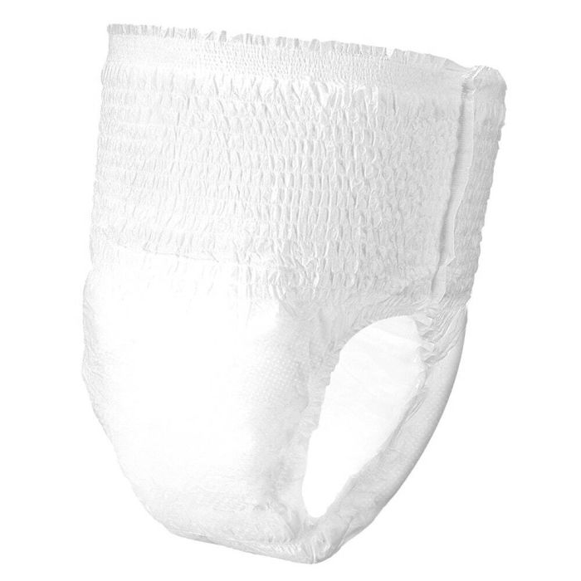

Protective Undergarments

Slide 24


Skin Care
Good Hygiene
Skin barrier

Slide 25


Questions???

