Slide 1

July 24, 2025
Welcome!
Please mute your audio.
We will start shortly.
This webinar will be recorded and available on the LWCE website.

Slide 2





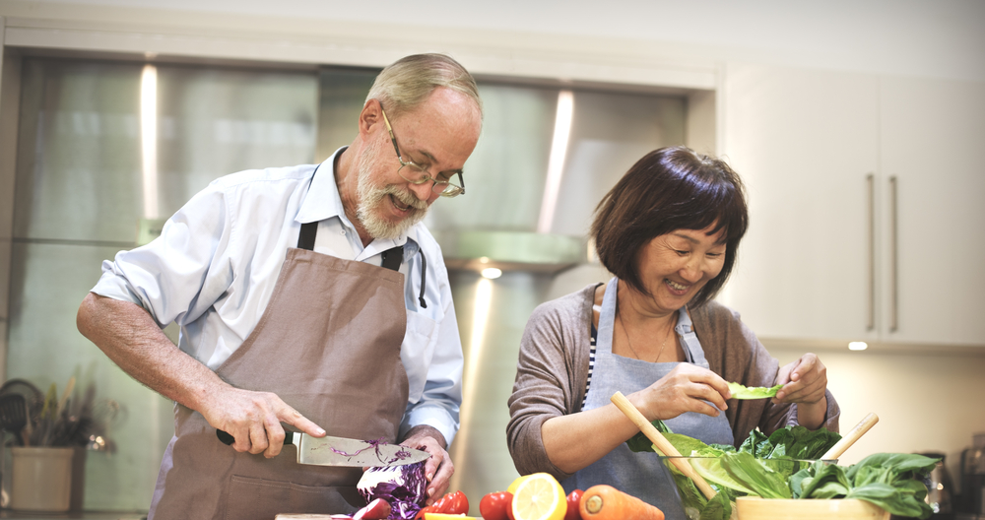
RESOURCES
Virtual Statewide Workshops
Dementia Series (Recorded webinars here)
FindHelp LWCE
AD8 Screening
CONTACT US

Slide 3
Save the date: august 21th 12:15 PM
Managing Urinary Incontinence and Bowel Elimination

Slide 4
Supporting our Caregivers
Kevin Grunden M.S., CCC-SLP
Speech Language Pathologist
InnovAge Pace, Charlottesville, VA
Adjunct Faculty Virginia Commonwealth University, Richmond, Va

Slide 5
What are common behaviors that are challenging when caring for someone with dementia?

Slide 6
COMMON PROBLEMS – WHAT DO WE DO?
He/she won’t do what they need to do (meds, bathing, dressing, etc.)
They are antsy and unsafe
They won’t engage in anything
They are paranoid
They are physically aggressive or threatening
They won’t eat
Wandering
Notes:
Getting Difiore to the bathroom
Lew spontaneously getting up to go somewhere
Joe or Ruby doing nothing
Difiore getting aggressive
Redirect the wanderer

Slide 7
What are some reasons that a person with dementia may exhibit challenging behaviors ?

Slide 8
UNMET NEEDS!

Slide 9
COMMON TRIGGERS
Many likely reasons include:
Having to go the bathroom
Being hungry
Being hot/cold
Being in pain
Being bored or tired
Being overstimulated or overwhelmed
Just being upset! We all get angry at times.

Slide 10
What are some tips for caregivers when behaviors become an issue in caring for their loved one?

Slide 11
TEEPA’S APPROACH
Extend a welcoming hand out and hold hands as you greet them if they allow. Thumbs up with pressure on the palms.
Stand to the side, not head on which can be confrontational
Positive, not negative
Use visual cues, then verbal. Only touch if they are comfortable with you.
Work with them – don’t do for them

Slide 12
WHAT DO I DO AS A CAREGIVER?
Realistic Expectations
Identify what they still can do
Have activities available they can do on their own
Have activities available they can do with others
Remember how the environment impacts their behavior
Use routines to our benefit

Slide 13
HOME ACTIVITIES
Sorting activities
Folding laundry
Cleaning/chores
Tinkering and fiddling
Puzzles
Word Finds
Crossword Puzzles
Looking at books or magazines
Gardening
Coloring
Painting
Sewing, knitting, rolling a ball of yarn
Singing, dancing, listening to music
Baby doll
Ball or balloon toss
Reminiscing, looking through photo albums
Favorite music, movies, or TV shows
Can-Do Jar
Card game or other favorite game
Bird watching
Going for a walk
Cooking
Interacting with children or pets
Sensory exploration

Slide 14

DAILY ROUTINES
Routines allow people with dementia to thrive, especially when they are in their homes and familiar surroundings.
Keeping a consistent daily routine can help improve
Sleep/wake cycle
Mealtime – getting them to the table and increasing intake
ADL routine – participating and allowing assistance
Overall mood
Disruption of routines can lead to a significant decline
How can you make their day more predictable?

Slide 15
Should caregivers notify the healthcare team of behaviors?

Slide 16
YES
?disease progression?
?medication side effect?
?acute issue?
?changes based on dementia type?

Slide 17
Should medications be considered first when a behavior presents?

Slide 18
YES and NO
Yes…
- recent medication changes?
- Safety?
- Polypharmacy?
No…
If not explainable, seek non-pharmacological intervention

Slide 19
Non-pharmacological Interventions

Slide 20
BENEFITS OF STAYING ENGAGED
Improves quality of life
Improves interaction with others and the environment
Provides cognitive stimulation
Helps maintain/slow regression of functional abilities
Keeps people awake in the day – improves sleep/wake cycle
Decreases agitation
Decreases fall risk
Decreases caregiver stress and burden
Decreases need for pharmacology

Slide 21
HOW TO CHOOSE THE “RIGHT” ACTIVITY
Use what you already know
What did they like before their dementia?
What do they like now?
What are they able to do now physically and cognitively?
What was their profession? Hobbies?
What are there sensory preferences?
Can you tap into past roles
Examples: a mechanic may enjoy fiddling with nuts and bolts, a farmer/gardener may enjoy helping with potted plants, the family cook/chef may enjoy supervising during meal prep or helping with simple tasks like stirring, etc.

Slide 22
SOCIALIZATION TIPS
Keep gatherings small
Avoid large, loud restaurants and environments
Don’t do too much and allow the person quiet rest times
Set up opportunities for the person to socialize with friends and family
Even when they stop talking, they still enjoy interacting with their loved ones

