Slide 1
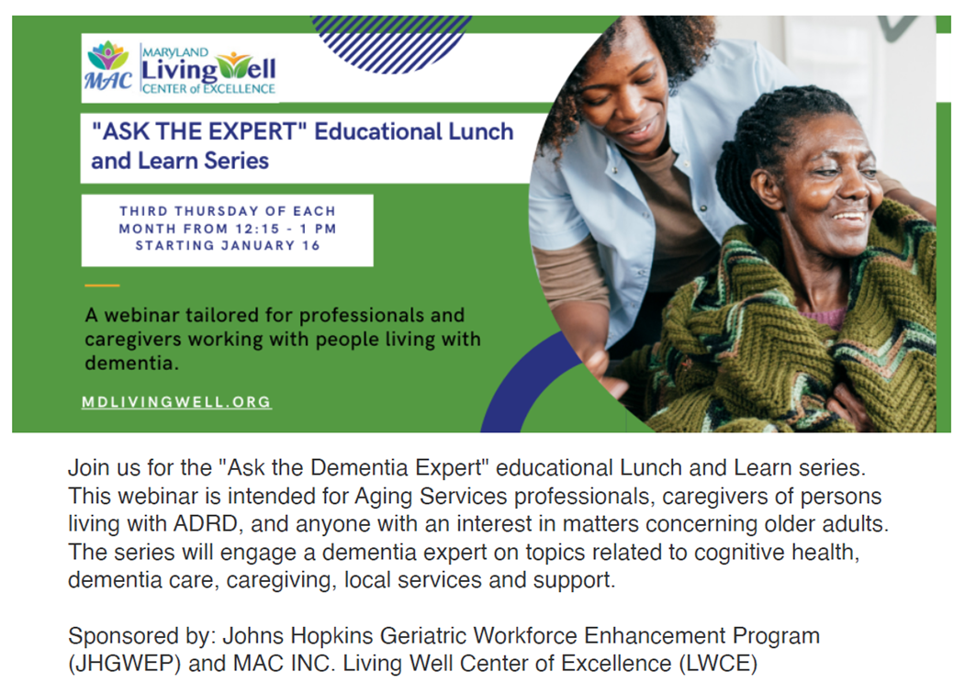
June 26, 2025
Welcome!
Please mute your audio. This webinar will be recorded and available on the LWCE website.

Slide 2






RESOURCES
Virtual Statewide Workshops
Diabetes Flyers and Social Media Ads
Dementia Series (Recorded webinars here)
FindHelp LWCE
AD8 Screening
CONTACT US

Slide 3
Save the date:
JULY 24th 12:15 PM
(PLEASE NOTE DATE CHANGE)
Managing Difficult Behaviors

Slide 4
Depression and Delirium:
Understanding the Difference and How They Present in a Person with Dementia
Elizabeth Galik, PhD, CRNP, FAAN, FAANP
Professor and Chair
Department of Organizational Systems and Adult Health
Editor in Chief, Caring for the Ages
University of Maryland School of Nursing

Slide 5
How does depression present in an older adult?
DSM 5 TR criteria for major depression are seen in older adults
In older adults, you may be more likely to see the following:
  Increased somatic complaints
  Fewer complaints about depressed mood, but anhedonia is more common, less seasonal impact
  Think about the impact of grief and loss
  Screening: PHQ2, PHQ9, Geriatric Depression Rating Scale, Cornell Scale for Depression in Dementia
  Important to assess suicide risk if depression is suspected

Slide 6
Can signs of depression be mistaken for dementia in an older adult?
Yes, there can be overlapping symptoms such as difficulty concentrating, difficulty making decisions, decreased energy, social isolation, decline in function
Dementia and depression may also co-exist

Slide 7
Can a person with dementia be depressed?
Yes, individuals living with dementia are at increased risk of depression.
Depression may also be a prodromal symptom or a risk factor of dementia.
Depression is highly treatable.

Slide 8
What is the treatment for depression in an older adult?
Non-pharmacological approaches: psychotherapy (cognitive behavioral therapy, interpersonal therapy, reminiscence), exercise, engagement in meaningful activity
Pharmacological approaches: SSRIs, SNRIs, mirtazapine, bupropion, etc.
Electro-convulsive therapy in treatment resistant or severe cases of depression

Slide 9
What is delirium?
Syndrome characterized by the acute onset of brain dysfunction with:
  A change or fluctuation in baseline mental status
  Inattention
  Disorganized thinking or an altered level of consciousness

Slide 10
Is it difficult to recognize in a person with dementia?
Yes, it can be as delirium can be superimposed on dementia and their symptoms can be similar.
Major differences include: delirium onset is acute and dementia onset is gradual, a hallmark of delirium is inattention which is not seen in dementia, delirium has a fluctuating course, and the functional decline is more rapid than seen with dementia.

Slide 11
What is the treatment for delirium?
Prevention and early identification of delirium is key
Prevention interventions and treatment interventions overlap, but they include: optimize sensory input, minimize the use of medication that acts on the central nervous system, hydrate, promote adequate nutrition, optimize mobility, establish a regular sleep wake cycle, treat acute illnesses and optimize the management of chronic conditions

Slide 12
Depression, Dementia, Delirium
Characteristic | Depression | Dementia | Delirium
Onset | Gradual | Gradual | Sudden
Course | Gradual worsening | Gradual decline | Fluctuating
Attention | Intact but slowed | Intact | Disrupted
Functional decline | Can do, but slow | Present | Abrupt decline
Lethargy | Typical | Apathy, but not sleepy | Typical fluctuations in sleepiness and agitation
Psychotic symptoms | Rare, only when severe; mood congruent delusions | 25% typically in moderate stages | Hallucinations are most common

Slide 13
Questions?

