Slide 1
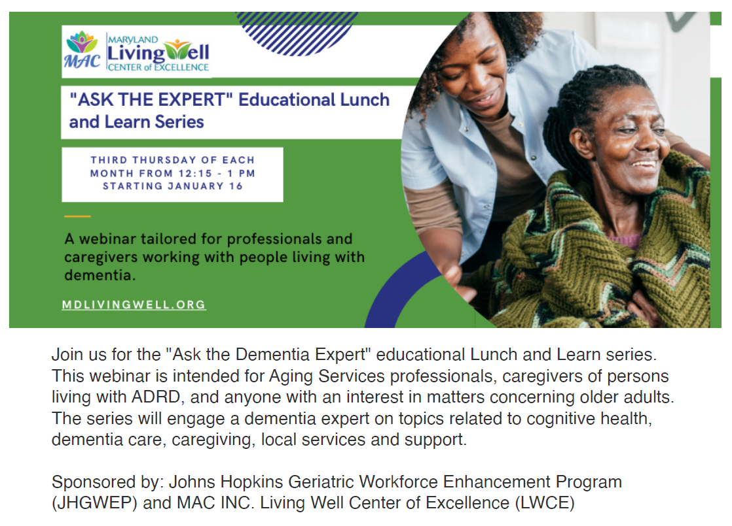
Welcome. Please mute your audio. This webinar will be recorded.

Slide 2






RESOURCES
Evidence-Based Programs (EBP)
Virtual Statewide Workshops
Diabetes Flyers and Social Media Ads
Dementia Series (Recorded webinars here)
FindHelp LWCE
AD8 Screening
Maryland Access Point (MAP)
Alzheimer’s and Dementia Conference
CONTACT US

Slide 3
Understanding the
Non Alzheimer’s Dementia
Haroon Burhanullah , M.D.
Assistant Professor
Director, Alzheimer’s anti- amyloid therapy
Geriatric and Neuropsychiatry
Johns Hopkins Medicine
ASK THE EXPERT, May 15, 2025

Slide 4
What are the other non-Alzheimer’s disease dementias?
Etiology | Prevalence
Alzheimer’s Disease | 60 - 70%
Vascular Dementia | 10 - 15%
Mixed Dementia | ~10 – 15 %
Dementia with Lewy Bodies | ~5 %
Frontotemporal Lobe Dementias | 5 - 8%
HIV Dementia | <5 %
Alcoholic Dementia | <5 %
Reversible Causes of Dementia (NPH, Hypothyroidism, B12 Deficiency) | <5 %

Slide 5
The 3 non-Alzheimer’s Disease dementias that will be addressed today include:
  Vascular dementia
  Lewy Body dementia
  Frontotemporal dementia

Slide 6
What is Vascular Dementia and discuss risk factors, how it presents in a person, diagnostic or work up and lastly how is it managed?

Slide 7
What is Vascular Dementia?
Vascular dementia is cognitive decline caused by impaired blood flow to the brain.
• It often results from strokes, small vessel disease, or ischemic injury.
• Frequently coexists with Alzheimer's pathology in older adults.

Slide 8
Risk Factors
Hypertension
Diabetes mellitus
Smoking
Atrial fibrillation
Hyperlipidemia
History of stroke or TIA

Slide 9
Clinical Features
Stepwise or sudden decline in cognitive function
• Memory loss may not be the initial symptom
• Focal neurological signs (e.g., hemiparesis, gait disturbance)
• Emotional lability or apathy
• Executive dysfunction often prominent

Slide 10
Diagnosis
Clinical history and neurological exam
• MRI or CT scan shows infarcts or white matter changes
Neuropsychological testing
• NINDS-AIREN criteria used for diagnosis

Slide 11
Management of Vascular dementia
• No cure, focus on prevention and slowing progression
• Control vascular risk factors (BP, glucose, lipids)
• Antiplatelet therapy if stroke history
• Cognitive therapy and physical rehabilitation
• Family education and support

Slide 12
Please describe Dementia with Lewy Bodies including the cause and treatment modalities.

Slide 13
Dementia with Lewy bodies
Clinical syndrome:
  Fluctuating cognition and consciousness
  Cortical dementia: aphasia, apraxia, agnosia and
  Mild parkinsonism poorly responsive to levodopa
  Very sensitive to EPS from antipsychotics
  More rapid progression than AD
  Vivid visual hallucinations (also fluctuating)
Pathology: Lewy bodies in many areas of cortex
  As opposed to Parkinsons’ where Lewy bodies are restricted to basal ganglia.

Slide 14
Lewy Body Dementia Treatment
Cholinesterase inhibitors, avoid antipsychotics.
Non- Pharmacological treatment:
- Environmental modifications
- Sensory optimization (glasses, hearing aids)
- Behavioral redirection and reassurance
- Sleep and routine support
- Medication review (reduce dopamine agonists)

Slide 15
Differentiating DLB
From Alzheimer’s
  Vivid VH
  Fluctuating cognition
  Prominent parkinsonism
From Parkinson’s
  Dementia comes first in DLB
  Cortical dementia
    Amnesia is early symptom
  VH innate to disease
    In PD, VH are commonly drug-induced
  Parkinsonian symptoms not very responsive to medication

Slide 16
How does frontotemporal dementia present, what is the cause and how is it managed?

Slide 17
Frontotemporal dementia
Young age of onset, often in the 50s
Two major presentations:
  Primary progressive aphasia
    Largely affects word-finding
  Behavioral variant
    Often-profound personality changes
    Agitation, aggression, impulsivity, apathy, social inappropriateness
    A tragic illness affecting people in mid-life.
Frontotemporal atrophy on MRI (often asymmetric)
Frontotemporal hypometabolism on FDG-PET
Increased tau, no amyloid decrease in CSF

Slide 18
FTD
Cause: Atrophy of frontal and/or temporal lobes.
Key Features:
- Early personality and behavior changes
- Disinhibition, apathy, language dysfunction
- Memory may be preserved early
Treatment: Supportive care, behavioral interventions.

Slide 19
Can you address briefly rapidly progressive dementia?

Slide 20
Rapidly progressive dementia

Slide 21
Rapidly progressive dementia
Most dementias progress slowly over years
Rapidly progressive dementias progress over weeks to months
Note that patients and families often overestimate the rate of progression
Particularly when expressive language is declining
  Also artifactually leads to “sudden” decline on office testing (MMSE and MoCA)
So most cases of “rapidly progressive dementia” are nothing exotic
Usually other dementias or delirium
Specific diagnoses leading to rapidly progressive dementia
  Prion disease
  Autoimmune encephalitis
Need LP for diagnosis

Slide 22
Prion disease
Jacob-Kreutzfeldt disease (JP disease)
Misfolded prion protein catalyze further misfolding of prion protein
A contagious disease where the infectious agent is a misfolded protein
Similar to mad-cow disease
Diagnosed by history and CSF
Patients are severely cognitively impaired and may appear delirious
Seizures are common
Characteristic imaging findings (next slide)
Needs LP for diagnosis
Send the CSF to National Prion Center
  Run by our former Hopkins fellow Brian Appleby
  Elevated 14-3-3 protein AND elevated tau
  14-3-3 alone = many false positives
No known treatment

Slide 23
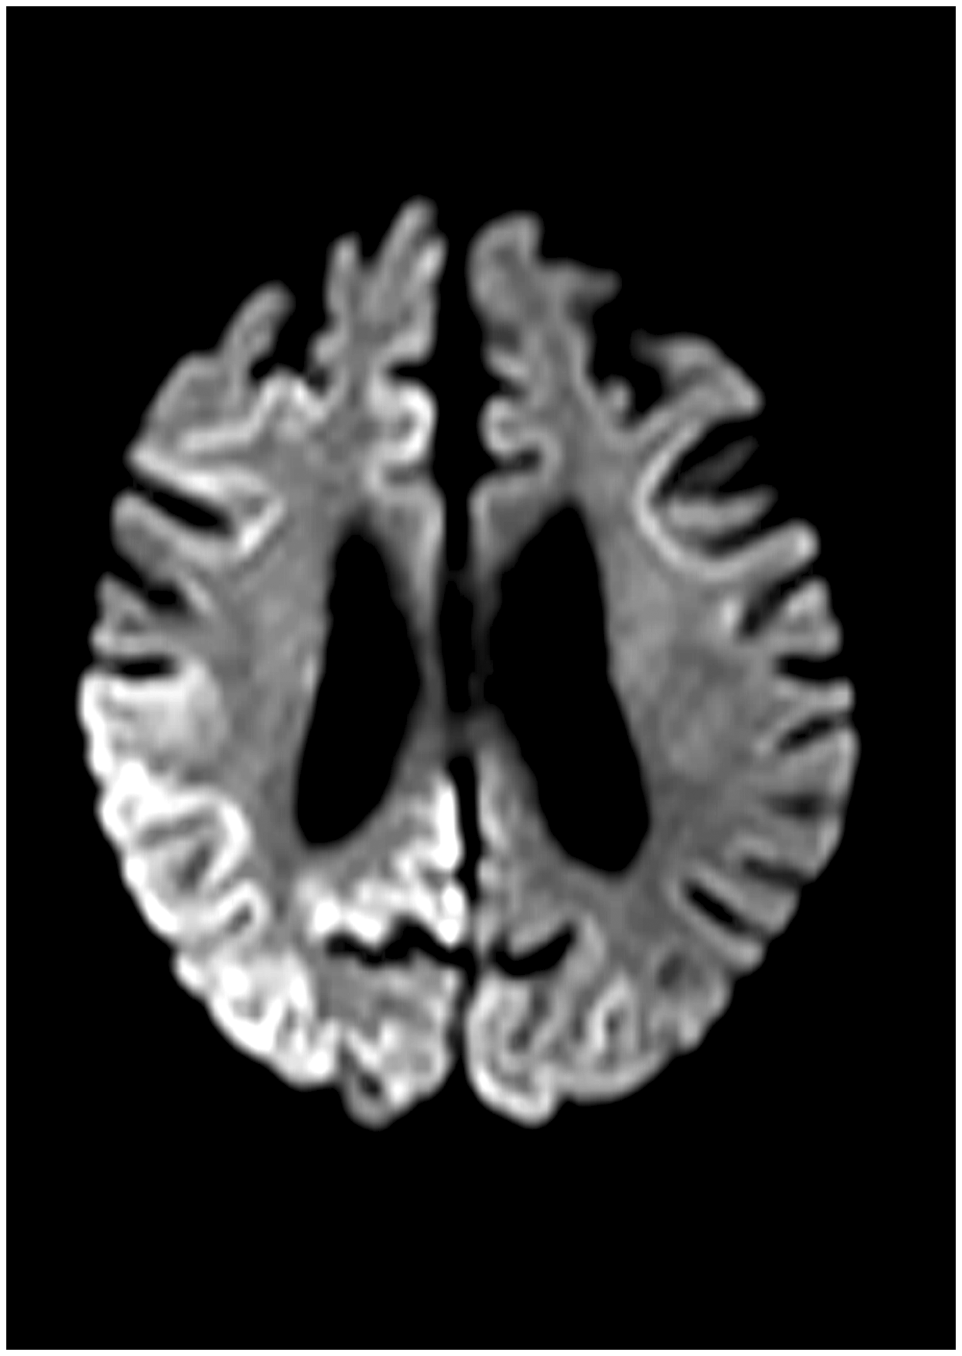

Figure 1 Axial image (case 3) showing cortical swelling with diffuse high intensity signal in the occipital cortex ...
Notes:
Figure 1 Axial image (case 3) showing cortical swelling with diffuse high intensity signal in the occipital cortex bilaterally, demonstrated on diffusion-weighted imaging (DWI).
Unless provided in the caption above, the following copyright applies to the content of this slide: © The Author 2017. Published by Oxford University Press on behalf of the Association of Physicians. All rights reserved. For Permissions, please email: journals.permissions@oup.com

Slide 24
Autoimmune encephalitis
Inflammatory response to self-antigens in brain
Often in limbic system so often termed “limbic encephalitis”
Floridly delirious and psychotic
Clinically similar to herpes encephalitis
Most common causes:
  Paraneoplastic
  Idiopathic autoantibodies to neurotransmitter recptors
    Anti-NMDA, GAD65 among other
Need LP and serum paraneoplastic antibodies to diagnose
Several immunosuppressive treatments
  Systemic steroids
  Plasmapheresis
  Rituxamab

Slide 25
Sleep and Dementia
Disrupted circadian rhythm is common in dementia due to SCN (suprachiasmatic) degeneration and melatonin loss.
Symptoms:
- Reversed sleep-wake cycle (sleeping by day, awake at night)
- Fragmented sleep, early awakenings
- Increased sundowning and agitation in evenings

Slide 26
Contributors:
- Alzheimer's: SCN and melatonin changes
- Lewy Body/Parkinson's: REM sleep behavior disorder
- FTD: Behavioral disturbances affect sleep pattern
Non-Pharmacological Management:
- Bright light therapy in morning
- Regular daytime activity and structured routines
- Avoid late naps and screen exposure before bed
- Calm nighttime environment, clock orientation cues

Slide 27
Neuropsychiatric Inventory (NPI)
Delusions
Hallucinations
Agitation
Depression
Anxiety
Euphoria
Apathy
Disinhibition
Aberrant motor
Irritability
Sleep
Eating

Slide 28
Depression in AD
Part of a spectrum of neuropsychiatric disturbance
More agitation, delusions, anxiety
Decreased motivation and pleasure in activities
Less guilt, self-deprecation, suicidal ideation, neurovegetative signs/symptoms
DSM-IV does not capture this range

Slide 29
Agitation in AD
Encompasses a huge range of behaviors and affects
Disturbing to caregivers
Often worse in the evening (“sundowning”)
Associated with delirium
Pacing
Shouting
Catastrophic reactions
Beseeching
Wandering
Essential to define target for treatment

Slide 30
Dementia-related psychosis
Delusions
Hallucinations
  Particularly visual hallucinations (VH)
Common throughout the dementias
Disease-specific features (next slide)
Diagnosis
  Careful about delusions vs. disorientation or forgetfulness
  VH can be very vivid (particularly in DLB)
  Need to rule out delirium
  Need to rule out medication toxicity
    Steroids
    Opioids
    Digoxin
Treat the cause
Benefit of antipsychotics is quite varied

Slide 31
Comparison of psychosis in dementias
Diagnosis | Clinical features
Alzheimer’s disease (AD) | Hallucinations may be visual or auditory Careful not to confuse delusions and disorientation Delusions often not systematic Distress usually caused by emotional reactions (paranoia, agitation) than by the delusions and hallucinations themselves Capgras’ syndrome Delusional jealousy
Fronto-temporal dementia (FTD) | Behavioral variant In context of profound personality changes (agitation, impulsivity, apathy, and social inappropriateness)
DLB | Visual hallucinations (VH) Can be very vivid and patients tend to act on them A major clinical problem and current medications not very effective
Parkinsons’ disease | Can have psychosis without dementia Can be very problematic Often related to dopaminergic agents and quite dose-dependent First reduce levodopa dose
Vascular dementia | Similar to AD but psychosis not as common

Slide 32
Lifestyle modifications for prevention of AD (1)
Lifestyle area | Potential mechanisms | Examples | Comments
Exercise | Improved blood flow to brain Enhance hippocampal neurogenesis Reduce depression and stress Reduction in inflammation and oxidative stress Improves synaptic health and “pruning” | Aerobic exercise Walking Swimming Tai Chi | Abundant epidemiologic evidence Many exercise programs currently being studied Aerobic aspects seem important Feasibility in frail elderly remains to be proven
Cognitive interventions | Cognitive reserve, strengthening brain circuits Improve brain plasticity (biological compensation) Improve compensatory strategies (behavioral compensation) | Many specific “brain fitness” programs available (examples Sudoko, Lumosity, crossword puzzles) Continuing education Paid or volunteer work | Education highly protective in epidemiologic studies Many strategies being studied in research But it has been difficult to show that “brain training” has significant real-world effects

Slide 33
Lifestyle modifications for prevention of AD (2)
Lifestyle area | Potential mechanisms | Examples | Comments
Diet | Reduction of atherosclerotic disease (i.e., “what’s good for the heart is good for the brain”) | Mediterranean diet Fruits, vegetables, and juices Maintaining healthy weight Preventing diabetes | Compelling rationale for extension of well-validated interventions for heart disease But difficult for people to implement and evidence quite weak to date Midlife risk factors affect late-life risk (long lag time)
Stress reduction | Prevent depression Improved brain connectivity | Psychotherapy Meditation Exercise Antidepressant medications | Late life depression and anxiety frequently linked to increased AD risk Interventions have been shown to alter brain connectivity No evidence from trials to date
Improving sleep | Reduce amyloid deposition | Sleep hygiene | Laboratory evidence that poor sleep enhances amyloid deposition and vice versa

Slide 34
Cognitive rehabilitation and training
Education protective against AD in epidemiologic studies
Cognitive reserve hypothesis
Many ways to stimulate the brain!
  Training (repetition, exercises)
  Strategies (teaching new strategies)
It is clear that older persons can improve in specific cognitive domains
Processing speed for sure
Memory not so clear

Slide 35
Questions?
Thank you!

Slide 36
Save the date:
June 19th 12:15 PM
Depression & Delirium-understanding the difference and how they may present in a person with dementia
Elizabeth Galik, PhD, CRNP, FAAN

