Slide 1

Welcome. Please mute your audio. This webinar will be recorded.

Slide 2
Impact of Hearing Loss on Cognition
Ask the Expert
Carrie Nieman M.D., M.P.H.
Associate Professor
Johns Hopkins University School of Medicine
Otolaryngology-Head and Neck Surgery
March 20, 2025

Slide 3
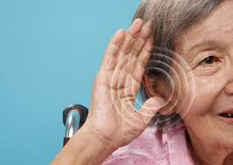
Can you describe age related changes in hearing?

Slide 4
What is hearing loss?

Slide 5
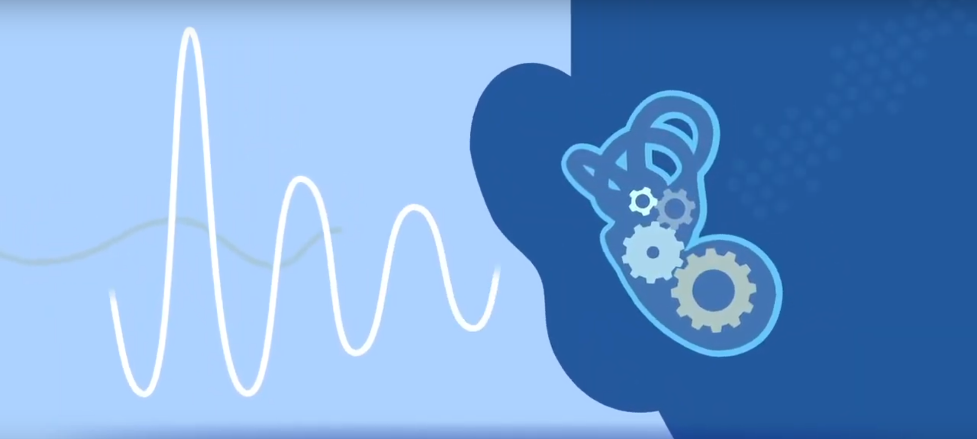

Slide 6
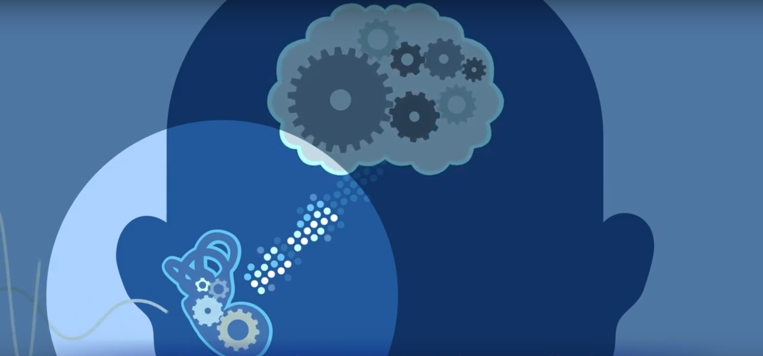

Slide 7
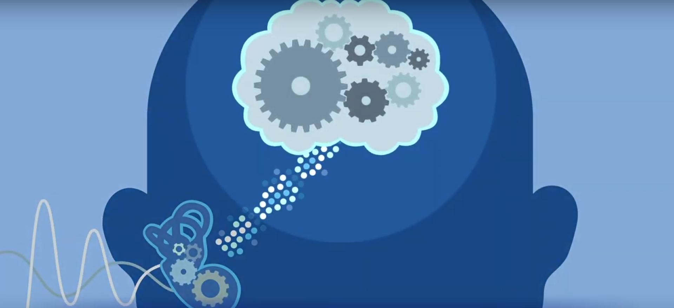

Slide 8
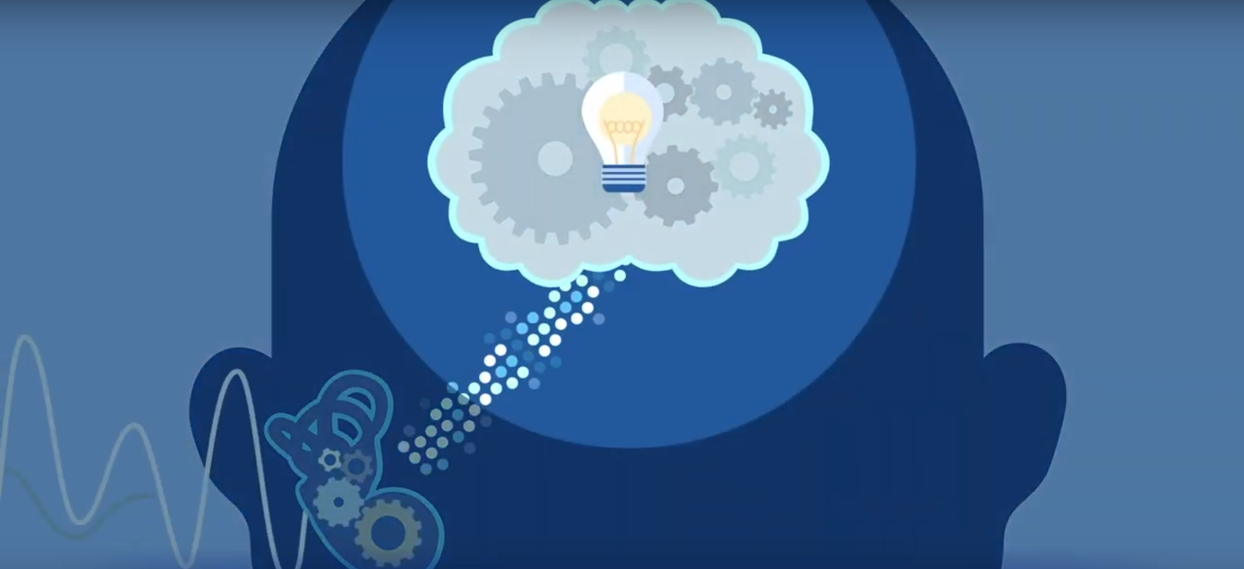

Slide 9
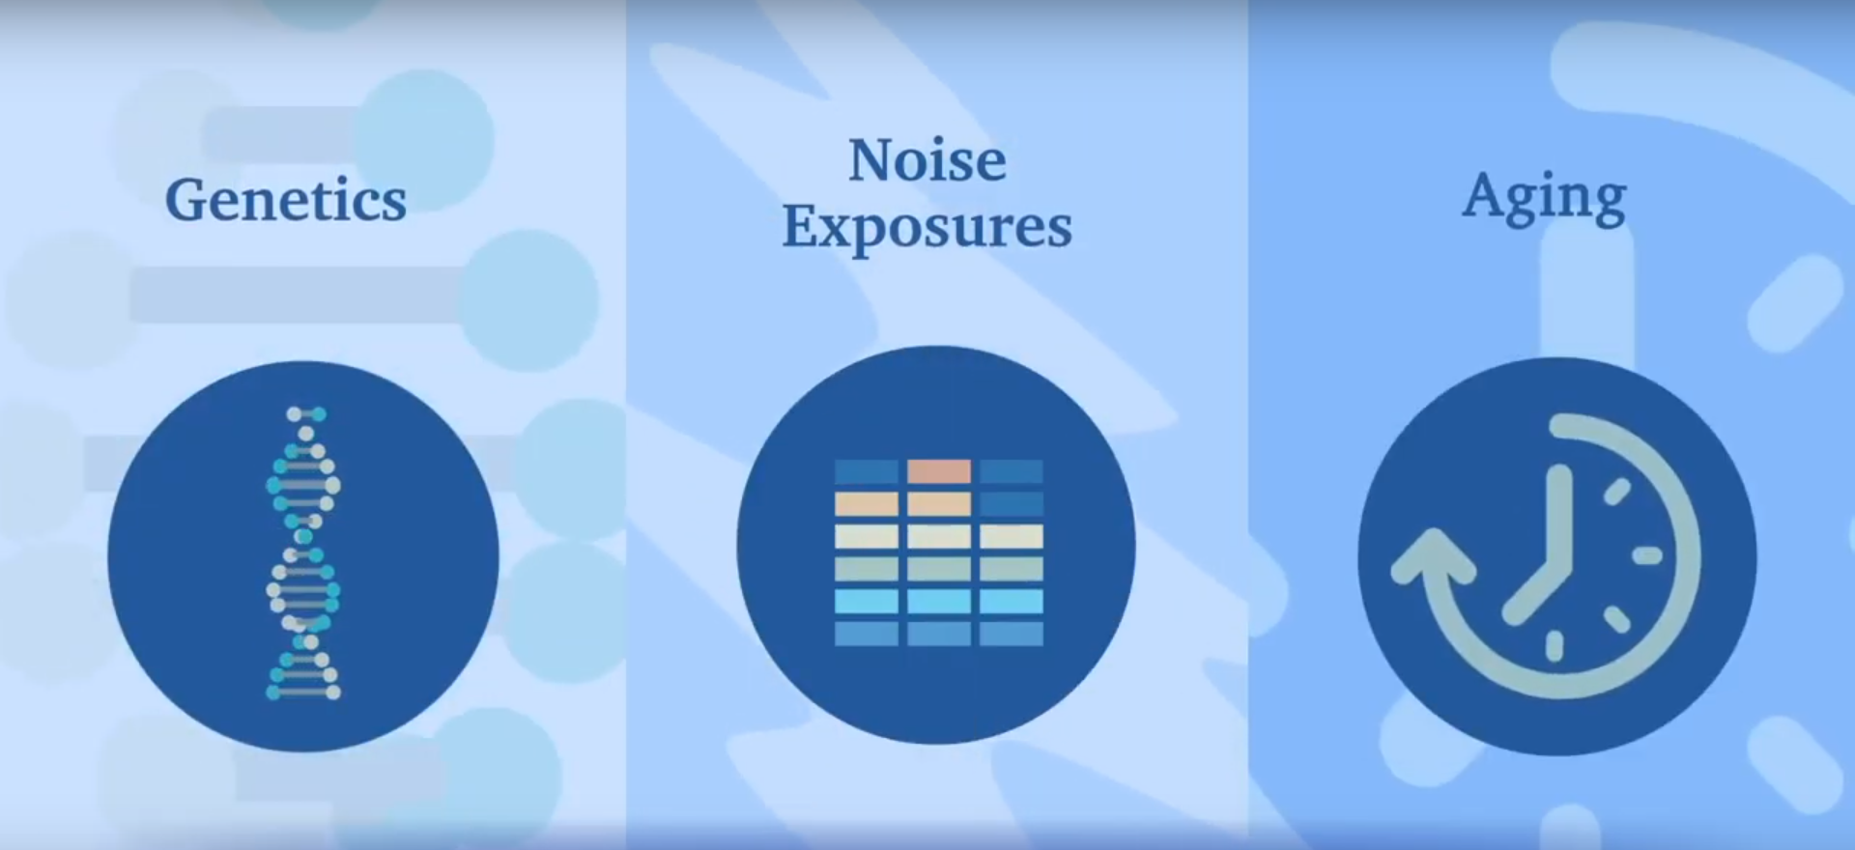

Slide 10
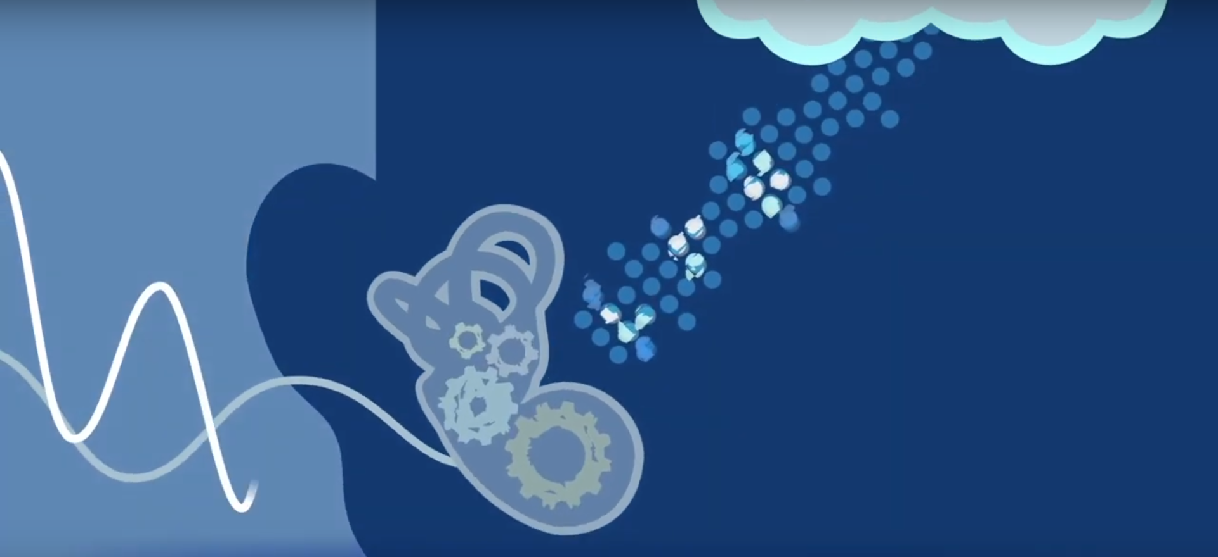

Slide 11
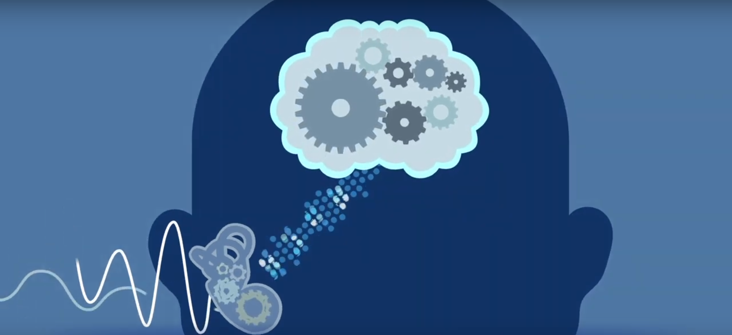

Slide 12
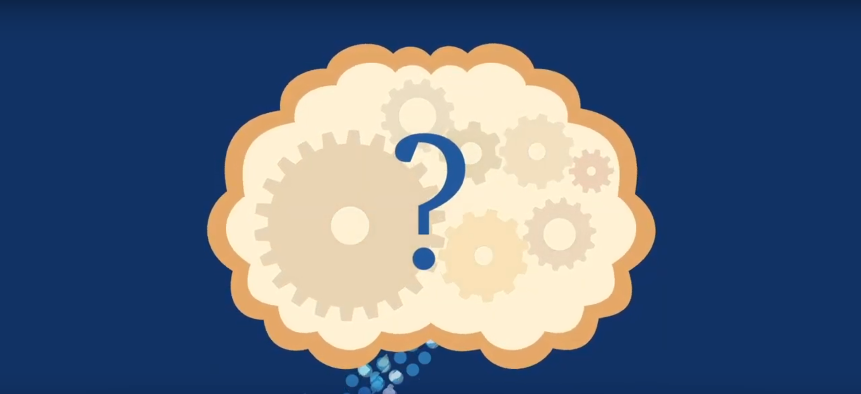

Slide 13
What are risk factors that impact hearing?

Slide 15
Does hearing loss matter as we age?

Slide 16
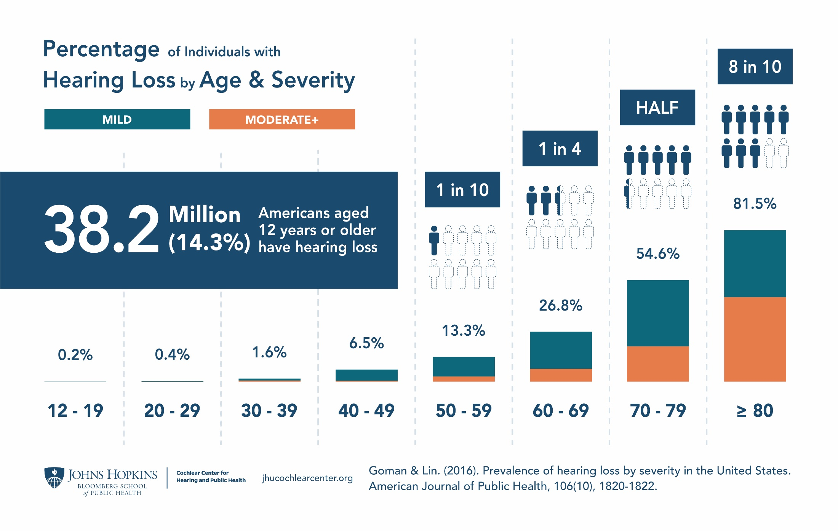

Slide 17
Hearing Loss & Healthy Aging
Recent Epidemiologic Studies
Cognitive Vitality & Avoiding Dementia
Healthy
Aging
Avoiding Injury
Maintaining Physical Mobility & Activity
Health Economic Outcomes/Mortality
Keeping Socially Engaged & Active
Notes:
Look across domains – healthy

Slide 18
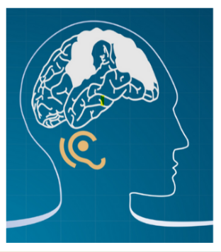
How does hearing loss impact cognition?

Slide 19
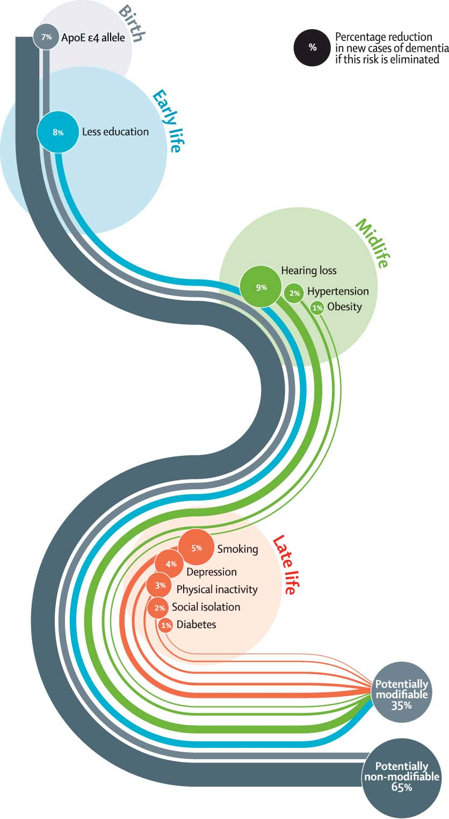
Hearing loss is
the largest potentially modifiable risk factor
Mild HL → 2x ↑ risk
Moderate HL → 3x ↑ risk
Severe HL → 5x ↑ risk
Hearing care
as
primary prevention?
Livingston et al., 2017

Slide 20
Hearing Loss & Cognition
Common Cause or Modifiable Risk Factor
Cognitive Load
Hearing Loss
Brain structure/function
Cognitive Functioning
Social Isolation
Common pathological process
F. Lin & M. Albert, Aging & Mental Health, 2014

Slide 21
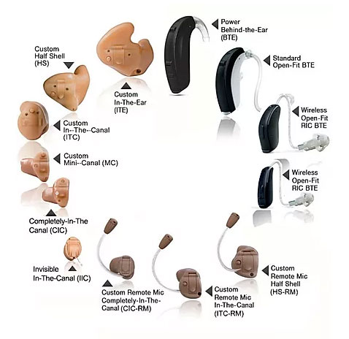
Does obtaining a hearing aide reverse changes?

Slide 22

Hearing Loss
Dementia

Slide 23
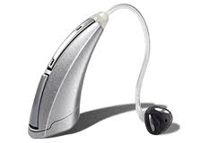
Hearing Loss & Dementia
Hearing Loss as a Modifiable Risk Factor
Cognitive Load
Cognitive Impairment &
Dementia
Hearing Loss
Brain structure/function
Social Isolation
Hearing loss intervention could:
Reduce the cognitive load of processing degraded sound
Provide increased brain stimulation
Improve social engagement
Role of HL as a potentially modifiable late-life risk factor for cognitive decline & dementia

Slide 24





Aging & Cognitive Health Evaluation in Elders Randomized Trial (N = 850)
Frank Lin & Joe Coresh & ARIC-NCS, 2017-2023
Secondary
Outcomes
Proximal/Mediating
Outcomes
Primary
Outcome
Intervention
Dementia
Social/Leisure Activities
Physical
Functioning
Mobility
Falls & Hospitalizations
MRI brain
Best-Practices Hearing Rehabilitative Treatment
Vs.
Successful Aging Control
Audibility of speech & environmental sounds
Cognitive
Functioning
Enhanced Verbal Communication & Social Engagement

Slide 25
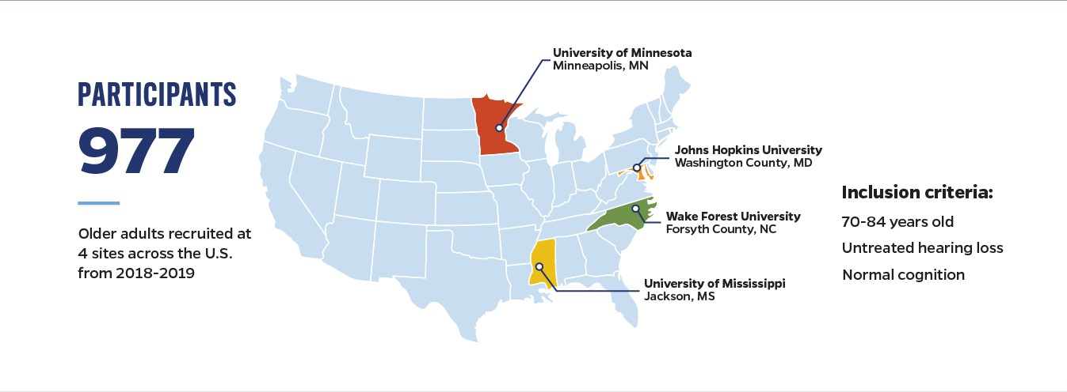

Slide 26
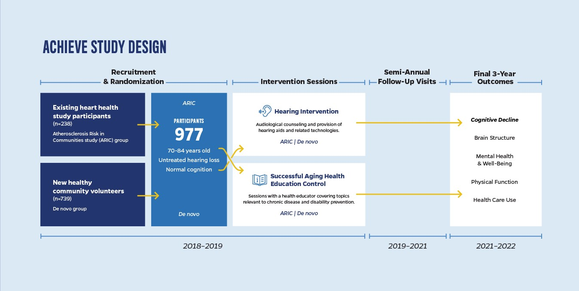

Slide 27
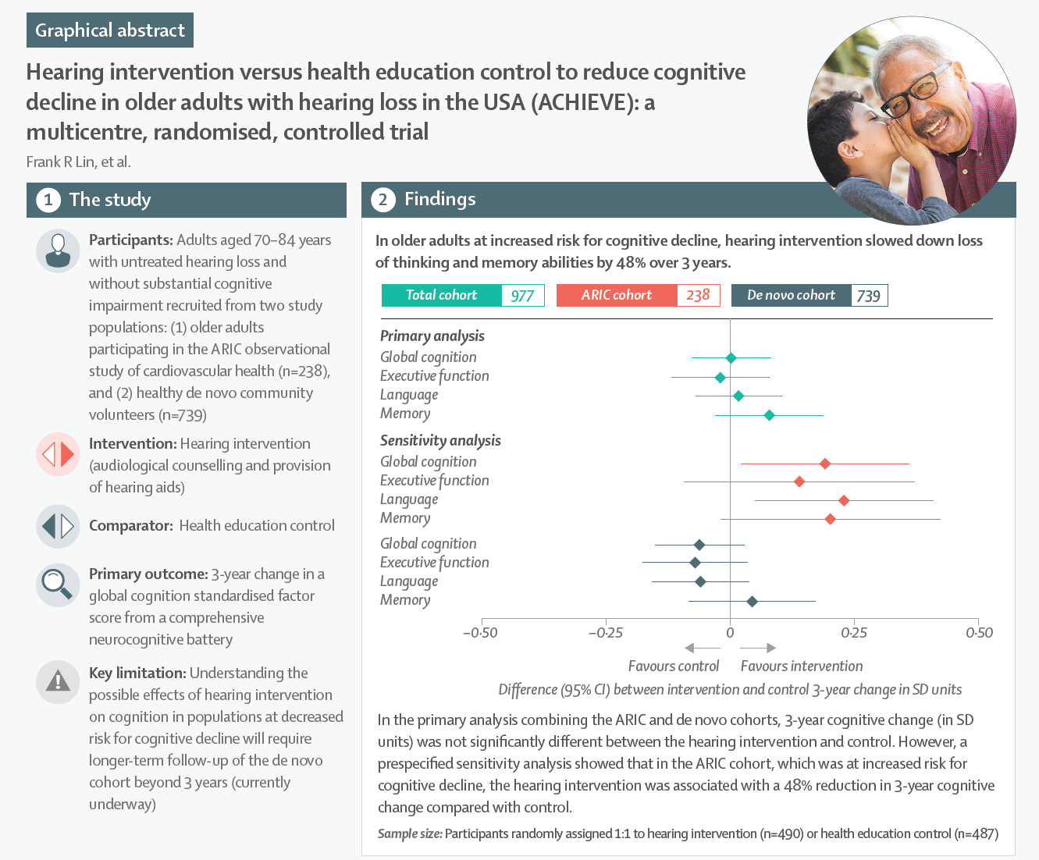

Slide 28
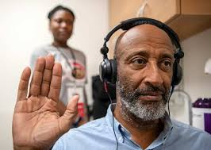
What is the best way to have hearing evaluated?

Slide 29
  How to check your hearing…
→ Audiologist
Hearing aid dispenser / Hearing instrument specialist
ENT
Big box stores like Costco
Hearing Number app --> https://www.hearingnumber.org/

Slide 30
How do we manage
age-related hearing loss?

Slide 31
Sensory Management
+
Aural Rehabilitation

Slide 32
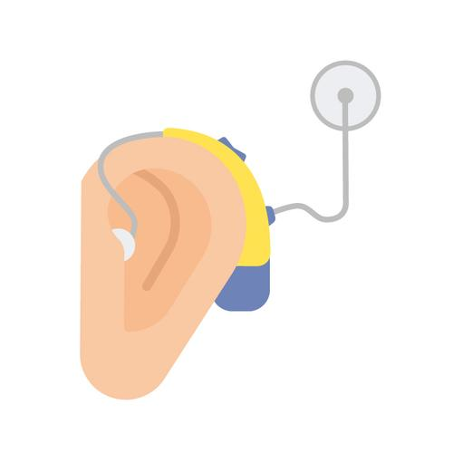
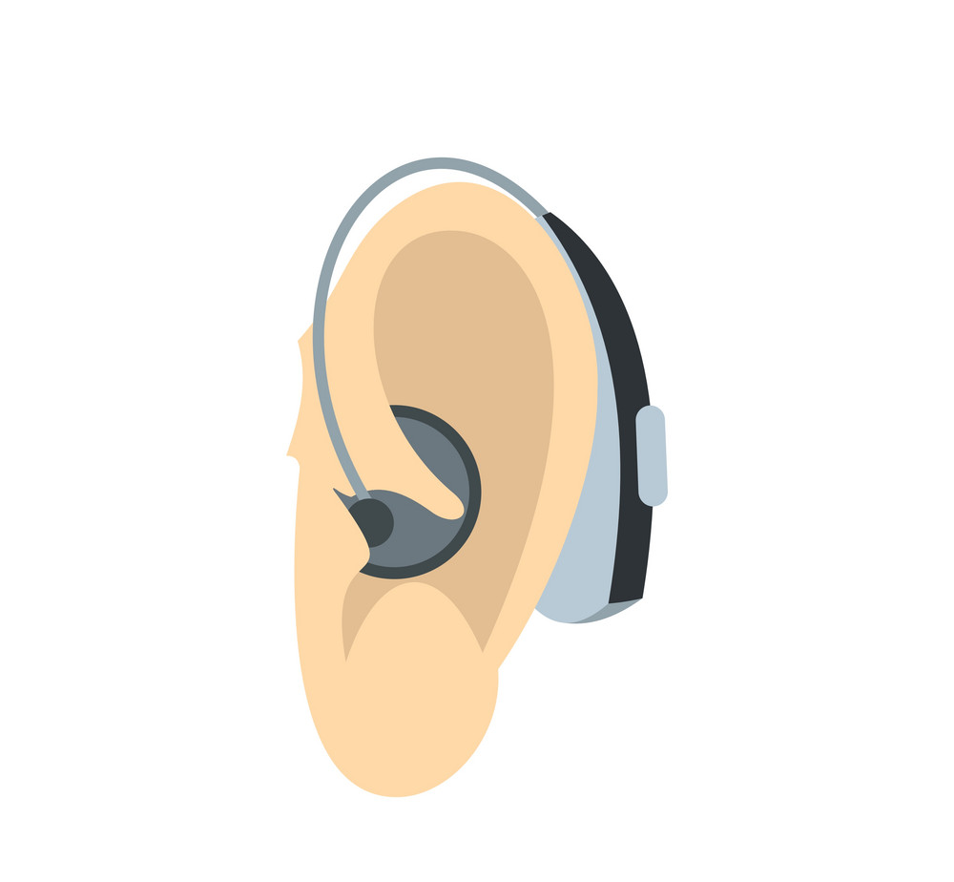
Hearing Aid
Cochlear Implant

Slide 33
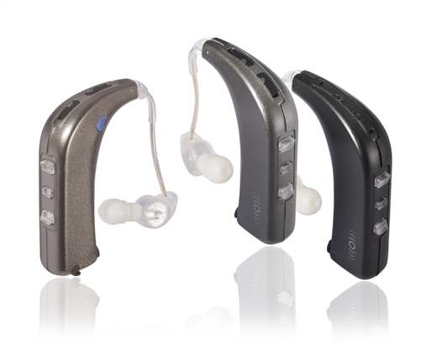
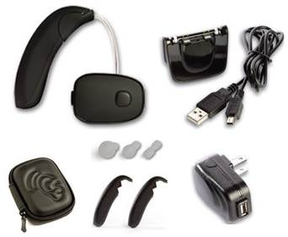
PSAPs
Sound World Solutions
CS-50+
Retail: $350
Sound World Solutions
Sidekick/Companion
Retail: $450

Slide 34
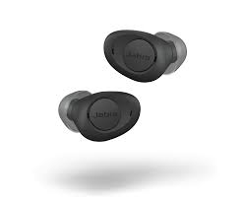
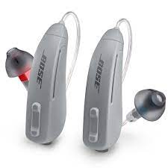
OTC Hearing Aids
Jabra Enhance Plus
Retail: $800
Bose Lexie
Retail: $800

Slide 35
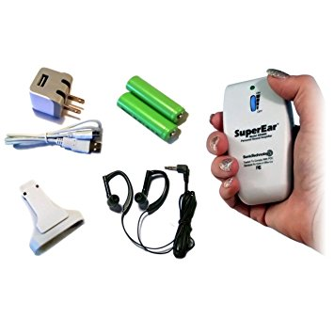
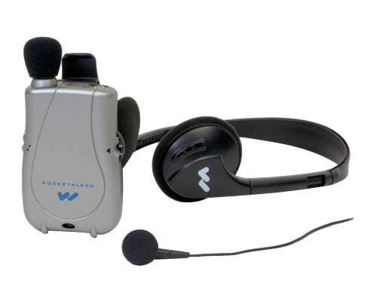
Large & Simple
PockeTalker Ultra Duo
Retail: $155
SuperEar SE9000
Retail: $100

Slide 36


  Resources
  https://www.hearingloss.org/hearing-help/technology/otc-hearing-devices/otc-hearing-aids/
  https://www.hearingtracker.com/

Slide 37

Does hearing loss matter in dementia?

Slide 38

Dementia
Hearing Loss

Slide 39
How common is hearing loss
among persons living with dementia?

Slide 40
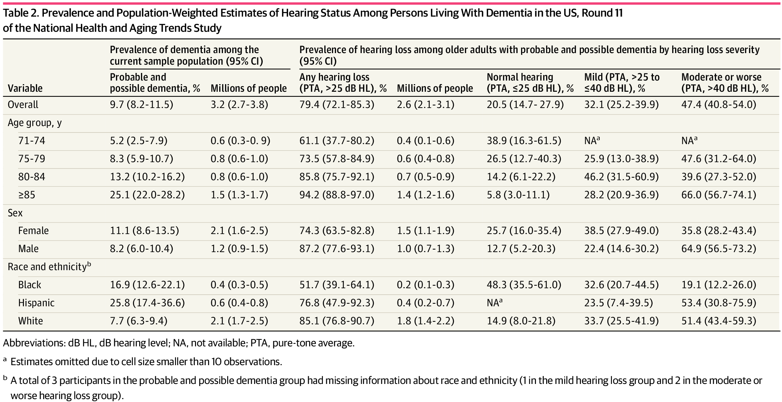
79.4% of older Americans with cognitive impairment have hearing loss
Nieman et al., 2024

Slide 41
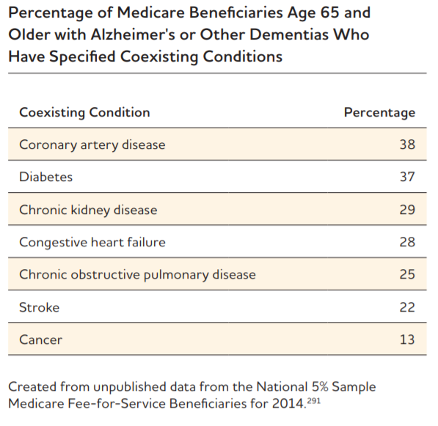

Slide 42
How common is hearing aid use
among persons living with dementia?

Slide 43
21.7% of older Americans with cognitive impairment and hearing loss
use hearing aids
Nieman et al., 2024

Slide 44
Hearing Loss & Healthy Aging
Persons Living with Dementia
Reducing Neuropsychiatric Symptoms
Healthy
Aging
with
Dementia
Avoiding Falls
Strengthening Care Partnerships
Delaying Institutionalization
Maintaining Connectedness
Notes:
Look across domains – healthy

Slide 45
What about OTC
hearing aids for me?

Slide 46
  Warning signs that may require evaluation:
  → History of drainage from the ear
  Ongoing ear pain or discomfort
  Dizziness
  Sudden change in hearing
  Asymmetric hearing loss

Slide 47
  OTC Hearing Aids are designed for…
→ 18 years and older
Symmetric, gradual nerve-related hearing loss
Mild to moderate hearing loss*
→ Trouble understanding conversations with background noise
May have difficulty on the phone
Need to turn up the volume of TV or radio
Feel like others are mumbling
Feel like I can hear but I can’t always understand

Slide 48
  Personal Sound Amplification Products (PSAPs)
  OTC Hearing Aids
  New category as of 10/2022
  Regulated by FDA
  → Safety standards
  Quality standards
  Available for 30+ years
  Previously not regulated

Slide 49
  Personal Sound Amplification Products (PSAPs)
  OTC Hearing Aids
  Registered with the FDA
  https://www.accessdata.fda.gov/scripts/cdrh/cfdocs/cfRL/rl.cfm
  Search “QUF” Product Code
  ~30 currently
  https://www.hearingtracker.com/full-list-of-otc-hearing-aids
  Not registered with the FDA but labeled as OTC

Slide 50
  Personal Sound Amplification Products (PSAPs)
  OTC Hearing Aids
  New category as of 10/2022
  Regulated by FDA
  → Safety standards
  Quality standards
  Self-Fit OTC Hearing Aids
  Available for 30+ years
  Not FDA regulated

Slide 51
  OTC Hearing Aids
  Self-Fit OTC Hearing Aids
  Registered with the FDA
  No specific review process
  Product does not need to exist
  Registered & Reviewed
  510(k) Review Process
  Only some OTC hearing aids
  Self-fit OTC hearing aids
  https://www.accessdata.fda.gov/scripts/cdrh/cfdocs/cfRL/rl.cfm
  Search “QDD” Product Code

Slide 52
  Where to purchase…
→ Online
Pharmacies
Big box stores like Costco
Audiologists & ENTs

Slide 53
  Considerations…
How much do I want to know about my hearing loss?
→ Hearing testing is often covered by insurance
vs hearing aids are often not
How much do I want to navigate this on my own?
If I run into an issue, do I have friends or family who can help?
How comfortable am I with technology like smartphones?

Slide 54
  If you are going to try an OTC hearing aid…
Does the device need a smartphone or computer to set up?
To use? To adjust settings?
Self-fit or preset?
→ Self-fit = Often need to download an app, connect via Bluetooth
What is the trial period? return policy?
Is it rechargeable or uses battery?
Does it have a telecoil and allow you to use a loop system?
Can you use it to talk on the phone or listen to music?

Slide 55
Quick Checklist for OTC Devices
Technical Considerations
Directional microphone
Remote microphone
T-coil
Older Adult Friendly
Size & layout of buttons, verbal prompts
Charging options
Accessible training materials: videos, large-print

Slide 56






RESOURCES
Evidence-Based Programs (EBP)
Virtual Statewide Workshops
Diabetes Flyers and Social Media Ads
Vaccine Partnership
Dementia Series (Recorded webinars here)
FindHelp LWCE
Maryland Access Point (MAP)
  Program Eligibility Requirements for select income-based federal and state programs
CONTACT US

Slide 57
Save the date:
April 17th 12:15 PM
Parkinson’s disease and Dementia
Howard Weiss MD

