Slide 1
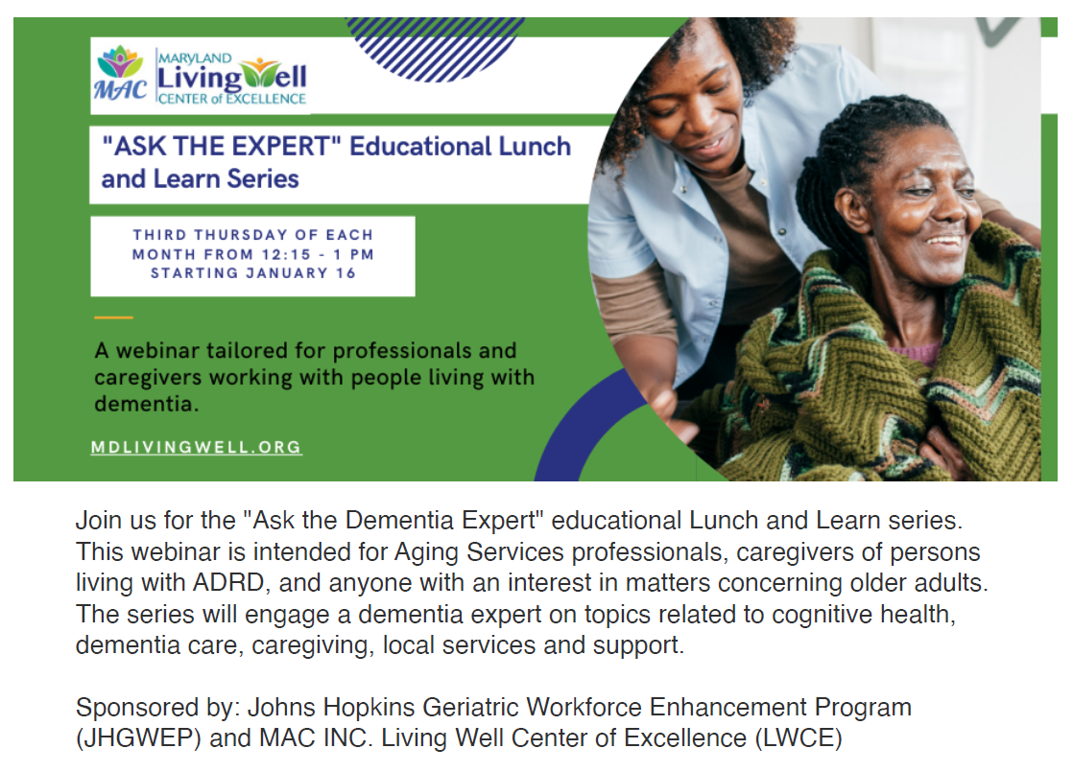
Welcome. Please mute your audio. This webinar will be recorded.

Slide 2
Promoting Brain Health
Ask the Expert
Jessica Colburn M.D.
Associate Professor
Johns Hopkins University School of Medicine
Division of Geriatric Medicine and Gerontology
February 20, 2025

Slide 3
What are considered normal changes in memory as we age?

Slide 4
Memory and Executive Function
Working memory
Brief, to complete tasks in your head
Episodic memory
Recall of past events and/or experiences
Semantic memory
General knowledge, facts, objects
Executive Function
Organization and regulation

Slide 5
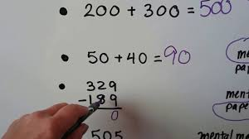
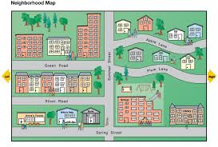
Working Memory

Slide 6
Episodic Memory

Slide 7
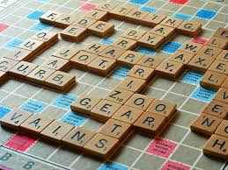
Semantic Memory

Slide 8
What changes do we see with normal aging?
Working memory and processing speed decline with normal aging, beginning in early adulthood
Episodic memory declines with normal aging, more commonly > age 60
Some components of executive function (planning, organizing, multitasking) decline with normal aging

Slide 9
What improves or remains stable with normal aging?
Verbal abilities (vocabulary and word knowledge) are well-preserved
Semantic memory stable or improved
Accumulation of knowledge over a lifetime
Some components of executive function may improve (conflict resolution, emotional regulation)
Increased experience of older adults in problem solving and conflict resolution
Improved focus and inhibition of distraction

Slide 10
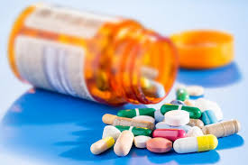
What is not normal aging?
Changes in memory or executive function that impact function and ability to carry out activities of daily living

Slide 11
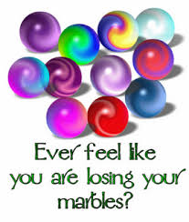
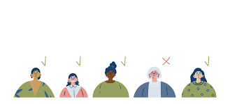
A word about ageism

Slide 12
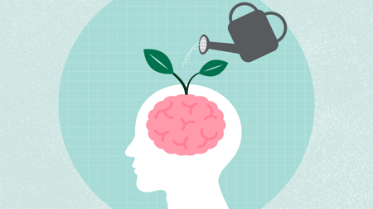
What actions can we take to promote positive brain health? Including: nutrition/dietary habits physical activity social engagement brain games

Slide 13
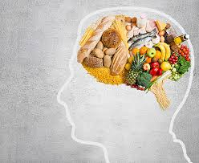
Nutrition

Slide 14
Nutrition and Cognition
Mediterranean diet and Dietary Approaches to Stop Hypertension (DASH) diets have been associated with improvement in cognitive function and decreased risk of dementia
Plant-based – whole grain, nuts, legumes
Healthy fat – olive oil
Lean protein – chicken, fish
Wengreen et al, Am J Clin Nutr 2013
Valls-Pedret et al, JAMA Internal Med 2015
Seago ER, J Acad Nutr Diet 2024

Slide 15
Mediterranean Diet & DASH Diet
Seago ER, J Acad Nutr Diet 2024

Slide 16
Exercise
Notes:
Aerobic exercise
Multicomponent training, which includes a combination of aerobic, strength, balance, and flexibility exercises, has also been found to be effectiv

Slide 17
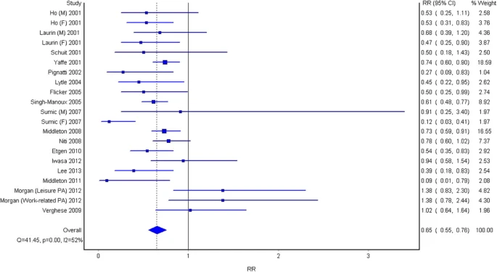
Physical activity
Cognitive decline
Dementia
Observational studies show higher physical activity associated with lower risk of cognitive decline (RR 0.65, 95% CI 0.55-0.76) and dementia (RR 0.86, 95% CI 0.76-0.97)

Slide 18
Physical activity to preserve cognition
No dementia
Aerobic exercise or MCE
Less new dementia at 6 yrs
Mild cognitive impairment
Aerobic or MC 60min x2
Improve global cognition and exec function
Dementia
Aerobic or MC
Improve MOCA ~7 points
Li Z, et al. Arch Gerontol Geriatr. 2024.
Lee AT, et al. J Am Med Dir Assoc. 2015
Yan J. Arch Phys Med Rehabil. 2023
Notes:
NO dementia-self reported exercise at BL, 3 years-group that did more stretching or toning had more incident dementia, median in both groups 45 min/d 7 d/week
MCE all had aerobic + strength or balance or both
this benefit is associated with exercise-induced neurotrophic factors and inflammatory factors that inhibit cognitive function. These neurotrophic factors, such as brain-derived neurotrophic factor (BDNF), can cross the blood-brain barrier and have a protective effect against neurodegenerative diseases (dementia, etc.); insulin-like growth factor 1 (IGF-1) and vascular endothelial growth factor (VEGF) are similarly trophic factors that have a positive effect on cognitive function in the brain. At the same time, exercise inhibits the production of factors that are harmful to the brain or inhibit cognitive function, such as S100 calcium-binding protein B (S100B), the inflammatory cytokine interleukin 6 (IL-6), and C-reactive protein

Slide 19
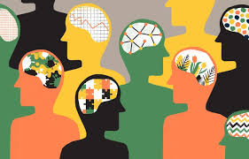
Social Engagement & Connection

Slide 20
Social Engagement
Strong social engagement and frequent social contact are associated with a decreased risk of developing dementia
Support alone did not decrease risk
Loneliness is associated with an increased risk of dementia
Wang S, Molassiotis A, Guo C, Leung ISH, Leung AYM. Association between social integration and risk of dementia: A systematic review and meta-analysis of longitudinal studies. J Am Geriatr Soc. 2023 Feb;71(2):632-645. doi: 10.1111/jgs.18094.

Slide 21
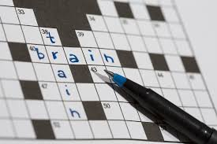
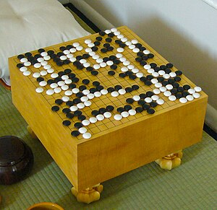
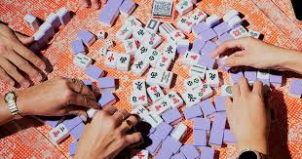
Brain Games

Slide 22
Brain Games
Association between number puzzles and improved grammatical reasoning, episodic memory, and spatial working memory (some of which decline with age)
Soduko
Board games may improve cognitive function as measured with cognitive testing
Mahjong, Go, Chess
Pozzi et al, Journal of Alzheimer's Disease 2023

Slide 23
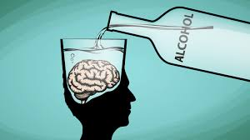
Are there substances we should be aware of that can impact brain health such as smoking, alcohol, cannabis?

Slide 24
Tobacco Use and Cognition
Smoking has been associated with 1.5-2 times the risk of developing dementia
Smoking cessation is an important way to decrease the risk of developing dementia

Slide 25
Alcohol and Cognition
Increased risk of dementia with alcohol intake of an average of 2 drinks/day
Limiting alcohol use has positive health benefits
Women < 1 drink/day
Men < 2 drinks/day
Unclear if moderate alcohol consumption is associated with risk

Slide 26
Cannabis and Cognition
Long term cannabis use is associated with smaller brain volumes and cognitive deficits in mid-life, which is associated with an increased risk of developing dementia in later life
Current cannabis users have a higher rate of cognitive deficits as compared to people who do not use cannabis

Slide 27
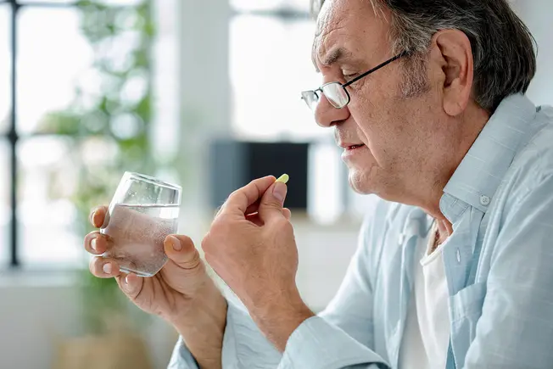
What about supplements for memory we see advertised, do they make a difference in memory?

Slide 28
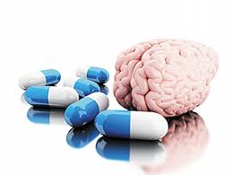
Supplements

Slide 29
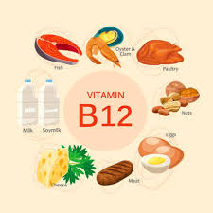
Vitamin B12
Low vitamin B12 levels associated with cognitive decline
B12 supplementation in people with B12 deficiency can improve cognitive impairment
Role of B12 in reducing dementia in general population is not clear

Slide 30
Prevagen
Dietary supplement that contains apoaequorin, a protein found in jellyfish
Studies do not demonstrate benefit
Protein is digested in the GI tract and does not make it to the brain
Side effects have included seizures, strokes, chest pain, tremor, confusion
$1-2 per pill

Slide 31
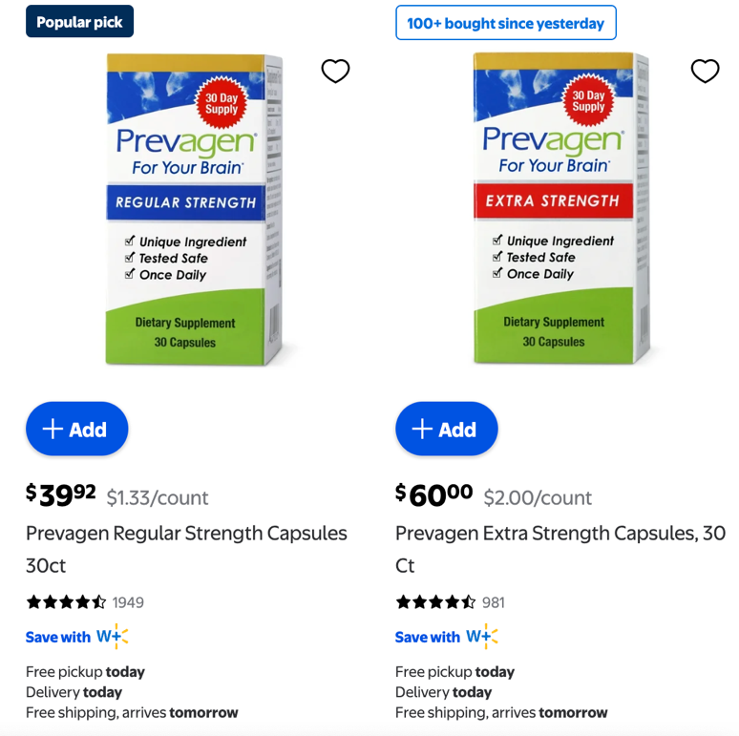
Prevagen

Slide 32
Other Supplements
Carnitine – over 50 trials, no evidence to support benefit in dementia
Coenzyme Q10 – no significant results in dementia
Coffee/caffeine – efficacy not curtained, not well studied
Gingko biloba – 36 trials, inconsistent and unclear evidence

Slide 33
Other supplements (2)
Omega-3 fatty acids – 3 RCTs with no improvement in cognition for patients with dementia
Vitamin B6 – no sufficient improvement in cognition
Vitamin E – does not slow progression of dementia or prevent cognitive decline

Slide 34
Supplements for Memory
Dietary supplements are a multibillion dollar industry
Supplements are not regulated by the FDA
Many studies have not evaluated supplements in their raw form (lack of consistency)
There is no significant evidence that currently available supplements improve memory and cognitive function

Slide 35
Take Home Points on Brain Health
Working and episodic memory decline with age, though semantic memory is stable/may improve
Conflict resolution and problem solving improve with normal aging
Mediterranean and DASH diets are best for brain (and heart) health
Exercise is great (cardio/resistance)
Social engagement and frequent social contact are protective
Tobacco, alcohol and cannabis all may increase risk
Supplements are expensive and unlikely to help

Slide 36
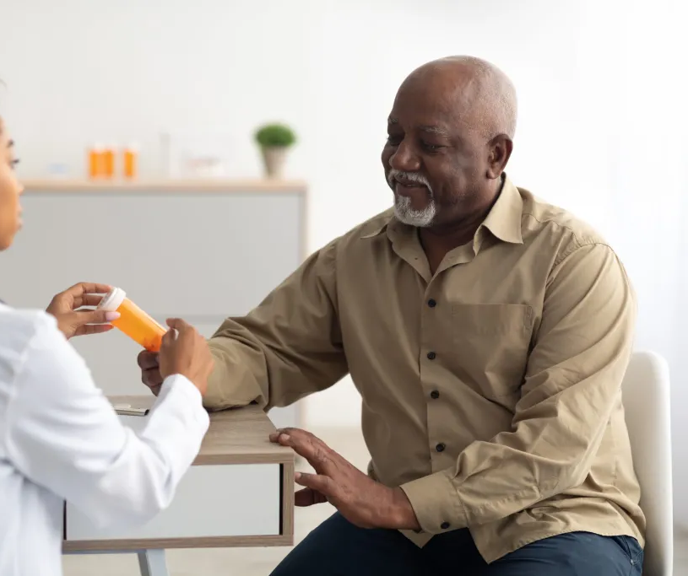
RESOURCES
Evidence-Based Programs (EBP)
Virtual Statewide Workshops
Diabetes Flyers and Social Media Ads
Vaccine Partnership
Dementia Series (Recorded webinars here)
FindHelp LWCE
Maryland Access Point (MAP)
Program Eligibility Requirements for select income-based federal and state programs
CONTACT US

Slide 37
Save the date: March 20th 12:15 PM The Impact of Hearing Loss on Cognition
Carrie L. Nieman, MD, MPH Associate Professor, Department of Otolaryngology-Head and Neck Surgery at the Johns Hopkins University School of Medicine and co-founder of Access HEARS

