Slide 1
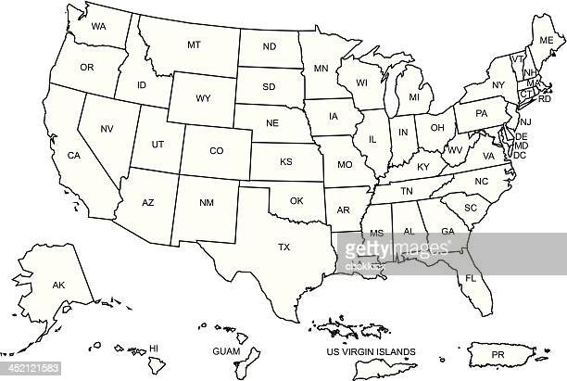
Johns Hopkins Geriatrics Workforce Enhancement Program
48 GWEPS
Integrating Geriatrics into Primary Care
Partner with Community organizations
Educate families and caregivers

Slide 2
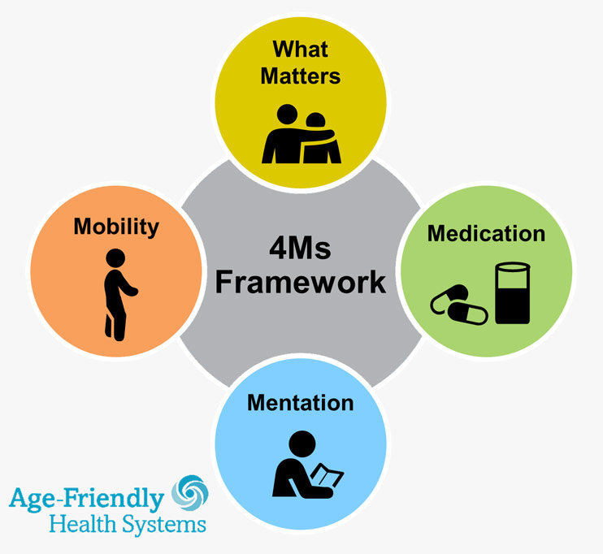
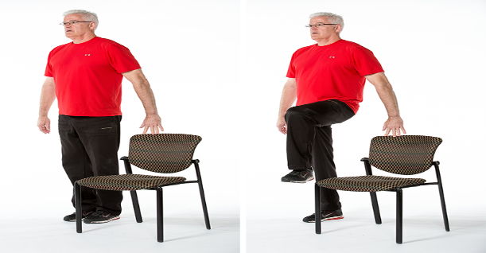
Building Better Balance

