Slide 1


Maryland's Dementia Capable
Community Connections Grant
Presentation and Dementia Live® Demonstration
for the Maryland Living Well Center of Excellence Academy
November 4th, 2021

Slide 2

Overview
3-year grant from Administration for Community Living (2019 – 2022)
Project goal: Create and sustain a dementia-capable home and community-based system (HCBS) that provides relevant and easy access for people with ADRD and their caregivers by providing a set of high quality and well-coordinated services and programs.
Partners (Core Work Group):
  Alzheimer’s Association of Greater Maryland (and Capital Area)
  Geriatrics & Gerontology Education and Research Program (GGEAR), University of Maryland
  Johns Hopkins Geriatric Workforce Enhancement Program (GWEP)
  Maryland Living Well Center of Excellence
  Mental Health Association of Maryland
  Independent Evaluator: Schaefer Center for Public Policy, University of Baltimore

Slide 3
Grant Activities
Strengthen delivery of caregiver workshops in partnership with the Living Well Center of Excellence (LWCE)
Train AAA staff in dementia capability (screening, detection, referrals, and communication for people with Alzheimer’s and related dementia and their caregivers)
Enhance MAP website to better highlight caregivers and persons with Alzheimer’s and related dementia and connect to existing online resources
Convene stakeholders

Slide 4
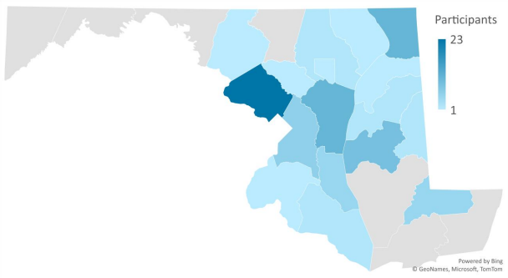
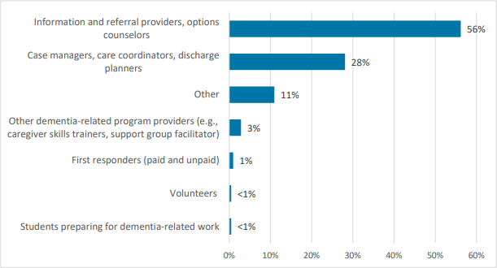
Progress to date
113 individuals served in virtual workshops since launch of grant in FY20
149 professionals received Dementia capability training

Slide 5

Maryland Access Point Website
AD: 8 Washington University Dementia Screening Test
The AD8 was developed as a brief instrument to help discriminate between signs of normal aging and mild dementia.
The AD8 contains 8 items that test for memory, orientation, judgment, and function.
Can be used by an individual or their loved one prior to scheduling a full assessment with a primary care provider or healthcare practitioner.
https://marylandaccesspoint.211md.org/explore-my-options/alzheimers-disease-related-dementia/assessment/?_ga=2.26009144.480712642.1635867381-884580820.1628014137
Reprinted with permission. Copyright 2005. The AD8: The Washington University Dementia Screening Test (“Eight-item Interview to Differentiate Aging and Dementia”) is a copyrighted instrument of Washington University, St. Louis, Missouri. All Rights Reserved.

Slide 6

The AD-8 Screening Tool
8 Screening Tool Questions
  Problems with judgment (e.g., problems making decisions, bad financial decisions, problems with thinking)
  Less interest in hobbies/activities
  Repeats the same things over and over (questions, stories, or statements)
  Trouble learning how to use a tool, appliance, or gadget (e.g., VCR, computer, microwave, remote control)
  Forgets correct month or year
  Trouble handling complicated financial affairs (e.g., balancing checkbook, income taxes, paying bills)
  Trouble remembering appointments
  Daily problems with thinking and/or memory

Slide 7

Personalized Results
Answer 2 or more questions with “Yes” response…
  “You answered yes to 2 or more of the questions in this screening, which may indicate a potential impairment in thinking and/or memory. Reach out to your physician to schedule a formal assessment.”
Answer fewer than 2 questions with “Yes” response…
  “Your results indicate normal cognition.”
Learn more and connect to resources from the Alzheimer’s Association:
    Know the 10 early signs and symptoms
    Call the 24/7 helpline at 800-272-3900
    Connect to a support group

Slide 8
For Professionals
https://marylandaccesspoint.211md.org/explore-my-options/alzheimers-disease-related-dementia/

Slide 9


Dementia Live® Experience - a high impact, dementia simulation experience that immerses participants into life with dementia, resulting in a deeper understanding of what it is like to live with cognitive impairment and sensory change.
APD-21-14-Grant Application for Dementia Live® Training and Startup – Released August 24, 2021
Funding for Area Agencies on Aging and any other non-profit, in good SDAT standing, with an interest in educating the community on Dementia and/or Alzheimer's Disease and Related Disorders (ADRD)
To provide sub-grant funds to implement locally the Dementia Live® Experience
Let’s take a deeper look at the program…..

Slide 10
The Virtual Experience DEMO
Presented by Amanda Distefano, Long Term Services Administrator, Maryland Department of Aging
Notes:
Welcome to Dementia Live - The Virtual Experience!

Slide 11
Elevating Care, Compassion and Empathy
Notes:
In order to elevate the quality of care, compassion and empathy that care partners provide for others, we must first gain a deeper understanding of the challenges that one faces who is living with dementia.

Slide 12
By Stepping into Their World
You will gain a unique inside-out perspective of life with dementia
Real-life DementiaLive® Experience
Notes:
Dementia Live - The Virtual Experience will still allow you to gain a unique inside-out perspective of life with dementia and will enlighten you with new tools to respond to the needs of those living with cognitive challenges.

Slide 13
Welcome to DementiaLive®️ - The Virtual Experience!
What you will need:
Sunglasses
Pair of gloves
Glass of water, tea, coffee or other beverage
Wallet or purse (with wallet inside)
Pad of paper, pen and paperclips
Sticky notes
Cell phone
Magazine
Notes:
When you send out invitations for Dementia Live - the Virtual Experience, please ask participants to have these items with them. If you would like to substitute other items, that's fine, however we know these work well and easy items for people to have on hand.
You might give them a minute or so to gather these while in your session.

Slide 14

Are you Ready? Follow along with me…
Notes:
Okay, I'll walk you through your script during this 3 -minute bite-size session. You definitely want to practice this so you know get the timing down pat with the sounds. Have your volume set so that it is normal and tell your audience that they need to set their volume normal and not too soft or it will take away from their experience! The sound is embedded in the Powerpoint and just click on it to start, and the beeps will come up. Here's the script:
Okay, is everyone ready? You are going to hear a series of beeps as we get started and you can adjust your volume so it is normal. Make sure it's not to low as you will miss this incredible experience!
Go ahead and put those sunglasses on and gloves and following along with me as I ask you to do some tasks.
(when confusion sound starts, you are ready to go. You are going to keep giving tasks without time for them to actually complete each task)
Let's start by digging into your wallet and finding your Driver's License. Once you've found that, write down your number and the expiration date on the pad of paper.
Next, let's pull out our favorite friend, the cell phone. Would you send a short text to a loved one and tell them what you are doing now?
You have a magazine or book in front of you, so turn to page 13 and read out loud the headline, first line of text or it might be an advertisement, just go ahead and read that out loud.
Now I hope everyone has taken care of what I asked you to do with your license. And surely you've sent that text.
OOOOHHHHH, let's take a quick break and grab that water or tea and take a sip, because we aren't finished.
Let's find those sticky notes. Please write one task on each of two notes of things you must get done before the end of the day. When you are finished just stick those up on your computer so you have a reminder.
Next let's go back to our phone and find the calculator. Can you Add 21 + 36 and then subtract 12. You know if you need to do this on your pad of paper, that's perfectly fine, just go ahead and work those numbers so you come up with the accurate answer.
With your paperclip, please grab that magazine or book and clip 5 pages together and then you can set that aside.
Get you pad of paper out, and write two words that describes how you are feeling right now.
Oh my gosh, what was that noise?
You can put your license back in your wallet. When you do that check to see if you have any bills or coins. If you do, could you get those out and just place them in front of you.
Maybe pull out your care keys.
Tidy up your desk now because we are finished!!!

Slide 15
Notes:
Wow, how are you feeling? Take a look at this list, and why don't you chat in your answers.
Most of you are feeling a bit frustrated and anxious right now, aren't you?
Can you see how someone living with dementia can feel these things as they go about their daily life? Because we just experienced a taste of their world for 3 minutes. They live with this 24/7. So does this give you a new perspective on why they might get angry, scared, embarrassed, overwhelmed?
Has this helped you to gain a different perspective? By allowing us to step into their world, we develop a deeper understanding of life with dementia, and will help us to be a more empathic caregiver.

Slide 16
How does it look LIVE & IN PERSON?
https://vimeo.com/250127784/53277dd8c3

Slide 17
The Empowerment Session
10 minutes or more
Quiet area/room
Share thoughts & feelings
Discuss tips to improve the caregiving experience
Vital to transformation in care
Shared learning experience

Slide 18

Increases Empathy
Improves Communication and Understanding
Helps Caregivers better understand & learn how to prevent caregiver burnout
Notes:
I've provided four empowerment tools examples for this session. These are focused on the needs of families: Communications, Caregiver Burnout, Family Communications and Caregiver Guilt. You may choose to use any of the Empowerment Tools in your Coach resources. I do not suggest using any more than 3 if you are planning a one-hour session, because you will be encouraging interaction, especially if you are doing this with small groups.
Please refer to the live Coach Webinar for my presentation on the following tools.
Again, we encourage you to practice, using the Empowerment Tools provided, use examples and encourage participants to share during this time, much like you would in a live Empowerment Session. You may take each tool and bullet your main points. Also, have a handout of the Empowerment Tool you are using for the participants to download after the session.

Slide 19
Empowerment Tools accessible for Dementia Live®️ Coaches to guide discussion:
Better Communication and Understanding
Improving Care Processes
Creating a Dementia-Friendly Environment
Understanding Caregiver Burnout
Understanding Visual Deficits: Color and Contrast
How Noise Affects Persons with Dementia
Engaging Activities and Life Enrichment
Enhanced Nutrition and Dining
Understanding Behaviors
Understanding Caregiver Guilt
Caring for the Caregiver
Improving Family Communications
Successful Family Visits
AND MORE!

Slide 20

Interested in offering Dementia Live®
Funding available for:
  Training (minimum of 2 staff per site)
  Required Gear Pack
  Workshop Reimbursement
Contact:
AmandaK.Distefano@Maryland.gov
410-767-1074
www.AGEucate.com 817.857.1157
Notes:
Training Cost $695 per person for the first and an additional $295 per person for each additional person trained at organization
Gear Pack includes Dementia Live eyewear, 4 sets MP3 Headphones pre loaded with distraction audio, charger for headphones, gloves, 20 task materials and starter pack consumables (tic tacs, wipes for cleaning), training manual. $335 per pack on pack must be purchase per site.
Events held (must reach at least 8 per event – reimburse for costs associated at rate of $275 commit to two events by June 30th, 2022.

Slide 21
Questions?
Thank you for joining us.
Cameron Pollock, MPH
Food and Wellness Coordinator
Nutrition and Health Promotion Programs
cameron.pollock1@maryland.gov
(215) 337-1762 (Cell)
(410) 767-1269 (Direct)
(410) 767-1100 (Main)
Amanda Distefano, CRS-AD, CHWI
Maryland Access Point
Administrator, Long Term Services
AmandaK.Distefano@maryland.gov
(410)-767-1074 (Direct)
(410)-767-1100 (Main)
(240)-347-3310 (Cell)

