Slide 1










MAC Inc. Living Well
Center of Excellence
CHRONIC DISEASE
SELF-MANAGEMENT
EDUCATION PROGRAMS
Notes:
The Living Well Center of Excellence was a designation given to MAC, Inc. by the Maryland Department of Aging when the Stanford license and database ownership was transferred to us.
Currently, the evidence-based programs included are: Stanford Chronic Disease, Chronic Pain, Cancer Thriving and Surviving, Diabetes, Spanish Diabetes, and the Chronic Disease Self-Management Home toolkit. Also included are Living Healthy with Hypertension, DPP, Enhance Fitness, PEARLS – depression screening program, and Matter of Balance, Stepping On, and Otago for falls prevention.
The Living Well Program is an evidence based self-management program designed to educate people with chronic conditions. Designed to improve their quality of life, reduces health complications, and their need for emergency care.

Slide 2
Maryland Living Well Statewide
Demographics and Satisfaction Survey Results CDSME
September 1st, 2015-August 1st, 2017
Grant Goal 3,000 COMPLETERS BY AUGUST 31, 2017
TO DATE MARYLAND HAS REACHED 2,645 COMPLETERS
88% OF GOAL TO DATE
Special thanks to Maryland’s Area Agencies on Aging, County Health Departments, Hospital Partners, Other Community-Based Partners and to the U.S. Administration on Aging

Slide 3
MARYLAND LIVING WELL PARTNERS - AAAS, HEALTH DEPARTMENTS, HOSPITALS – YOU MADE IT HAPPEN!
Maryland Department of Aging Living Well Chronic Disease 03/01/2010 – 08/31/2015
6,734 participants 73.2% completer rate
LIVING WELL CENTER OF EXCELLENCE CDSME 09/01/2015 - 08/01/2016
3,436 participants 77% completer rate
62% have multiple chronic conditions
Hypertension 50%, Diabetes 42%, Arthritis 31%
55% are age 65 or older
44% are African American
4% Hispanic/Latino
4% Asian
23 Counties reporting 314 workshops
61% Medicare
14% Medicaid

Slide 4
Maryland Participants
Chronic Conditions

Slide 6
Percent of Workshop Completers by County
Maryland = 77%/National Average 68%

Slide 7
Maryland Participant Demographics

Slide 8
Participants Completing 4 or More Sessions

Slide 9
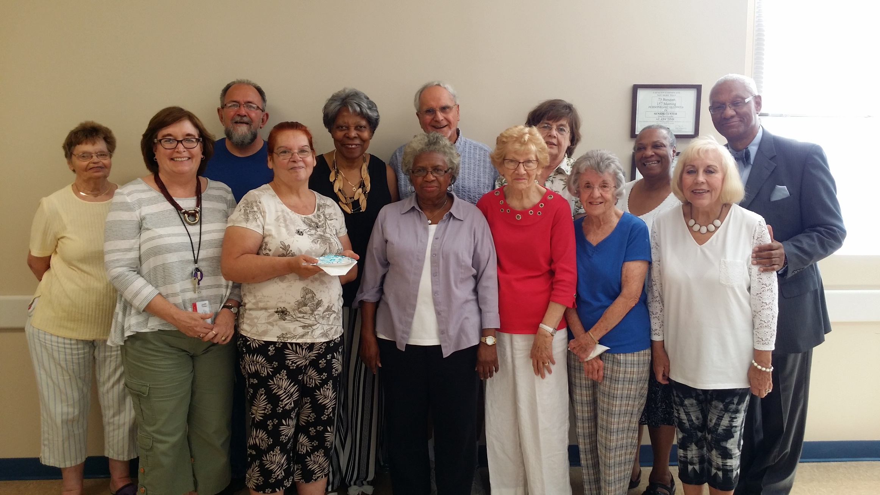
Leader Training Baltimore County, 2017

Slide 10
Total Number of Chronic Conditions

Slide 11
Participant Education Levels

Slide 12
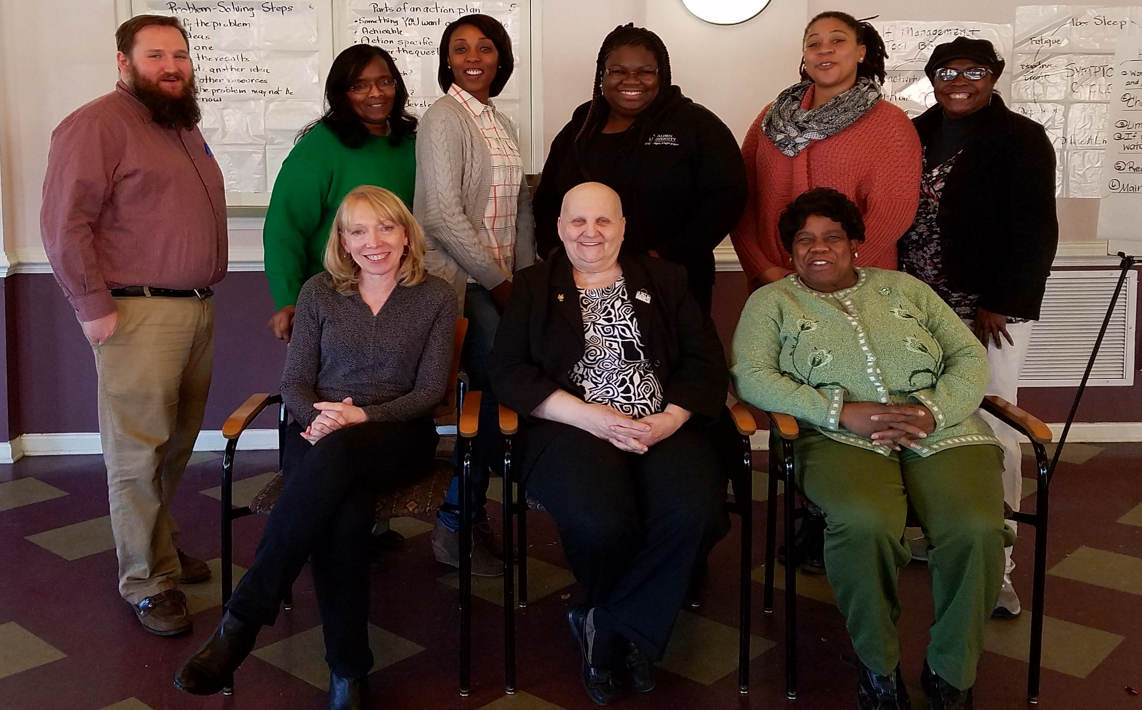
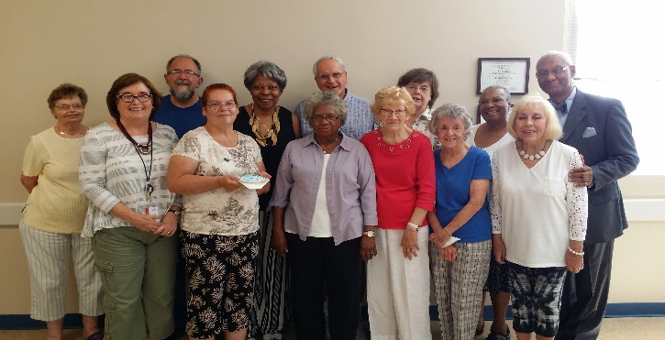
Leader Training Baltimore City 2017

Slide 13
Maryland Participants – Types of Insurance

Slide 14
Participants’ Self-Management Skills

Slide 15
Leader Quality Assurance Measures

Slide 16
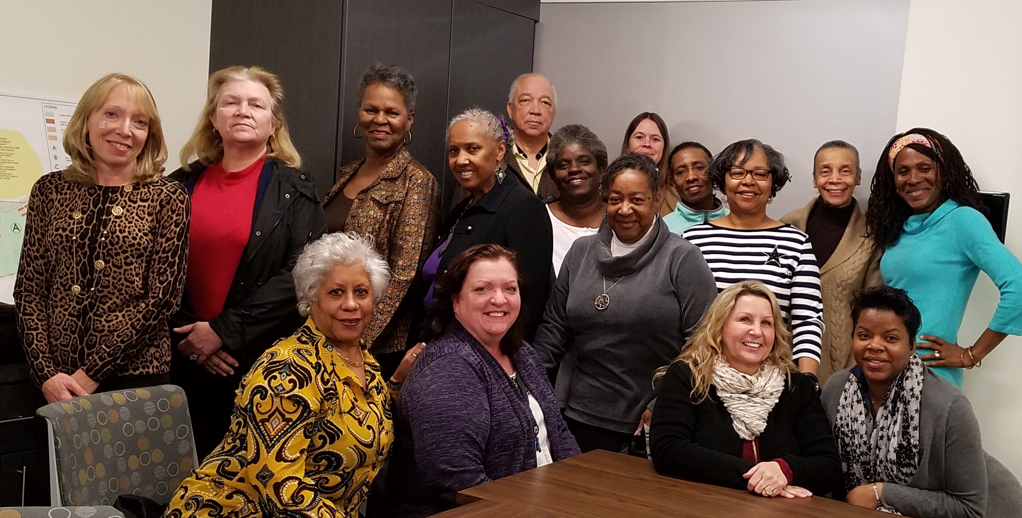
Leader Training Brandywine Maryland

Slide 17
Maryland Living Well Statewide
Demographics and Satisfaction Survey Results Stepping On
August 1 2016 –July 31, 2017
GOAL IS 2,000 BY July 31,2018
MARYLAND HAS REACHED 532 PARTICIPANTS
27% of GOAL
Special thanks to Maryland’s Area Agencies on Aging, County Health Departments, Hospital Partners, Other Community-Based Partners and to the U.S. Administration on Aging

Slide 18
Maryland Living Well Center of Excellence
Living Well Stepping On
08/01/2016 - 07/31/2017
48% have multiple chronic conditions
Arthritis 50%, Diabetes 24%, Heart Disease 21%
82% are age 65 or older
27% are African American (National 8%)
2% Hispanic/Latino

Slide 19
Stepping On Participants by County

Slide 20
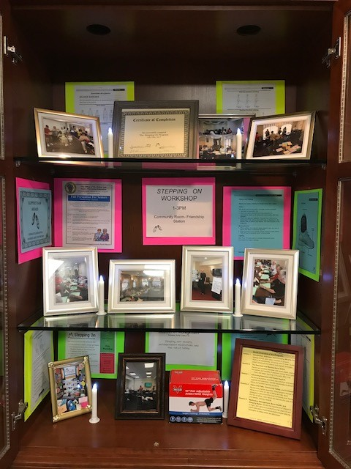
Anne Arundel
Stepping On
Window Display

Slide 21
Stepping On Participants Chronic Conditions
Lung Disease
12%

Slide 22
Participant Improvement in Managing Falls
238 PARTICIPANTS | PRE |  |  |  | POST
 | Very Sure | Sure | Somewhat sure | Not at all sure | Very Sure | Sure | Somewhat sure | Not at all sure
I can find a way to get up if I fall | 25% | 29% | 33% | 13% | 40% | 41% | 15% | 5%
I can find a way to reduce falls | 20% | 39% | 36% | 6% | 43% | 46% | 11% | 1%
I’m sure I can protect myself if I fall | 12% | 23% | 44% | 20% | 25% | 43% | 29% | 3%
I’m confident I can increase my strength | 27% | 39% | 26% | 8% | 53% | 35% | 9% | 2%
I’m confident I can be more steady on my feet | 24% | 39% | 31% | 6% | 42% | 42% | 14% | 2%

Slide 23
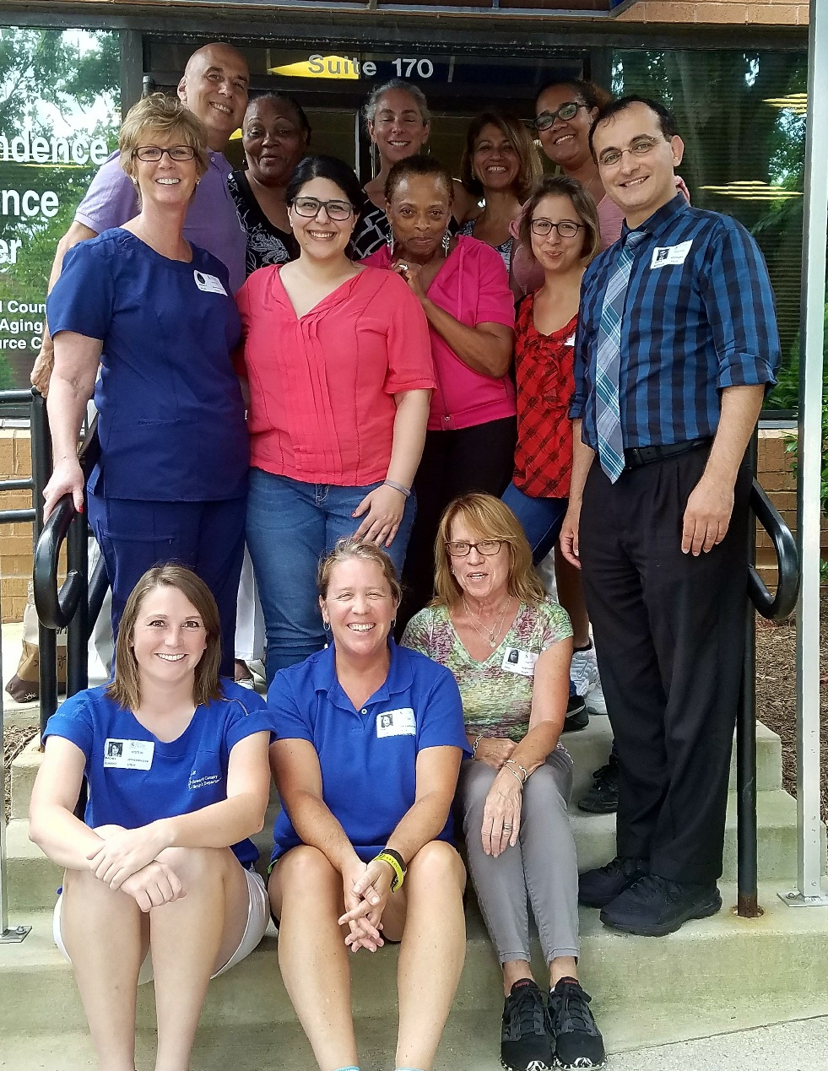
Statewide Stepping On Leader Training July 2017
Anne Arundel County
Baltimore City
Baltimore County
Howard County
Montgomery County
Prince Georges

